Slide 1
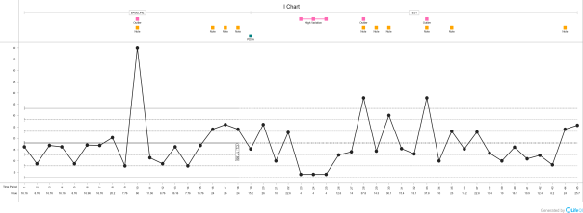
Pandemic innovation: a home-visiting service for laryngectomees Rhiannon Haag (NELFT NHS Foundation Trust) Michelle Coleman (NELFT NHS Foundation Trust)
The NELFT Speech and Language Therapy (SLT) department historically provided a laryngectomy service at a local acute hospital. Routine clinics ran fortnightly with ad hoc emergency appointments when required.
In March 2020, the outpatients department was closed and our clinic room was declared unsuitable for aerosol generating procedures (AGPs). Waiting times rose to a high of 83 days. An alternative, innovative model of community-based provision was introduced to reduce waiting times, limit covid exposure, and re-establish local care, whilst maintaining patient safety.
Travel distance to appointment
Introduction
Graph
The primary aim of reducing waiting times for valve changes from 83 days to <14 days was exceeded and patient satisfaction is high. Our balance measure of distance travelled showed some unexpected data. Our graph shows that since moving to a domiciliary service, there was a small overall reduction in the number of miles per appointment.
Since two clinicians are required per appointment, this includes travel for two vehicles to adhere to covid-19 infection control policies. In the future, clinicians will be able to car share, resulting in this distance being halved.
As such, the project not only led to improved service provision and patient satisfaction, it will also lead to a reduction in emissions and traffic.
Results
To reduce waiting times to valve change to <14 days during the pandemic.
To ensure safety by monitoring adverse events and responding accordingly.
To obtain service user feedback.
To monitor ‘balance measures’ for any additional consequences of the service change.
Aims
The Model for Improvement was used.
A driver diagram guided development of change ideas. PDSA cycles were implemented to introduce and monitor change ideas.
Multiple measures were used - SPC charts, including waiting times, distance travelled, adverse events, and service user ratings (efficacy, comfort, safety, quality).
Additional qualitative data from service users was also gathered.
The redesign of our service, away from a centralised, hospital-based model, to a domiciliary service, has had benefits over and above the anticipated improvements in access to services and patient satisfaction.
The change has had a significant impact on the travel miles required for the service, with a reduction in both emissions and local traffic. If this model were adopted for other, hospital-based services, there could be significant benefits for the environment.
Methodology
Conclusion/Future implication
References
Tordesillas, S (2020) Laryngectomy SLT Management in the Community. Guys and St Thomas’ NHS Foundation Trust and Lewisham and Greenwich NHS Trust (personal communication).
RCSLT (2009) ‘Prosthetic Surgical Voice Restoration (SVR): The role of the speech and language therapist. Policy Statement.

