Slide 1

Sustainable Healthcare Made Simple
Maria Cooke, QIF for Sustainability
Health Education East of England
Slide header 1
Sub header 2 to go here
NNUH
23rd January 2014

Slide 2
Acknowledgements
From a slide set developed by:
James Smith, Emma Waters & Helena Jopling, Public Health Trainees East of England
NHS data from the NHS Sustainable Development Unit www.sdu.nhs.uk

Slide 3
Objectives
Definition
Social, Environmental, Economic Responsibility
Why it is important for NHS organisations
Good Corporate Citizenship
New models of care
What you can do

Slide 4
What is Sustainable Development?

Slide 5
What is Sustainable Development?
Social
Economic
Environmental
“The goal of sustainable development is to meet the needs of today without compromising the ability of others, elsewhere and in the future, to meet their needs”
Notes:
In healthcare we are blinkered to the immediate and acute, we are not good at seeing the bigger picture, the worldwide picture, the picture of the future
We should live within our limits (Europeans use 3 planets, North Americans use 5 planets)
We should take only what we need and no more
We should leave enough resources so that future generations can have a similar standard of living
We should not do things DETRIMENTAL to the health of others
We should INVEST in & use WISELY our RESOURCES – PEOPLE & the ENVIRONMENT

Slide 6
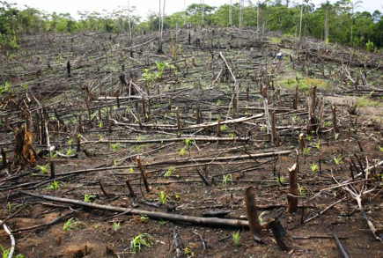
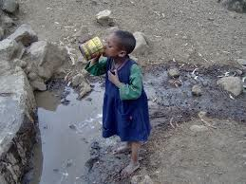


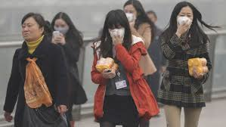
Environmental Responsibility
Notes:
Human activity (acts of countries, organisations, individuals) is having many negative impacts on the environment
None of the effects exists in isolation, the planet is a system.
In this country we have come a long way In improving the visible state of the environment but……

Slide 7
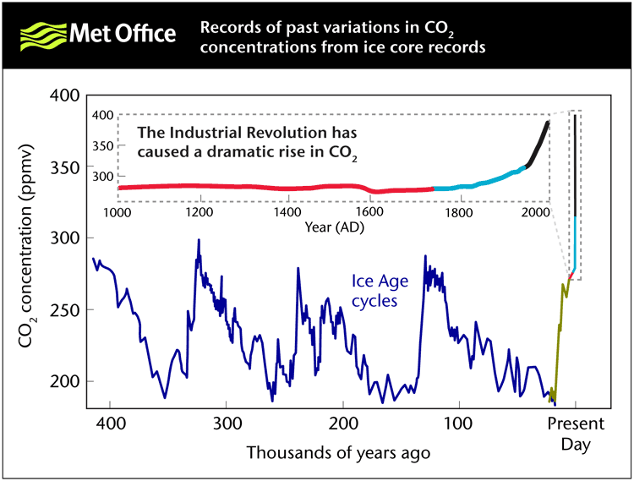
Notes:
We are releasing carbon at a phenomenal rate. The rise started with industrialisation and has escalated massively in the last 50 years.
Notes for the presenter:
You will need to explain the basic science of climate change, in 3 or 4 simple steps. The Met Office does this well – see: ‘Explaining the evidence of climate change’ where this image was taken from, at: http://www.metoffice.gov.uk/climatechange/science/controversy/facts.html (Last accessed: 5 July, 2010).
This slide shows that: ‘CO₂ concentrations in the atmosphere are rising. They have increased by about 38% since industrialisation began, from 280 ppm (parts per million) to 387 ppm. Two-thirds of that increase has occurred in the last 50 years. CO₂ levels are now 30% higher than at any time over at least the last 800,000 years.’

Slide 8
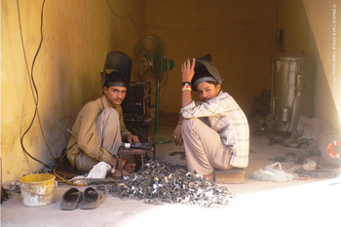
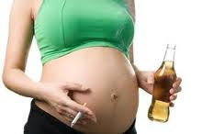
Social Responsibility
Notes:
Equity within our local population
Also a social conscience
Teenagers welding laryngoscopes in Sialkot, Pakistan
50,000 manual labourers work 12 hrs/day, 7/7, $2/day
5,800 children, some as young as 7 years
We have HUGE buying power – we could make a difference to peoples lives.
Sustainability information on products (like dietary information on food) How much carbon did it cost, is it Fair Trade?
We look for quality and we look at price – Perhaps we should be asking MORE Questions, Demanding more

Slide 9
What is Sustainable Development?
Put Simply…….
To be socially and environmentally responsible within financial constraints
  Now and in the future
  From Individual and Local to Worldwide scale
Social
Economic
Environmental

Slide 10
Why is it important for NHS organisations?

Slide 11
Why is it important for NHS organisations?
Government policy
Public opinion
NHS is affecting the environment
Our environment affects our health
Notes:
We are a National HEALTH service
Our activity should NOT have a negative impact on HEALTH
We are releasing as much CO2 as a small country!

Slide 12
Government Policy

Slide 13
Government Policy
Climate Change Act 2008
  Reduce CO2 by 80% of 1990 levels by 2050
Notes:
This is a PUSH factor

Slide 14
Notes:
We are on course to meet the 2015 target, but fall short of the 2020 target.
This is because we have done all the easy things in terms of transport and energy and need to look beyond…..

Slide 15
The following organisations have expressed their support for a more sustainable, resilient and healthy NHS, public health and social care system:
Allied Health Professions Federation
Association of Directors of Adult Social Services
Association of Directors of Public Health
Association of London Councils
Academy of Medical Royal Colleges
British Medical Association
Care Providers Alliance
Chartered Institute of Environmental Health
Care Quality Commission
Health Education England
Health Watch England
Health & Social Care Information Centre
Local Government Association
NHS England
National Institute for Health and Care Excellence
NHS Property Services
NHS Trust Development Authority
Public Health England
Royal College of Nursing
Royal College of Midwives
Royal Pharmaceutical Society
Society of Local Authority Chief Executives
Social Partnership Forum
Trade Union Congress
NHS Confederation
Department of Health
Department of Energy & Climate Change
Department for Environment, Food and Rural Affairs
Notes:
More PUSH Factors
Healthcare organisations are responding to the challenge
These are organisations that are a big part of our working lives
Expect to see changes coming!!!!:
NICE could putthe carbon cost of treatments into guidelines
CQC could be asking about sustainability as part of a measure of a quality service
It could become part of our curriculum and examinations…..

Slide 16
A National Sustainable Health and Social Care Policy
A national Sustainable Health and Social Care policy developed by the NHS Sustainable Development Unit will be launched on January 29th
Notes:
This is the most recent development

Slide 17
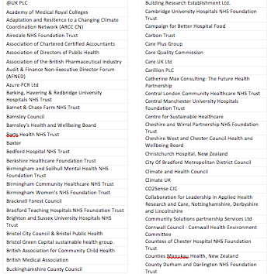
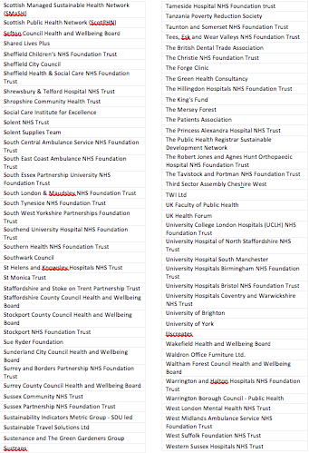
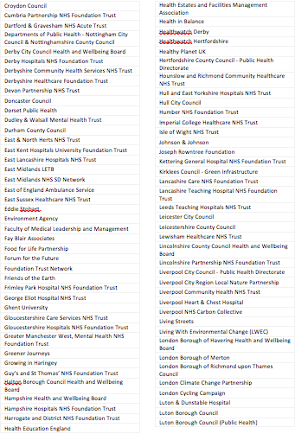
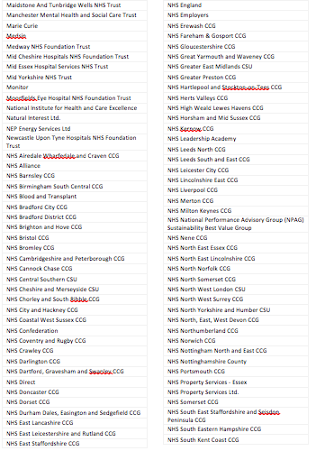
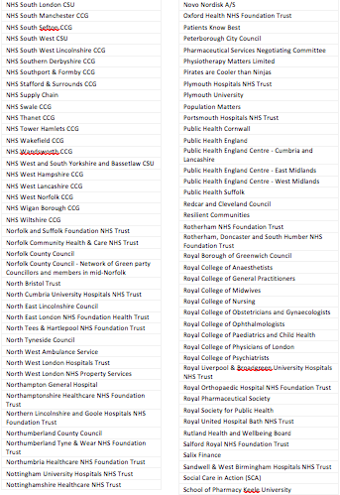

The following organisations, groups and networks were part of the consultation and engagement process which informed the development of the national strategy:
Notes:
This is expected to be the thing that really increases the PACE of change

Slide 18
Public Opinion

Slide 19
2 Surveys
The Health and Social Care sector should place higher importance on working sustainably
  Ipsos Mori Public Opinion Poll 89%
  Survey of Healthcare Students and Trainees 2013 84%
Notes:
Successful organisations LISTEN to their Staff & Customers
Improves reputation
Group who are ripe to be engaged
These are PULL factors

Slide 20
Health and the Environment

Slide 21
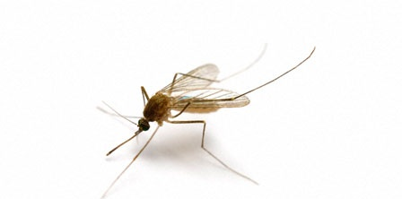

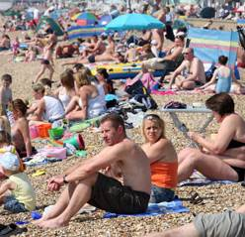
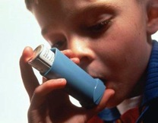
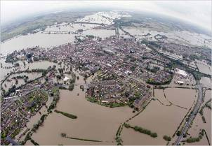
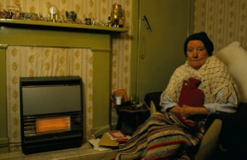

Although climate change can cause illness and death directly...
Notes:
The NHS is contributing to climate change.
Climate change has a NEGATIVE IMPACT on HEALTH:
Food poisoning, cataracts, vector borne disease, skin cancer, flooding, heatwaves.
OLD PEOPLE & Cold Snaps – Think of the Venn Diagram

Slide 22

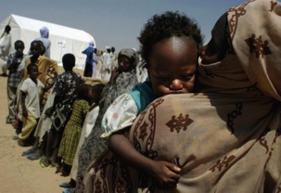




...there are MUCH greater health risks from:
Notes:
On a worldwide scale the big issues are: drought, crop failure, economic collapse, mass migration, civil unrest, societal collapse. ...Easter Island.

Slide 23
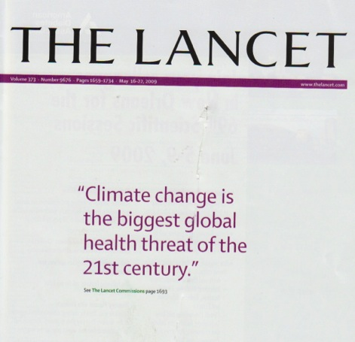
Notes:
This was the conclusion of a University College London and Lancet commission in 2009. It was supported by an editorial from Margaret Chan, head of the WHO recognizing the importance of the issue.

Slide 24
Why is it important for NHS organisations?
Government policy
Public opinion
NHS is affecting the environment
Our environment affects our health
NHS is not sustainable

Slide 25
Unsustainable Healthcare
Healthcare
Limited Resources
Ageing Population
Increasing Chronic Disease
Patient Expectations
Science & Technology
Increasing Regulation
Notes:
Demand continues to rise
(Regulation includes Reducing CO2 FOOTPRINT by 80% by 2050)

Slide 26
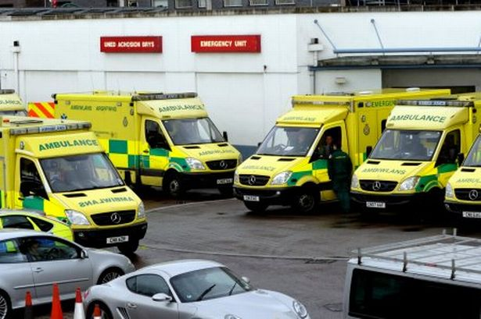
Notes:
We don’t have the capacity, or the money to meet demand.

Slide 27
Unsustainable Healthcare
Social
Economic
Environmental
The more healthcare we provide
The more resources we use and the more carbon and waste we produce
The more it costs
Notes:
The NHS is at breaking point

Slide 28

An Opportunity for Change
Notes:
Even with more money, we can’t keep doing MORE of the SAME
Are the things we are doing now making people healthier????
Change is an IMPERATIVE
Do you STAY on the burning platform, or do you jump?

Slide 29
Where do we start?
Social
Economic
Environmental
Quality Care
Maintain / Improve
Make no worse / Improve
Cost neutral / Save money
Notes:
In healthcare our first priority MUST be Quality patient care
We should be aiming for the sweet spot with service development
We should put the triple bottom line into business plans

Slide 30

Good Corporate Citizen
Travel
Energy
Water
Waste
Also encompasses
  Workforce behaviour
  Community engagement
Notes:
The straightforward stuff…
As individuals and Trusts we can be GCCs
Every Trust has a Sustainability Lead & Sustainability Manager to help them do this

Slide 31
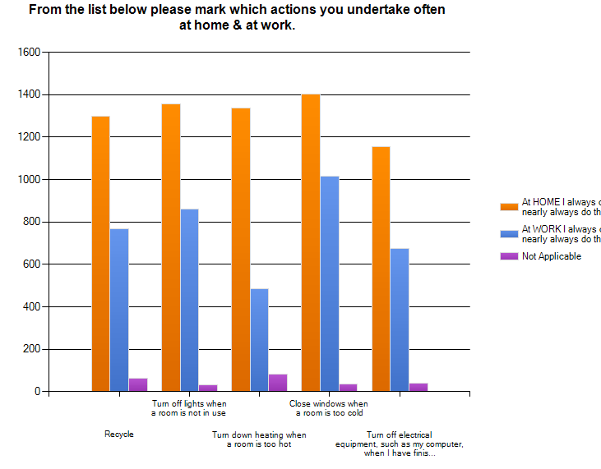
Local Evidence
Student & Trainee Survey
CO2 Footprint of ARCP
If every specialty trainee attended Fulbourn once a year for ARCP – 151,560 miles and produce 55,926kg CO2 equivalent.
Carbon Footprint of Training (Commuting)
One PH Trainee travelled approximately 11,500 miles in a year, producing 2000kg CO2e
If all 1904 trainees travelled to this extent it would result in 21,896,000 miles per annum and 3,808,000 kg CO2e

Slide 32
Sustainability at NNUH

Slide 33

Sustainability at NNUH
“The Trust recognises that it has a responsibility to demonstrate to patients, visitors and Norfolk as a whole, that it is prepared to take a dominant stance regarding sustainable environmental and social policies and practices”
Initiatives:
Park & Ride (20% increase in staff bus travel)
Bicycle purchase (238 people)
Energy saving (Switch off campaign, automatic power down software)
Waste (313 tonnes saved from landfill, Recycling 15% increase)
Theatre Waste Project
  Starting in January
  Yellow vs Clear bags
  Weighing waste
Every Can Counts
  Want to recycle the 46,000 cans sold pa
Health & Wellbeing initiatives
Website
Events for Earth Day, Environment Week & NHS Sustainability Day
25 Sustainability Champions
Sustainability Manager:
Gillian Lee extn 3909

Slide 34
Sustainable Healthcare

Slide 35
Notes:
The slightly less straightforward stuff….
If tomorrow every member of staff cycled and every hospital had a wind farm, we would still be left with procurement……
Everything we use has a CARBON FOOTPRINT or a CARBON COST that goes with it.

Slide 36
Notes:
Only 1:200 drugs make it to market
£300million drugs wasted each year (= 11,778 community nurses / 80,000 hip replacements / 312,175 cataract operations)
Sometimes we give drugs that are unnecessary / don’t work / cause side effects or patients decide not to take them……
This is where WE come in
These are the things that WE have control over

Slide 37
Look at healthcare differently:
New models of care
  Quality Care
  Minimise environmental impact
  Within budget
Social
Economic
Environmental
Notes:
Opportunity to look HOLISTICALLY
The GOOD NEWS is – most things that are good for the Environment also Benefit Health and Save Money
Where can we make changes that
Improve the Environment
Save Money
Improve Health
We should be aiming for the sweet spot with service development
We should put the triple bottom line into business plans

Slide 38
Four Principles of Sustainable Clinical Practice
Disease prevention and health promotion—to minimise the need for healthcare.
Patient education and empowerment—reducing disease progression, pre-empting complications and improving coordination of care by giving patients a greater role in managing their own condition.
Lean service delivery—targeted, evidence-based use of investigations, referral and interventions, supported by better use of IT to reduce duplication and unnecessary travel.
Low carbon—preferential use of modes of treatment and medical technologies with lower environmental impact
(Frances Mortimer, Centre for Sustainable Healthcare)

Slide 39
Disease prevention and health promotion
More Health, Less Healthcare

Slide 40

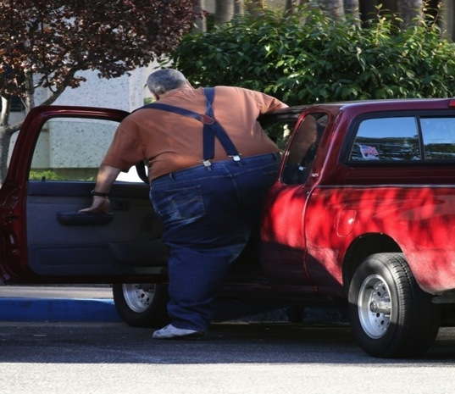

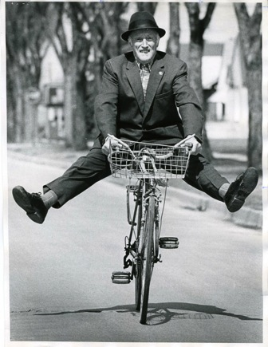


Notes:
What can we do to prevent disease / promote healthy lifestyles
What difference will it make?

Slide 41

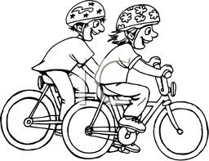
Disease prevention and health promotion
Increased Active Travel
Reduce:
Type II DM
Dementia
IHD
CV Disease
Cancers
Saving £17 billion
James Jarrett et al
Norwich Medical School, University of Cambridge, London School of Hygiene and Tropical Medicine
www.thelancet.com Vol379 June 2012

Slide 42

Patient education and empowerment
80% of Poorly Controlled patients moved into Well Controlled category.
5% improvement TTR across UK would:
Prevent 500 strokes
Save £6,000,000
Notes:
TTR = Time in Therapeutic Range

Slide 43
Lean service delivery
Five things that do not add value
  Patients having to come to hospital on different days for different tests.
  2. Time spent finding the necessary equipment or information.
  3. Time spent doing things again, such as the paperwork or diagnostic tests.
  4. Unnecessary appointments and follow ups in outpatients (the same as 1).
  5. Unnecessary diagnostic tests and re-doing diagnostic tests.

Slide 44
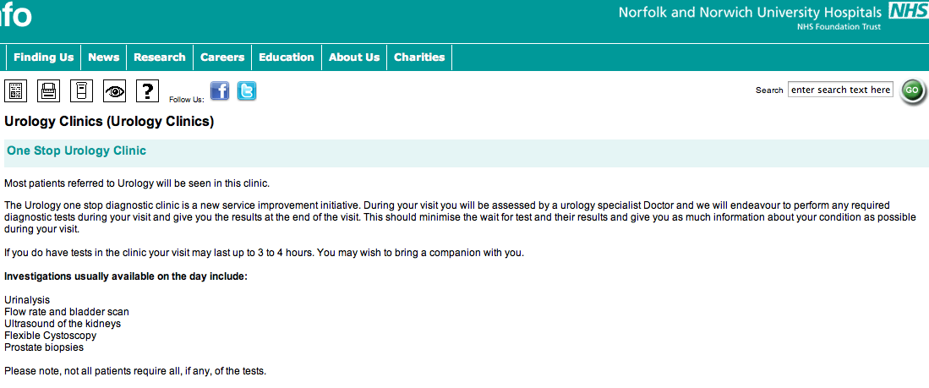
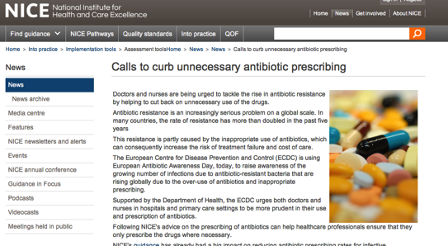
Lean service delivery
Results Letters
Bradford Haematuria Service
Negative results by letter rather than follow up appointment.
Saved 300 clinic slots a year.

Slide 45
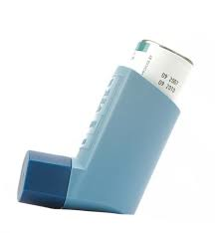
Low carbon
Metered Dose Inhalers
Hydrofluorocarbons
Greenhouse gas effect 3800 times greater than CO2
Switch to dry powder
Reduce metered dose inhalers from 70% to 25% in UK
Reduce emissions by 1.3million tonnes
Toby Hillman SpR Respiratory Medicine
BMJ 2013
http://www.bmj.com/content/346/bmj.f3359

Slide 46
Your role:
Look, notice, ask questions, make suggestions
Join up – groups / teams / networks
Put carbon savings into business cases
Make health a priority

Slide 47
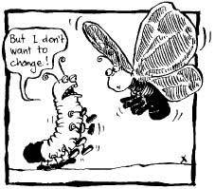
Take Home Messages
Carbon is a cost
Reduce, Reuse, Recycle
More Health,
Less Healthcare
New models of care
  Co benefits / Triple bottom line

Slide 48
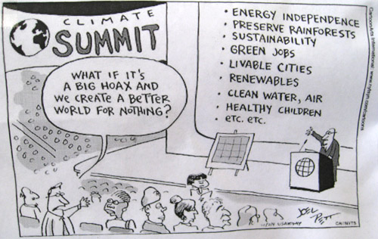
Thank You
NNUH Sustainability Manager:Gillian Lee extn 3909
HEEoE: Maria Cooke maria.cooke3@nhs.net
or sustainabilityeoe@gmail.com
Facebook Group: Sustainable Healthcare East of
England

Slide 49
References
http://www.metoffice.gov.uk/media/pdf/t/r/UK.pdf
http://www.sduhealth.org.uk/documents/Carbon_Footprint_summary_NHS_update_2013.pdf
http://www.thelancet.com/journals/lancet/article/PIIS0140-6736(09)60935-1/fulltext?_eventId=login
Mahmood Bhutta, 2014. The Human Cost of Healthcare. Available at:
http://aaobulletin-365.ascendeventmedia.com/article/4061/
Medical Fair and Ethical Trade Group, BMA
www.fairmedtrade.org.uk
Frances Mortimer 2010 The Sustainable Physician
http://www.rcplondon.ac.uk/sites/default/files/clinmed10.2_110-11.pdf
James Jarrett, 2012 Effect of increasing active travel in urban England and Wales on costs to the National Health Service. Available at:
http://www.thelancet.com/journals/lancet/article/PIIS0140-6736(12)60766-1/abstract
Toby Hillman2013 Inhaled drugs and global warming: time to shift to dry powder inhalers
http://www.bmj.com/content/346/bmj.f3359
Jeff Walker A Review of Self-Testing Patients: How Are They Doing?
Posted on December 23, 2013 by ACSMA
http://www.acsma.org.uk/a-review-of-self-testing-patients-how-are-they-doing/

