Slide 1
Health Services
5. To recognise how rising demand for healthcare is putting strain on both point of care services and the global ecosystem
Define the concept of sustainability

Slide 3
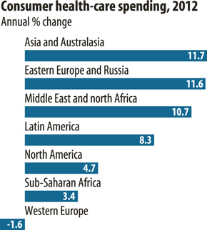
Source: The Economist

Slide 4
150 years
100 years
50 years
NOW
Domestic light bulb
First home PC
4142 cars, 10 miles concrete road in US
First commercial jet ticket
First Oil Well
We’re releasing 350 million years of buried CO₂ VERY quickly…
240,000,000 PCs
650,000,000 cars
4,800,000,000 passenger flights/year
Notes:
Compare spending graph to a wider exponential increase in resource use
Thanks to Hugh Montgomery and David Pencheon

Slide 5
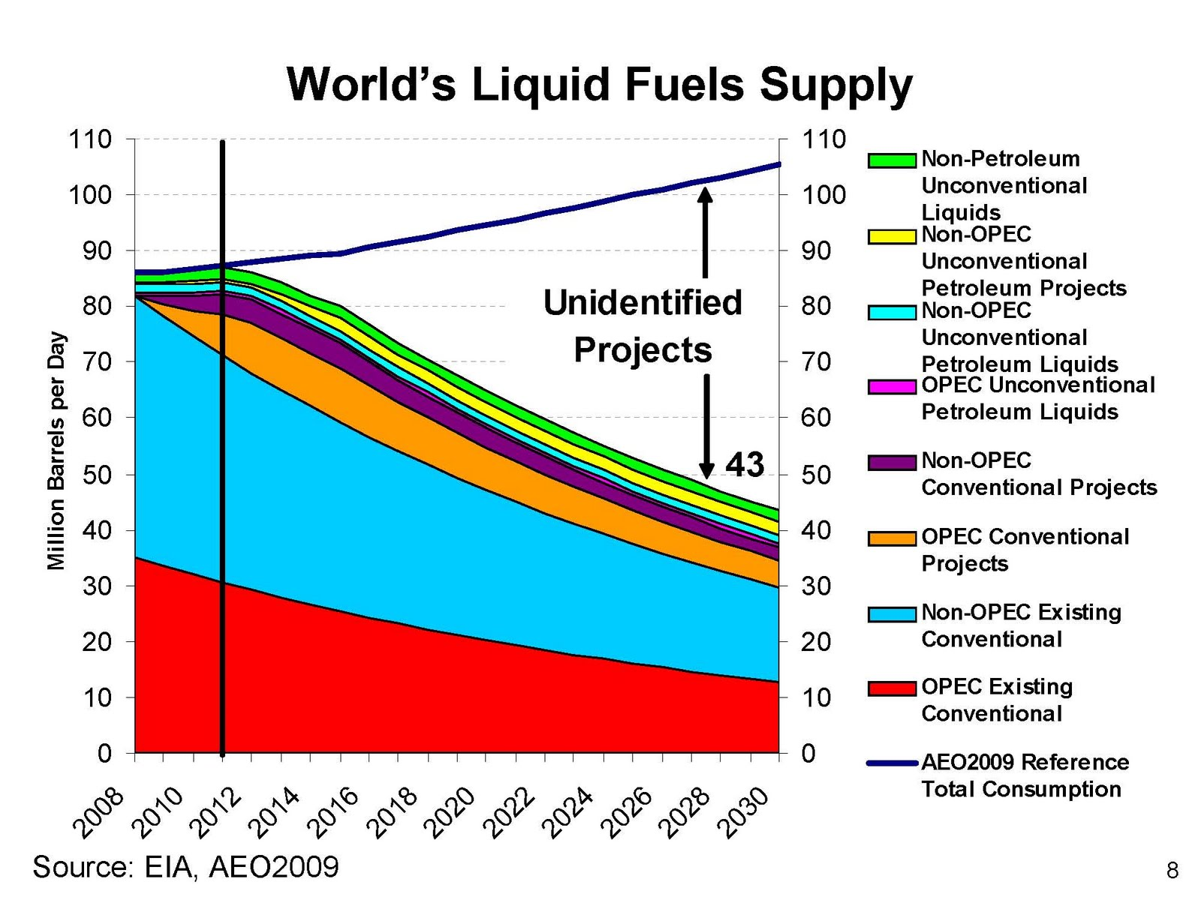
Energy Information Administration, 2009

Slide 6
Need, demand, and supply
What do these figures tell us about current and future need, demand, and supply?

Slide 7
Sustainable development
Development that “meets the needs of the present without compromising the ability of future generations to meet their own needs.”
Brundtland Commission
Social
Environ-mental
Economic
Climate change/ carbon reduction?
Notes:
Can we adapt the definition(s) of sustainable development – e.g. this one from the Brundtland Commission?
Sustainable development is a goal – but the term is often also used to describe a route to that goal, e.g. achieving a balance between the “three pillars” of sustainable development depicted here: social development, environmental development and economic development. Sustainable development is attained at the intersection of these three (blue star).
Where would the students put “healthcare” currently in this Venn diagram?
How does climate change/carbon reduction fit in? – just one aspect of sustainable development

Slide 8
Health Services
6. To discuss concepts of equity and equality in a global context
To understand how climate change will exacerbate global inequality

Slide 9
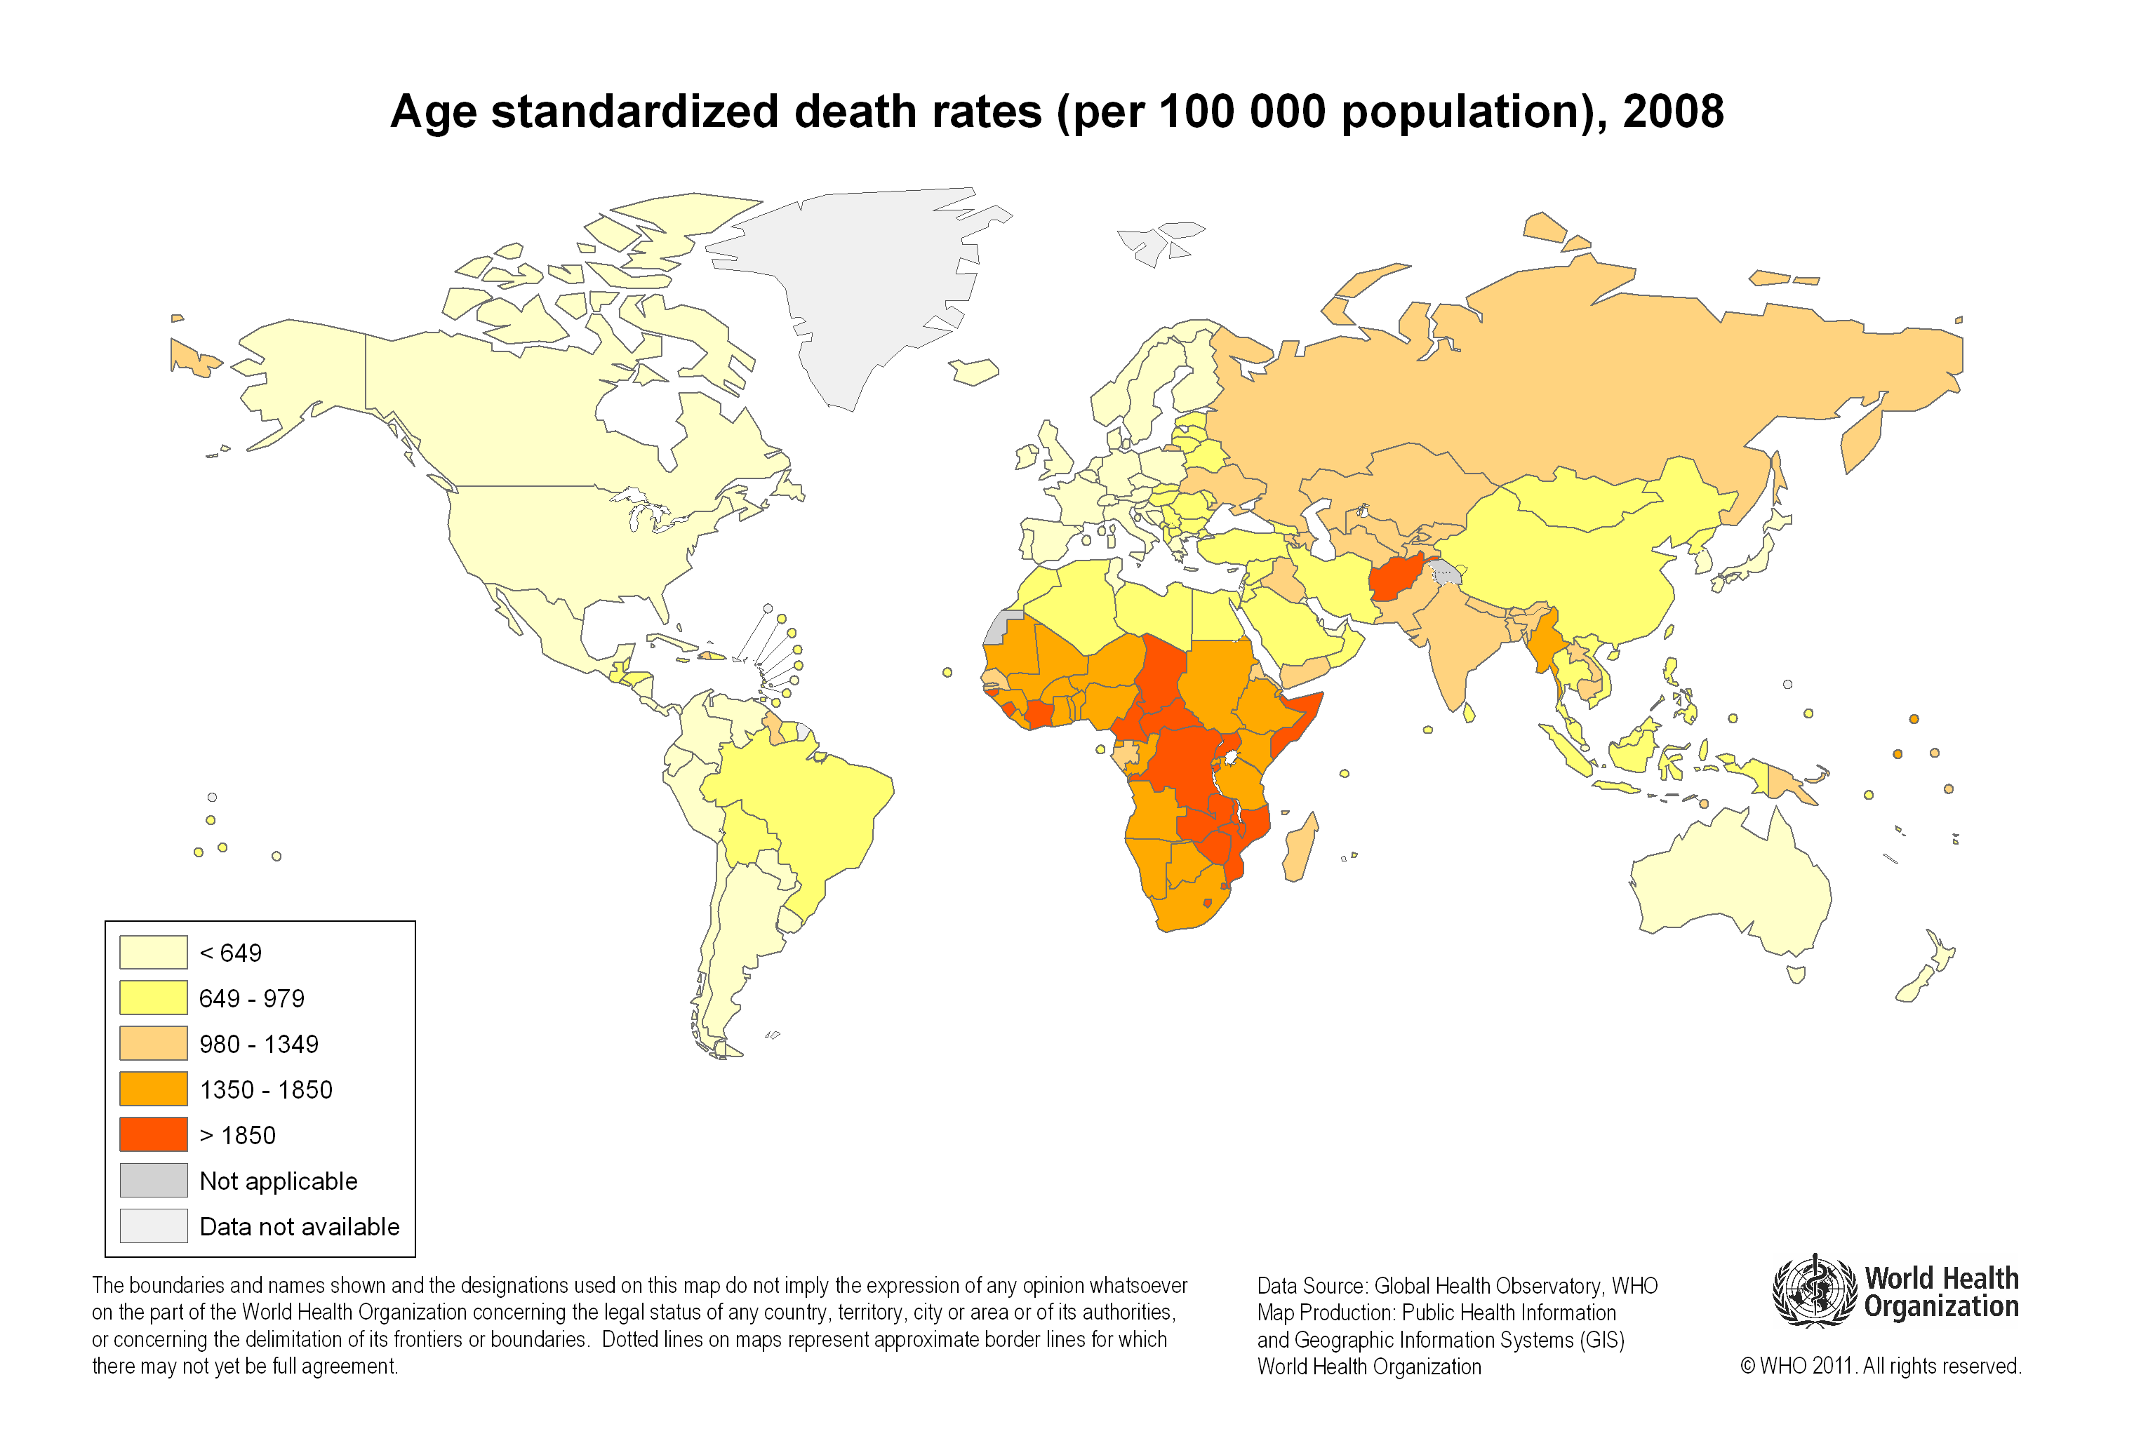
Global inequality
Notes:
Should doctors take a role in reducing global health inequality?

Slide 10
What are our responsibilities?
Should everyone be entitled to the same set of health resources?
Should everyone be entitled to a ‘minimum set’ of health resources?
Notes:
Get students to come up with arguments
Does this apply globally or only within a country

Slide 11
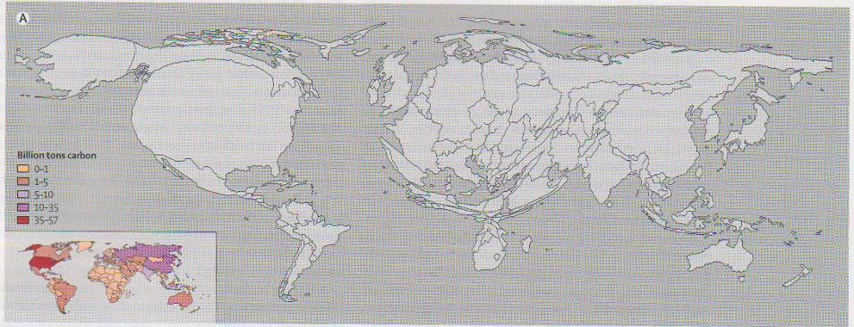
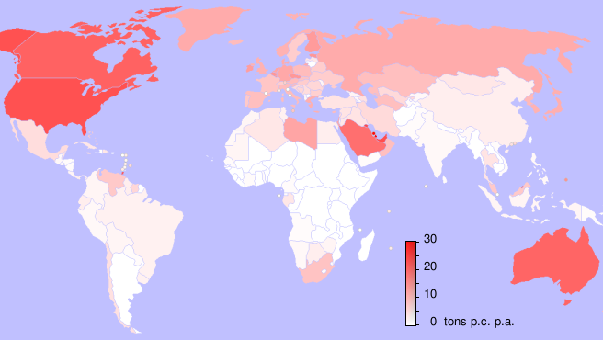
Who produces the greenhouse gases?
The world map reflecting production related to climate change.
Notes:
The top figure shows: CO2 emissions by country 1950-2000. Which regions were responsible for the most carbon pollution?

Slide 12
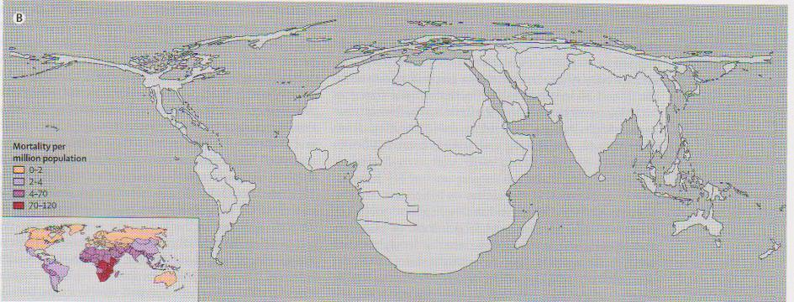
Who bears the burden?
The world map reflecting mortality related to climate change.
“Climate Change presents the biggest threat to health in the 21st Century” The Lancet (373;9697 pp 1659-1734, May 16-22 2009).
Notes:
This figure shows: the distribution of 4 climate-sensitive health consequences (malaria, malnutrition, diarrhoea, inland flood-related fatalities). Which regions suffered the most from climate change?
Climate change is an extremely regressive problem. That is, those who have contributed the least, are being hit first, and hardest. Addressing climate change is synonymous with addressing health inequalities.
Source (1): Climate Change presents the biggest threat to health in the 21st Century” The Lancet (373;9697 pp 1659-1734, May 16-22 2009).

Slide 13
What are our responsibilities?
Should everyone be entitled to the same set of health resources?
Should everyone be entitled to a ‘minimum set’ of health resources?
Notes:
Get students to come up with arguments
What would be on the list of a realistic minimum set of resources – eg access to clean water, food, fuel, education, vaccination and healthcare.
Does this apply globally or only within a country – we are the ones paying for the NHS
Rich counties are actively causing harm – does this change our responsibilities (ie concept of a debt)

Slide 14
Health Services
7. To understand environmental indicators and how they may be applied in healthcare management

Slide 15
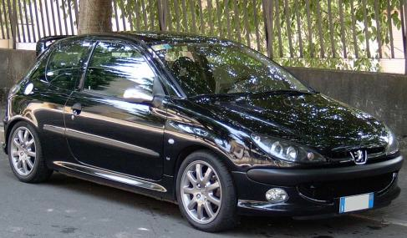
1 tonne per day
Average UK person: 8 tonnes per year
112g CO₂/km
Notes:
What are the pros and cons of using carbon footprinting?
Should it be included within economic evaluations?
Pros – easy to understand, easy to set and assess targets, correlates directly with an outcome that will affect climate change (concentration of co2 in atmosphere), applicable across many domains (every population, system or activity)
Cons – difficult to calculate, difficult to decide what sources of carbon should be included (how far back down the production chain should we go? UK offsets a lot of its carbon production by not counting things that are manufactured in other countries), unclear how much added benefit saving a certain quantity of carbon emissions actually brings, one dimensional measurement – ignores other economic, environmental and social factors.
Carbon footprint: "A measure of the total amount of carbon dioxide (CO₂) and methane (CH₄) emissions of a defined population, system or activity, considering all relevant sources, sinks and storage”

Slide 16
The ideal evaluation?
Social
Environmental
Economic
Notes:
Should cover all of these aspects to see which brings most overall gain to a population.

Slide 17
Health Services
8. To discuss how carbon as well as capital could be seen as a scarce resource to be allocated
To understand that doctors working in the NHS share their institution’s legal duty to reduce greenhouse gas emissions 80% by 2050 (Climate Change Act 2008)

Slide 18
Notes:
NHS current, projected and target CO2 emissions
Orange line are legal targets set by the 2008 climate change act – all doctors share a responsibility in achieving this goal

Slide 19
Carbon Reduction Targets
How might efforts to reduce carbon:
Reduce health inequalities
Exacerbate health inequalities
Notes:
It is always the most vulnerable in society who will be adversely affected by change
Should this stop us trying to mitigate the effects of climate change?

Slide 20
Principles of sustainable clinical practice
Prevention of disease, health promotion
Greater engagement of patients in managing their own care
Lean care systems: minimising low value activities (including travel)
Preferential use of effective & proven technologies with the lowest carbon footprint
Mortimer-F. The Sustainable Physician
Clinical Medicine 2010, Vol 10, No 2: 110–11
Notes:
How is this reduction in carbon to be achieved?

Slide 21
Sustainability & Quality of Care
Patient safety
Efficiency
Clinical effectiveness
Equity of access
Timeliness
Patient experience
?
Sustainability
Notes:
Some senior physicians have called for sustainability to be included as a dimension of quality in healthcare, alongside those listed here.
It could also enhance the other dimensions – using the 4 principles of sustainable clinical practice on previous slide, can the students think of examples?
Overall governance type interventions
Projects with benefits to cost-efficiency of care:
Reclamation of reject water in dialysis units, energy saving from retrofit of heat exchangers to dialysis machines,
eliminating use of non-necessary disposable equipment – e.g. iv giving sets in haemodiafiltration
mapping of environmental wastes can highlight opportunities to improve processes
Projects with benefits to efficiency and patient experience:
Use of telephone clinics
increased patient empowerment and support for patients to self-care
Proposed projects with benefits to patient safety and experience:
sustainable approach could help get treatments right first time
Greater use of RenalPatientView (allows patients to access test results online) and patient self monitoring
References
Royal College of Physicians “Leading for Quality” http://www.rcplondon.ac.uk/About-the-college/mission/Documents/RCP-Leading-For-Quality.pdf (See section 2.5, Tackling the Impacts of Climate Change on Health: “The RCP believes that doctors have a collective responsibility within their professional communities to take action on climate change and look at how they can alter working practices so that, while remaining safe and of a high quality, they support a more sustainable future.”)
Article: "Place sustainability at the heart of the quality agenda" Justyn M Thomas and Paul A Cosford, Qual Saf Health Care 2010;19:260e261. doi:10.1136/qshc.2010.044123
Renal Tsar’s Blog: http://renaltsar.blogspot.com/2010/05/sustainability-seventh-dimension-of.html

Slide 22
Your turn: identify an opportunity to improve sustainability in your medical school or in a clinical setting and the channels by which change can be brought about.
What unsustainable practices can you think of:
a) On a general medical ward?
b) In an operating theatre?
Notes:
Emphasise that these are things an individual doctor can think about with regards to their own practice, and in quick interventions that they can effect themselves at a ward level.
a)On a general medical ward: Excessive heating and lighting, food waste, unused medicines, over-ordering, unnecessary or avoidable admissions, wasteful use of paper and office items, computers and appliances left on when not in use, leaking taps…etc.
b) In an operating theatre: single-use disposable items (e.g. anaesthetics trays and equipment, some surgical instruments, gowns, masks, gloves), sterile packaging and equipment going into clinical waste unnecessarily (disposal of clinical waste is carbon-intensive and expensive), delays/downtime, unused medicines etc.

