Slide 1
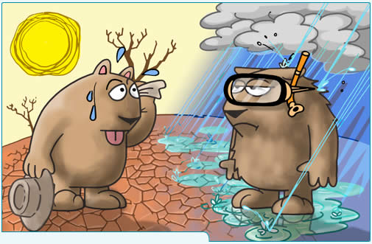

What did medical students learn from our discussion of climate change?
http://www.keepbanderabeautiful.org/climatechange.html

Slide 2
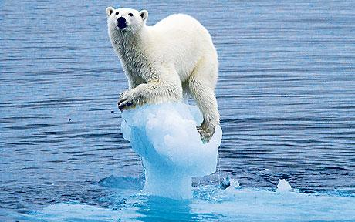
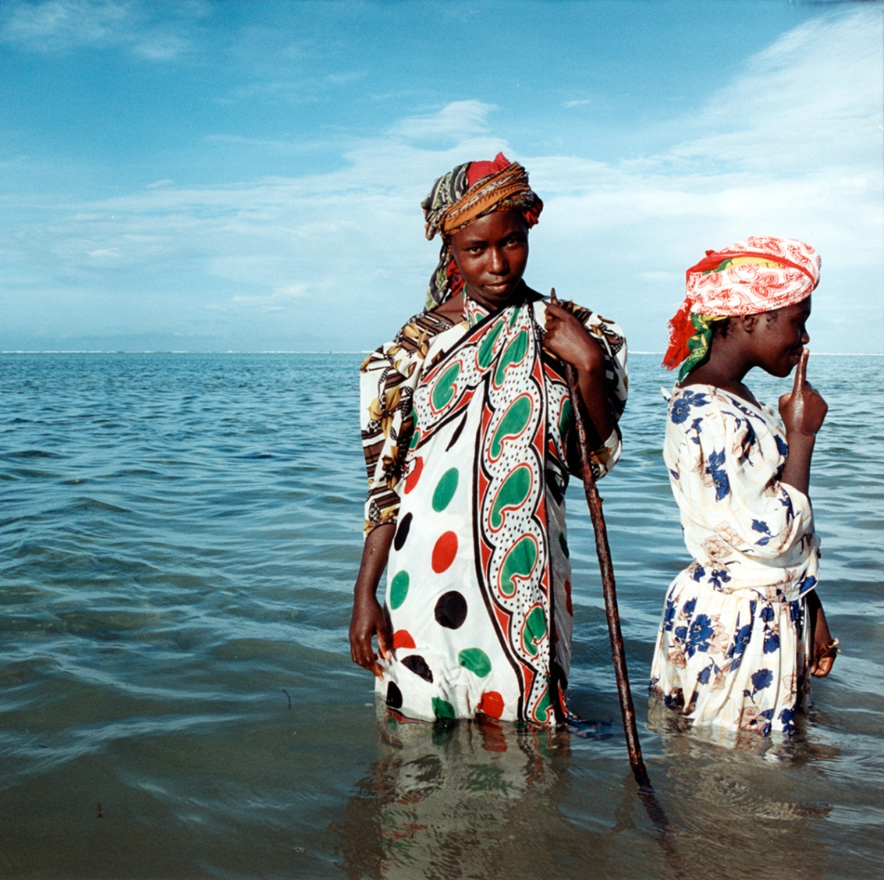
Climate Change
http://www.socialistrevolution.org/ideas/capitalism-puts-the-planet-under-threat/can-capitalism-stop-climate-change/
I do not deny it’s happening, but it’s nothing to do with my clinical practice….
What can we do, anyway?
http://cugh.wordpress.com/2010/09/21/the-effects-of-climate-change-and-global-health/

Slide 3
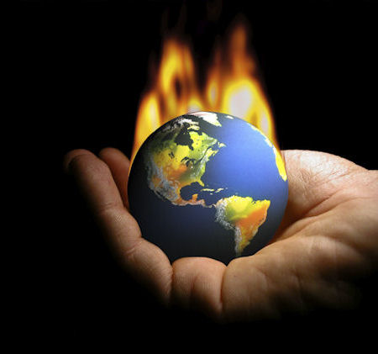
Is it, really?
http://bostinno.com/2012/08/12/we-need-to-strengthen-new-englands-cap-and-trade-program/climate-change/

Slide 4
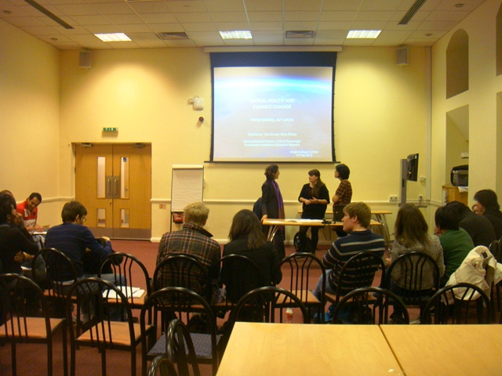

Let’s find out what medical students in London wrote in their essays after their ‘climate change’ workshop!

Slide 5
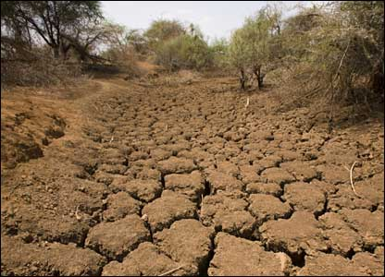
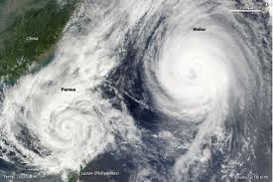
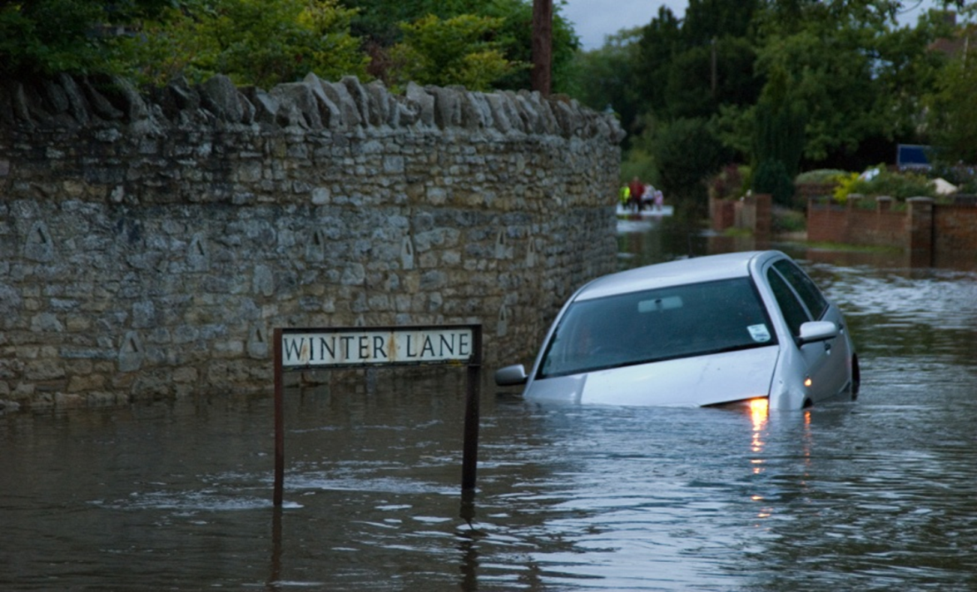
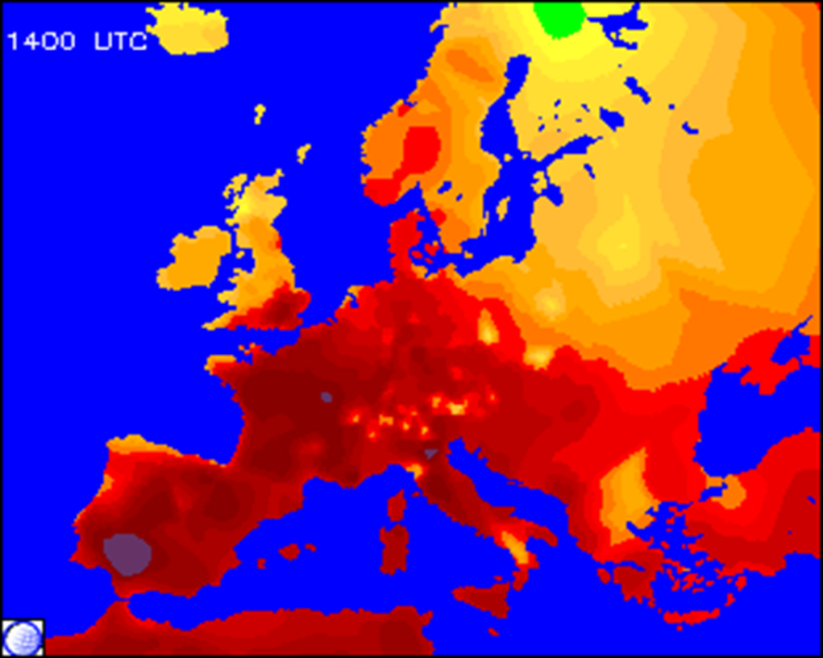
Climate change could cause…
http://www.chapel.byethost13.com/images/drought.jpg
http://www.examiner.com/images/blog/EXID23333/images/TyphoonMelor_TSPara.png
www.sdu.nhs.uk
www.supercourse~

Slide 6
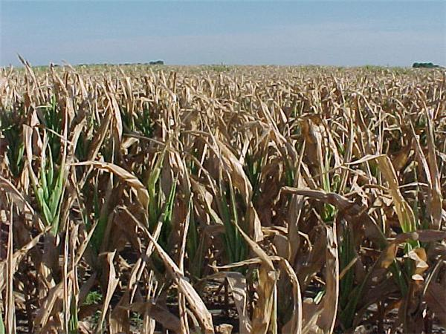
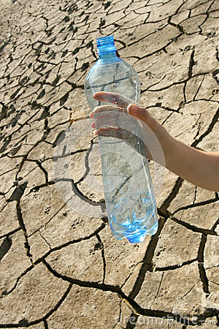
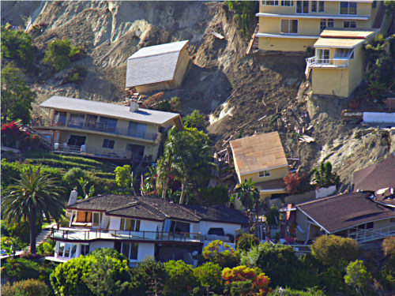
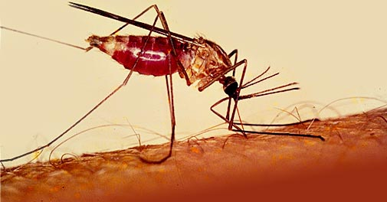
Therefore…
http://www.consumerenergyreport.com
Crop Failure
http://www.vios.com.au/disastermgmt/
Water shortage
Topnews.in
Spread of vectors/pathogens
Destroyed infrastructure

Slide 7
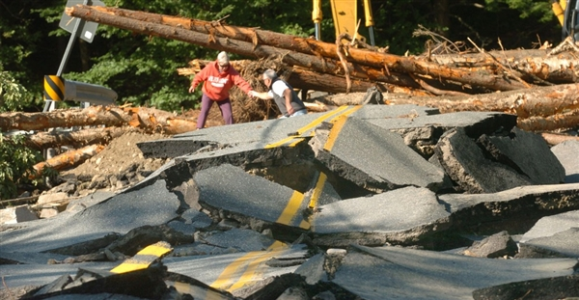
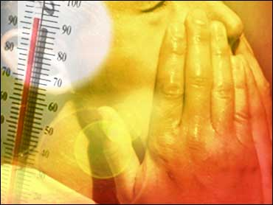
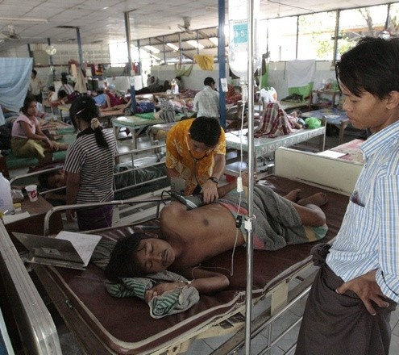
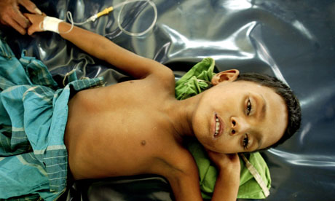
As a result…
NBCNEWS.com
Injuries/trauma
Heat stroke
TopNews.ae
Democratic Voice of Burma
theguardian.uk
Diarrhea
Malnutrition
Spread of infection

Slide 8
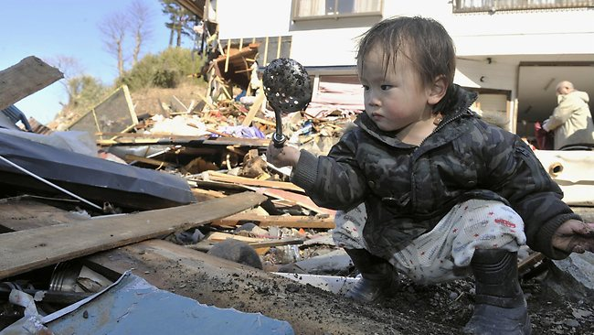
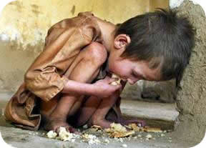
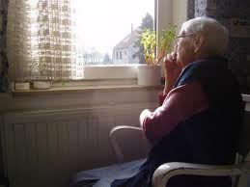
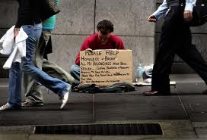
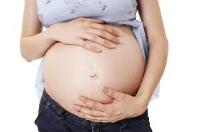
Who are the vulnerable?
http://machikawaco.wordpress.com
The poor
http://cdnworldissues.edublogs.org
Children
The homeless
The elderly
http://www.allamericanpatriots.com/
Pregnant women
http://www.beta-gibbs.pcsb.org
Health-care-blog.com

Slide 9
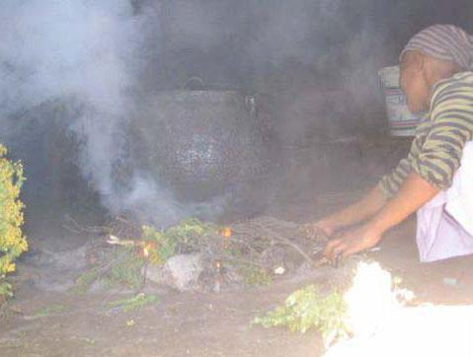
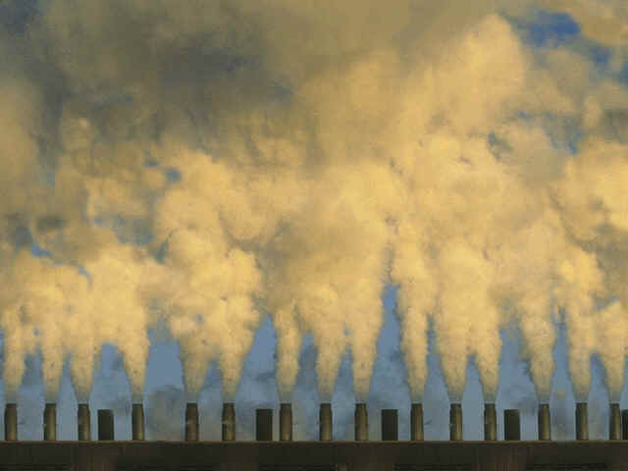
Is this fair?
http://www.eufeco.org/
see-the-sea.org
“…less clearly recognised is the idea that the ability to make
‘green’ and health friendly choices can be thought of as a luxury
that is beyond consideration for those living on the poverty line.”

Slide 10
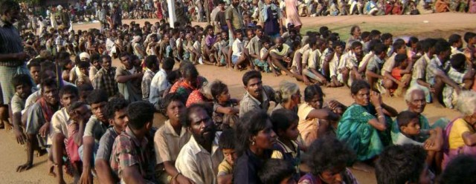
Social determinants of health
UNHCR, Japan
“It is not just direct starvation which kills though.
Food shortages often prompt migration to places where living conditions are inadequate, with poor hygiene and unsanitary water and this, coupled with depleted immune defences from lack of food, leads to infection-related deaths”

Slide 11
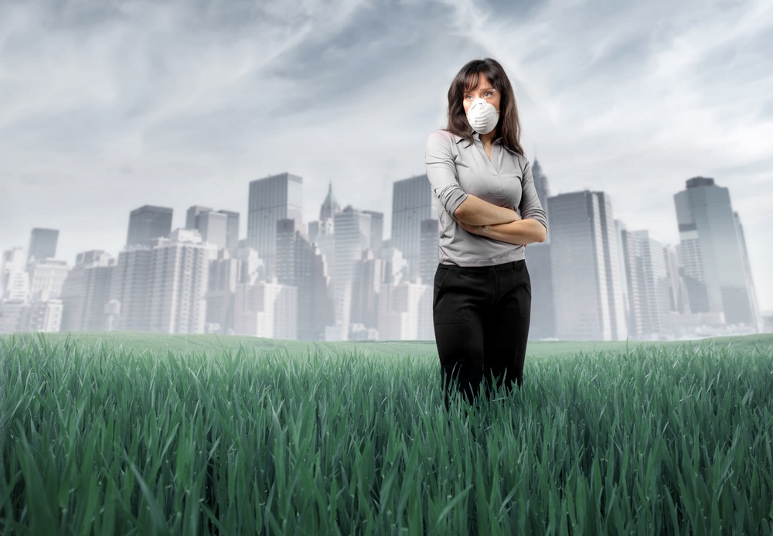
She could be my clinic patient…
weheartworld.com
“…the increase in air pollutants associated with climate change…, can result in cardiovascular and respiratory problems and exacerbation of pre-existing problems especially in pregnant females, the young and the elderly.”

Slide 12
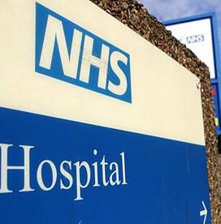
We are also responsible…
http://ukhumanrightsblog.com
“As Europe’s biggest employer, the NHS produces 20 million tonnes of carbon dioxide per annum, giving it the potential to have a significant effect on climate change (SDU, 2012 cited in student’s essay).”

Slide 13



Students recognised the importance of…
Education
International action
A policy level
approach
An interdisciplinary
perspective

Slide 14
In summary, topics of “climate change” provided opportunities for students to explicitly discuss;
Global burden of disease
Socioeconomic & environmental determinants of health
Health systems
Global health governance
Human rights & ethics
Cultural diversity & health
Johnson et al. Global health learning outcomes for medical
students in the UK. Lancet 2012, 379: 2033-35

Slide 15

The challenge is …
how to encourage students to consider themselves as
agents of change as health professionals.

Slide 16


Music: New orleans shall rise again
George Winston solo piano
from Gulf Coast blues and impressions
- A Hurricane relief benefit

