Slide 1

Project Drawdown
Name of presenters

Slide 2
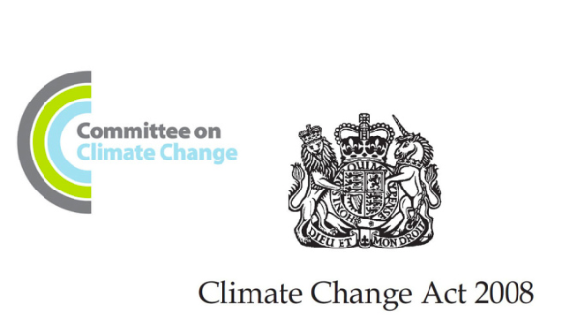



Environmental concern
Climate Change Act 2008
NHS commits to 80% reduction targets
BJA 2015
Atmospheric science, anaesthesia, and the environment
IPCC Report 2018
      UN ‘12 years to save the plant’
ASA 2018 Project Drawdown Challenge
Reduce Inhalational CO₂ emissions by 50% by 2020
RCoA 2019 – 2022 Sustainability Strategy

Slide 3

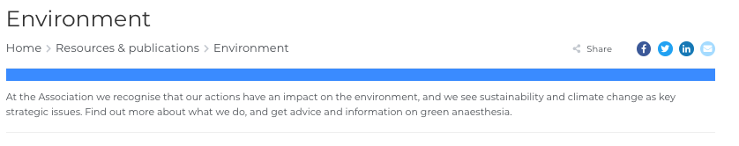
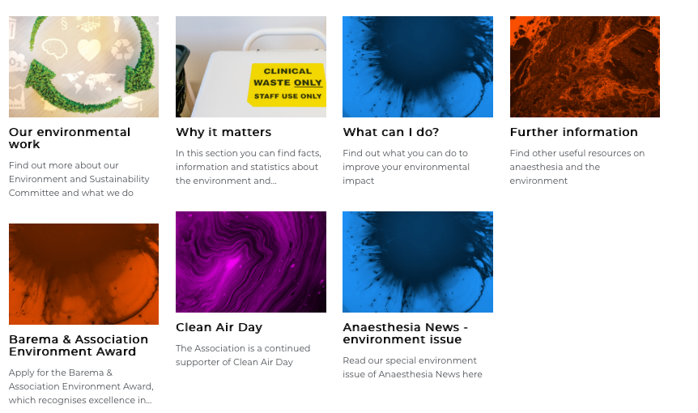
Association of Anaesthetists

Slide 4
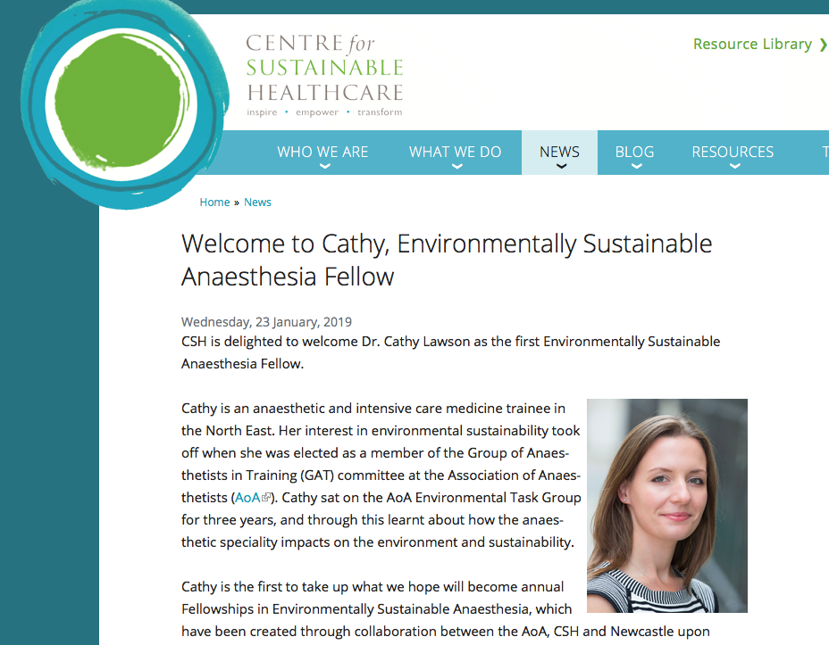

Slide 5
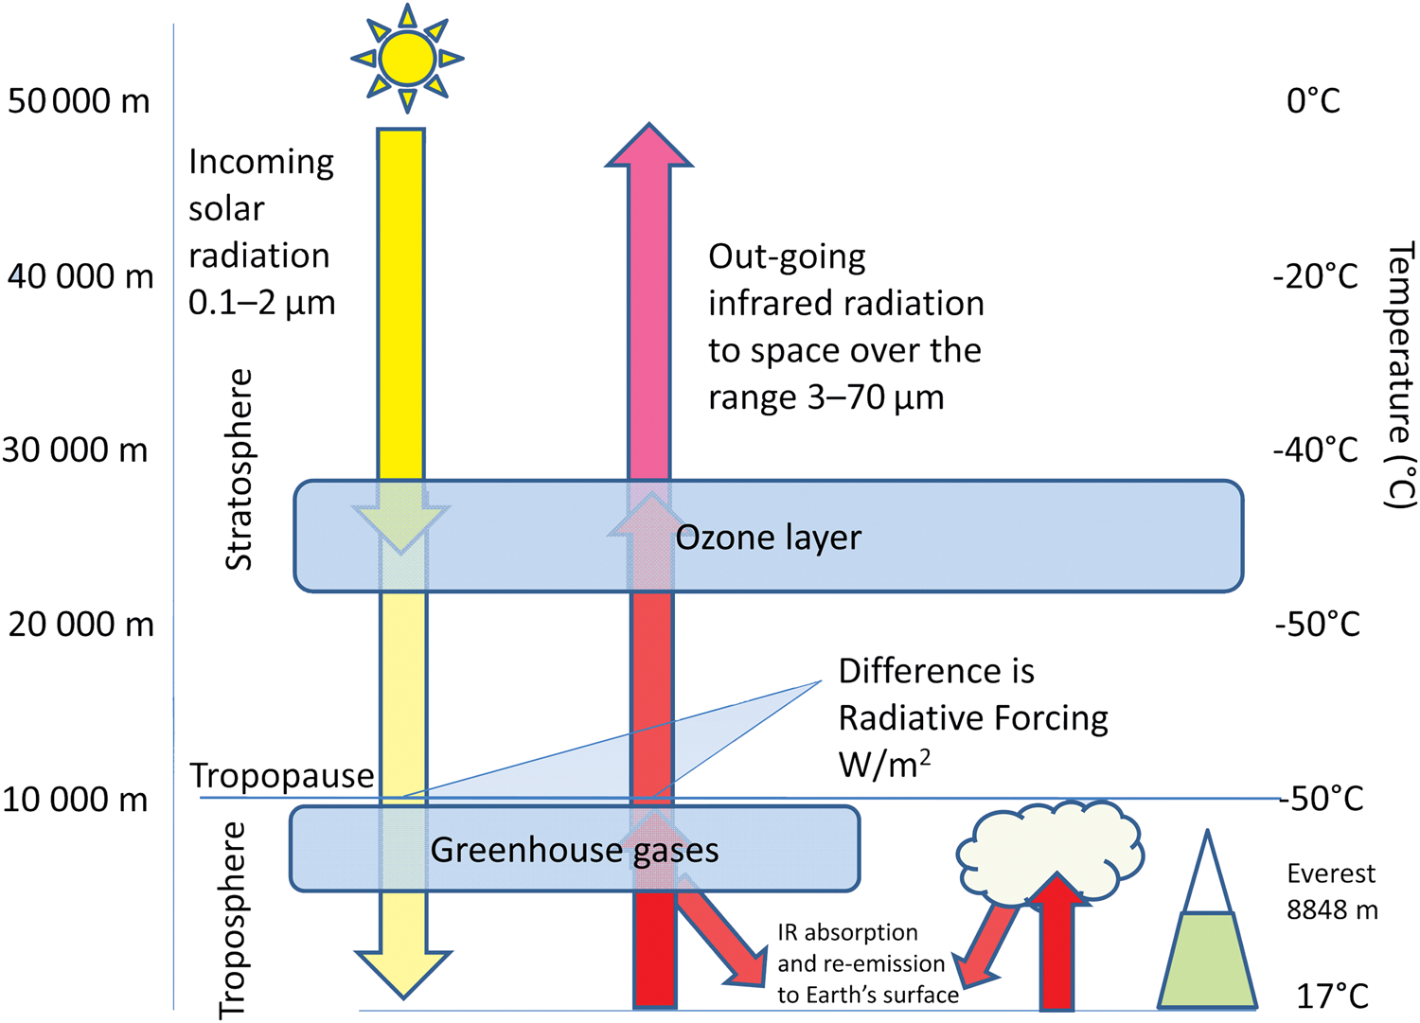
Earth’s atmosphere
Ozone
Limits earthward transmission of UV light

Slide 6
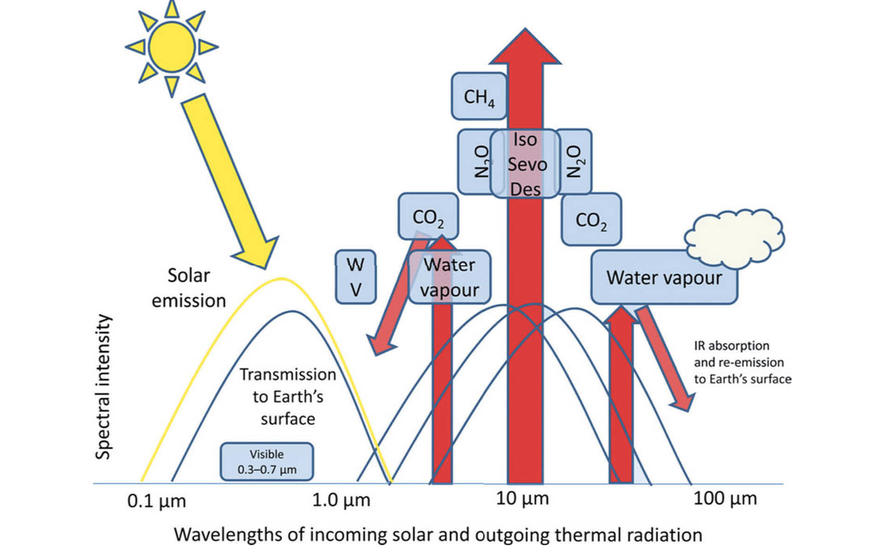
Earth’s energy neutrality
Maintained by a balance
  Reflected solar radiation
  Outgoing long wave infrared radiation

Slide 7
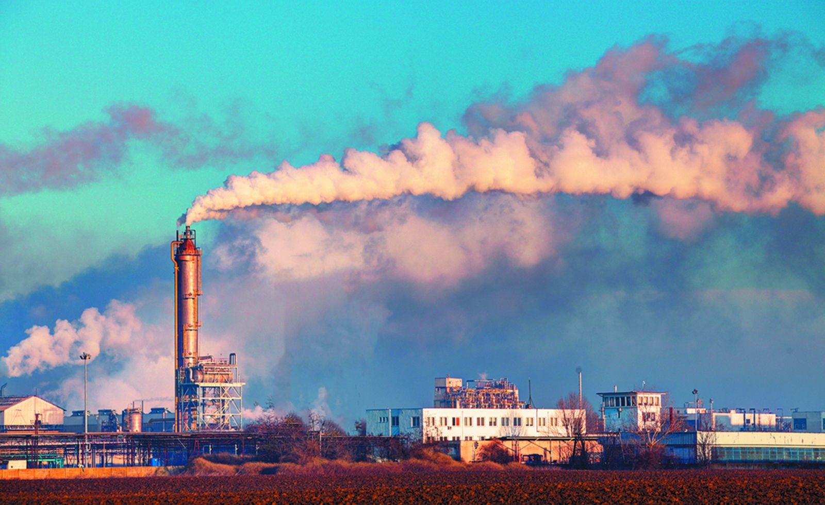
NHS emissions
Approx 5% of all UK emissions
almost 40% of public sector!
IAA’s 5% of acute facilities
~Desflurane 80%

Slide 8
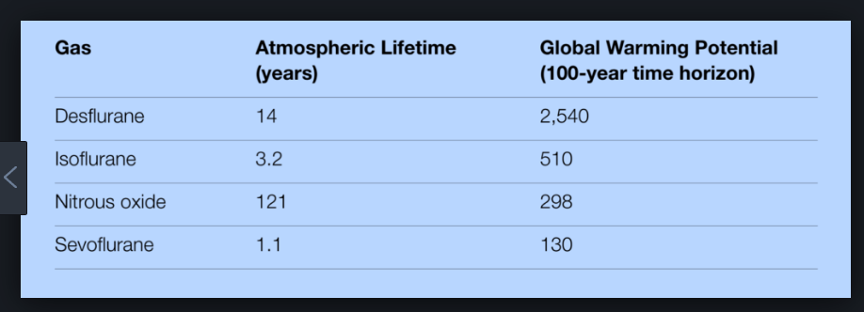
Environmental Impact of Inhalational Anaesthetic Agents (IAAs)

Slide 9
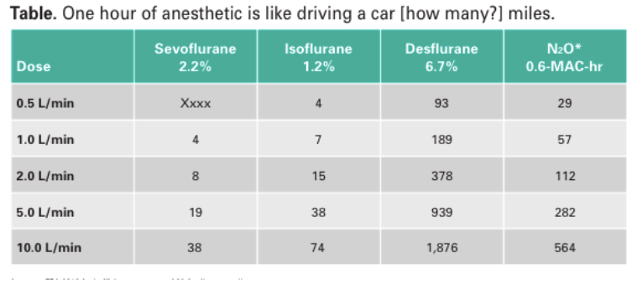
IAAs

Slide 10
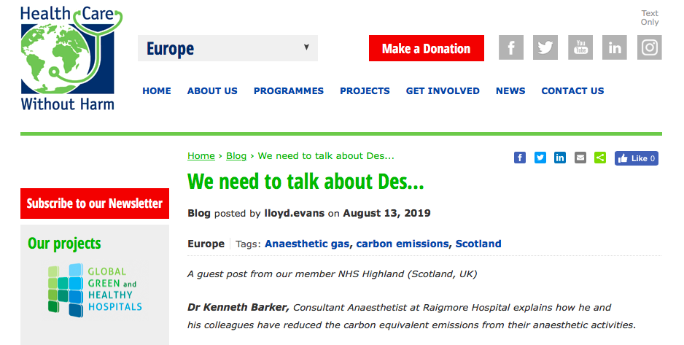

Slide 11
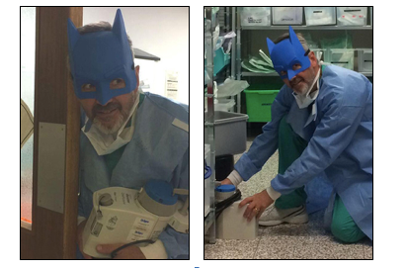
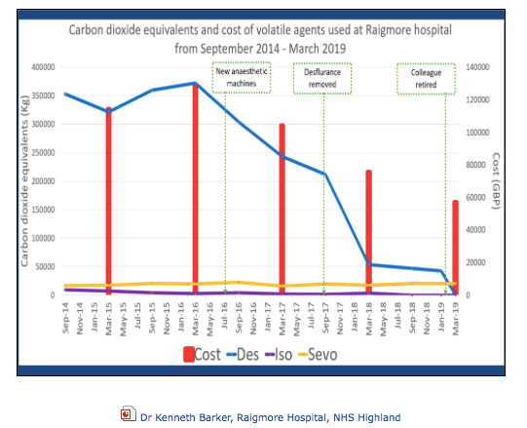
Scotland SEA-G
Dr Kenneth Barker
Raigmore Hospital, NHS Highland

Slide 13
Story So Far at UHW

Slide 14
Story So Far at RGH

Slide 15



Project underway in 2 hospitals
UHW and RGH are saving a combined total of 108374Kg CO₂ emissions on average per month.
That’s the equivalent of:
    Driving 268,253 miles in an average car
    Eating 3,772Kg of beef
    Flying to New York 100 times!!
UHW and RGH are both spending over £4,000 less per month on volatiles

Slide 16
Welsh Environmental Anaesthetic Network
brennanfm@doctors.net.uk
jayne.sutherland@doctors.org.uk
agmorgan@doctors.org.uk

Slide 17
References
https://www.sduhealth.org.uk/policy-strategy/legal-policy-framework/climate-change-act.aspx
Atmospheric science, anaesthesia, and the environment Matt Campbell, J. M. Tom Pierce BJA Education, Vol. 15, Issue 4, p173–179 August 2015
https://report.ipcc.ch/sr15/pdf/sr15_spm_final.pdf
https://publichealth.yale.edu/climate/research/conferences/challenge/
https://www.rcoa.ac.uk/system/files/SustainabilityStrategy2019-2022.pdf
Sustainable Development Unit. Reducing the use of natural resources in health and social care 2018. https://www.sduhealth.org.uk/policy-strategy/reporting/natural-resource-footprint-2018.aspx
Centre for sustainable healthcare. https://sustainablehealthcare.org.uk/
Sulbaek Andersen MP, Nielsen OJ, Wallington TJ, Karpichev B, Sander SP. Assessing the impact on global climate from general anesthetic gases. Anesth Analg. 2012;14(5):1081–5.
Ryan SM, Nielsen CJ. Global warming potential of inhaled anesthetics: Application to clinical use. Anesth Analg. 2010;111(1):92–8
Health Care Without Harm https://www.greenhospitals.net

Slide 18
Resources
Prof Hugh Montgomery Intensivist UCL & director of the UCL Institute for Human Health and Performance https://youtu.be/9UP_-Bvf5fU
Sir David King, former Chief Scientific Advisor to the British government https://www.talkingpoliticspodcast.com/blog/2019/160-david-king-on-climate-repair
https://sustainablehealthcare.org.uk/
https://www.biologicaldiversity.org/programs/biodiversity/elements_of_biodiversity/extinction_crisis/
https://www.nejm.org/doi/full/10.1056/NEJMp1906035
https://www.bma.org.uk/collective-voice/influence/international/global-justice/fair-medical-trade

