Slide 1
Sustainability eco-infrastructure
Neil Murray on behalf of the Fred Hollows Foundation NZ
Acknowledgement: Andrew Bell’s poster presentation at GA10 Durban
Notes:
10 GA 2016

Slide 2
eco-building
Honiara, Solomon Islands
new national eye clinic and day stay theatre complex
single storey, roof 800 square metres
developed world standard air conditioning
positive pressure HEPA filtered in theatre
Notes:
Building opened mid 2015

Slide 3
eco-building problems: hot and wet with unreliable power
Power: average 10 power cuts per day, 5 x NZ price
Temperature: average 26.6 degrees centigrade
Humidity: average 79%
Rainfall: average 2171mm
Notes:
Rainfall that people in capetown would give their eye teeth for

Slide 4
eco-building solution: 100KWH solar power system 400 roof mounted solar panels delivering 94% of the expected power required by the facility capable of producing up to 450kw/day roof water tank storage 20,000 litres
Notes:
Iron bottom Sound: Battle of Guadalcanal 1942-43 Guadalcanal, Savo and Florida Islands more than 40 major naval vessels sunk Honiara sits at the southern end of the Sound,

Slide 5
green is actually good and economical
Expected (and delivered) :
annual average supply since 2015: 70,000 KWH
more than 96% of power requirements
saving US$400/day at current Solomon Island prices
pay back investment within 5 years

Slide 6
green is good and economical
unexpected (but nice):
no equipment damaged by power fluctuations
self sufficient for all water needs

Slide 7
eco-building lessons
hot, wet and unreliable power environment eco-building works
adequate roof for solar sufficiency then also adequate for water sufficiency
over engineered is good
surge free value add: protects sophisticated electronic equipment

Slide 8
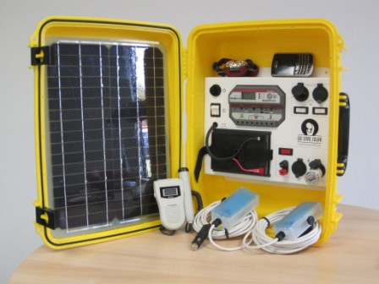
power generation solutions
mobile microgrids
suitcase solar panel for power at the smallest health facility
solar panels on roof of outreach vehicles for lighting, etc at outreach points
solar suitcase— http://www.wecaresolar.org
acknowledgement Hannah Faal

Slide 9
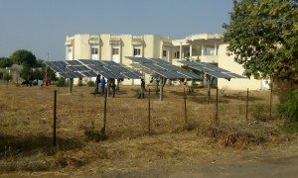
power generation solutions
solar panel micro grid for a smaller facility
MICRO grid concept
http://powerupgambia.org/almost-a-decade-for-upgrade
acknowledgement Hannah Faal

Slide 10
power storage solutions
minimise environmental consequences
batteries
store and release power
disposal
“green batteries” salt water technology instead of lead acid
acknowledgement Hannah Faal

