Slide 1
Sustainability: innovating Procurement, Innovating healthcare
19 June 2018, Tanya Harris
WOC – Masterclass in Environmental Sustainability
Author has no financial disclosures or conflicts of interest related to this topic. Images are not meant to support or criticize any particular company, product, or health system.
Notes:
Chances are, social and environmental responsibility is not the key driver for your organisation. You know it exists, but you are more likely to be focused on delivering medical interventions to the highest quality possible.
As a contributor to the Sustainable Procurement ISO 20400:2017 and the Global Manager of Procurement for The Fred Hollows Foundation, supporting eye health in 25 countries, I would like to show you how YOU can leverage sustainable procurement to Do No Harm in a broader context than eye interventions

Slide 2
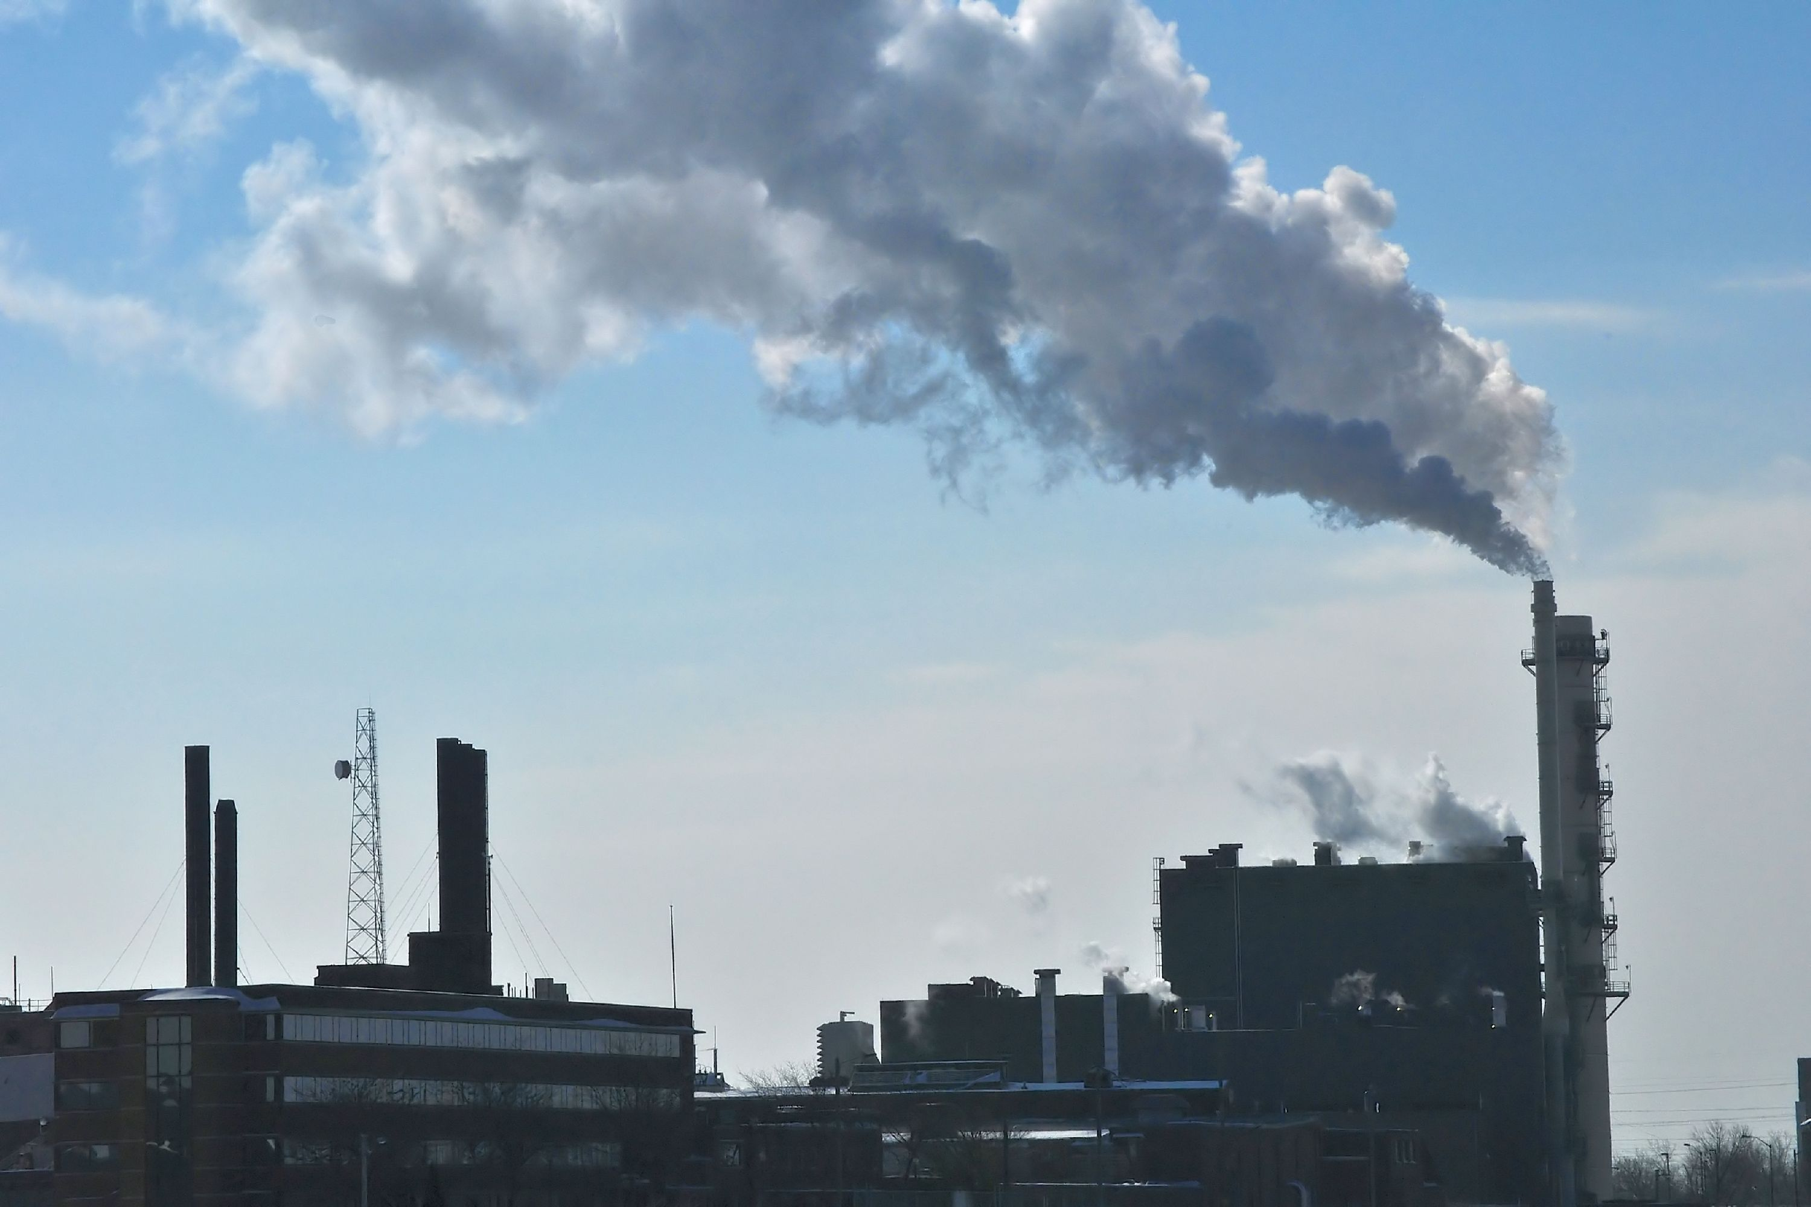
Emissions from healthcare
(ERIC FEFERBERG/AFP/Getty Images)
Photo by Rhett A. Butler.
http://www.digitaljournal.com/img/9/0/1/5/0/3/i/8/4/0/o/DSC_00590001_filtered.jpg
Notes:
“research had calculated that healthcare activities emit 8 percent of the nation’s (USA) greenhouse gas emissions……..direct and indirect emissions from healthcare caused 12 percent of acid rain, 10 percent of smog formation and 9 percent of respiratory disease from particulate matter in 2013.”
Retrieved 17/06/2018, from https://www.reuters.com/article/us-health-hospitals-pollution/hidden-harm-us-healthcare-emits-more-greenhouse-gas-than-entire-uk-idUSKCN0Z82FR

Slide 3
Deforestation for rubber plantations
Photo by Rhett A. Butler.
(ERIC FEFERBERG/AFP/Getty Images)
Notes:
Surgical gloves – Deforestation and degradation of the environment to make healthcare supplies

Slide 4
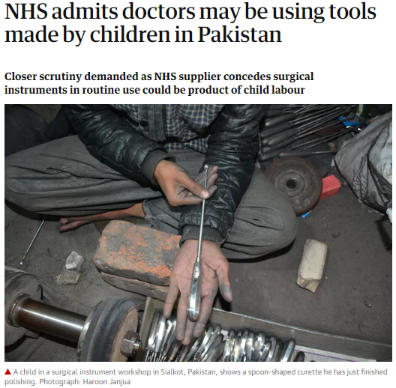
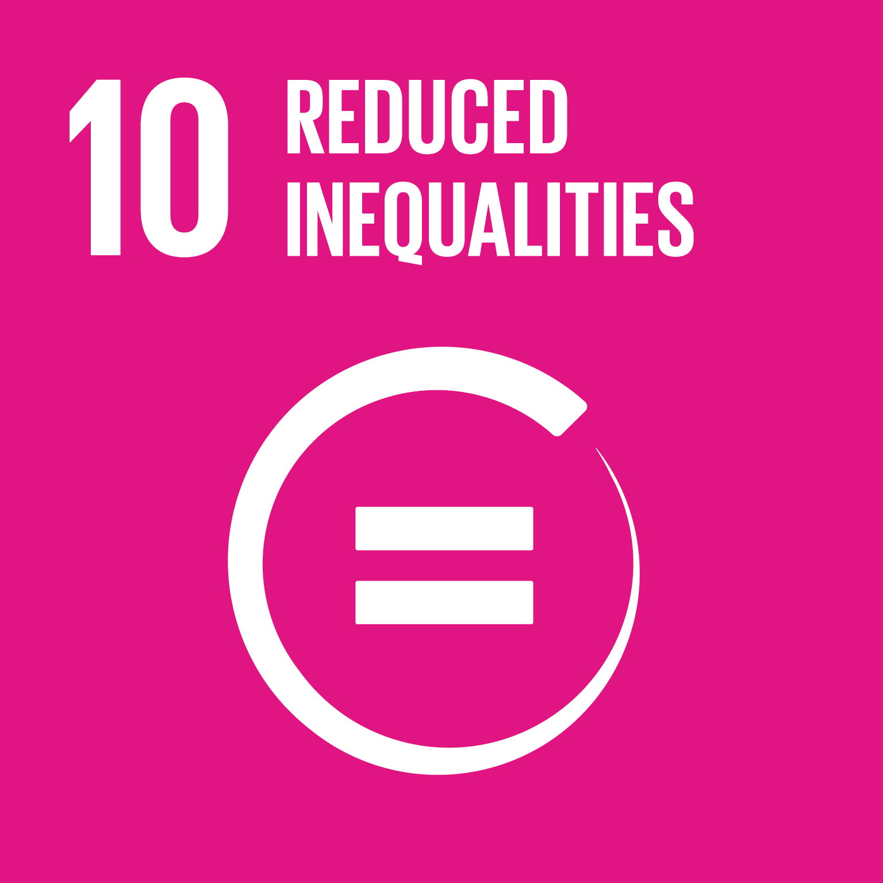
Conflict minerals in surgical instruments & medical equipment
(ERIC FEFERBERG/AFP/Getty Images)
Notes:
Conflict minerals in high tech equipment and surgical instruments, slave or forced labour, unfair working conditions. Do you know how your supplies were made?
Retrieved on the 19 June 2018: https://i.guim.co.uk/img/media/0bce2c46660131d21dd80b98dee6a5cd5023e9f5/0_0_6000_4000/master/6000.jpg?w=620&q=55&auto=format&usm=12&fit=max&s=867a4dc72b65bc6c0e425cfde4fd4610

Slide 5
Bribery & Corruption
https://www.larrysharpe.com/wp-content/uploads/2018/01/HealthcareBriberyImage.jpeg
(ERIC FEFERBERG/AFP/Getty Images)
Photo by Rhett A. Butler.
Notes:
Through the award of contracts, construction of hospitals and healthcare clinics, undue supplier influence on medical practitioners, un-informed consent

Slide 6
Increasing national & international regulations
https://www.agedcareinsite.com.au/wp-content/uploads/2017/11/compliance.jpg
(ERIC FEFERBERG/AFP/Getty Images)
Photo by Rhett A. Butler.
Notes:
Supply Chain Reporting Acts in the EU, UK, USA and incoming to Australia, waste practices, organisation policies on the use of medicines, reputational damage, extensive punitive consequences to individuals and organisations

Slide 7
THIS IS the world your procurers face….
http://www.lynnpickford.com/wp-content/uploads/2013/12/blog-overload-645x300.jpg
Notes:
Procurement is much more complex than just buying ‘stuff’.
Sustainable Procurement is the process of making purchasing decisions that meet an organization’s needs for goods and services in a way that benefits not only the organization but society as a whole, while minimizing its impact on the environment. Making the most POSITIVE impact across environment, social and economic pillars

Slide 8
Sustainability, Procurement, what has this got to do with me?
“Clinicians play an increasingly vital role in supporting a healthy supply chain.” Read more: http://hospitalhealth.com.au/content/clinical-services/article/a-healthy-supply-chain-supports-better-quality-care-456675541#ixzz5IfgSwiVf
Boersma, Martijn, Do No Harm? Procurement of Medical Goods by Australian Companies and Government (2017). Available at SSRN: https://ssrn.com/abstract=2961620 or http://dx.doi.org/10.2139/ssrn.2961620
Notes:
The decisions that YOU make are critical for your procurement team to achieve sustainable outcomes
You hold the budget, you make the calls, your choices matter

Slide 9
ITS IN YOUR HANDS…..
Discuss with your peers at Board and clinical governance levels: do you have commitment to environmental and social sustainability principles in purchasing? YOU CAN SET POLICY & STANDARDS
Inform your choices – ask your purchasers if they know:
WHO you are buying from
WHAT you are buying
WHY you require that type of product
Use your influence – you have the ear of suppliers and manufacturers
Require POSITIVE change to deliver higher quality outcomes that are broader than medical interventions
TOO DIFFICULT? NOT SO!
Notes:
Meet your colleagues, collaborate with your peers. Talk about what you and/or they are doing!
Do you have a public commitment to sustainability principles in your decision making for purchasing? If you do not, you are empowered to have those policies and minimum standards created. You can choose to only work with brands or award contracts to suppliers that credibly demonstrate they do have those commitments AND ARE DELIVERING ON THEM
Meet your procurement team, ask them:
WHO you are buying from – what's their track record? How do they treat their employees? Who are your suppliers suppliers? What due diligence with sustainability criteria has been conducted?
WHAT you are buying, what is in the products you are using? Where did it come from? What is the energy efficiency? What kind of sustainability certification has it achieved?
WHY: think strategically - single use instruments, are they really needed?

Slide 10
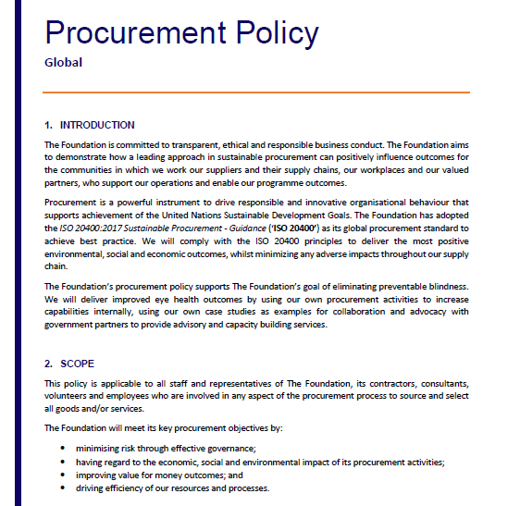
EXAMPLES IN ACTION The Fred Hollows Foundation
A global best practice, Board level endorsed procurement policy.
Commitment to the United Nations Sustainable Development Goals through our considered procurement activities.
Adoption of the ISO 20400:2017 Sustainable Procurement - Guidance (‘ISO 20400’).

Slide 11
EXAMPLES IN ACTION The Fred Hollows Foundation
Continued seed funding of disruptive technology
ARCLIGHT©
Photo source: https://iapb.standardlist.org/wp-content/uploads/2016/06/7155252.jpg
reducing the cost
increasing the access AND the quality
Notes:
In Fred’s footsteps: The arclight. normal ophthalmoscopes approx AUD$800 Arclight – an effective low cost model from AUD$10 Solar & USB charging
Applying the principles of Sustainable Procurement ISO 20400 ethical manufacturing supply chain, Sustainable product design, Renewable technology a core feature, Improved patient experience
Boost was launched yesterday here at WOC….

Slide 12
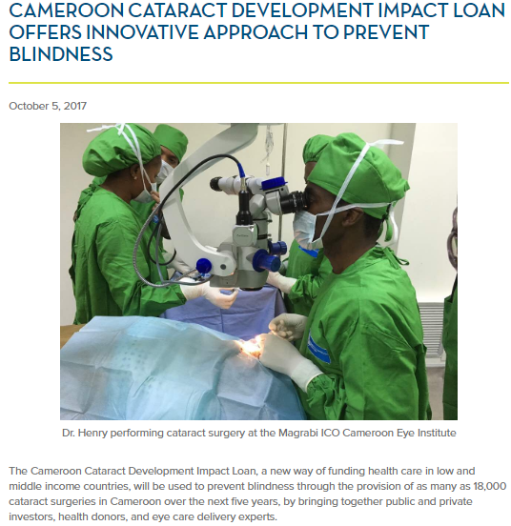
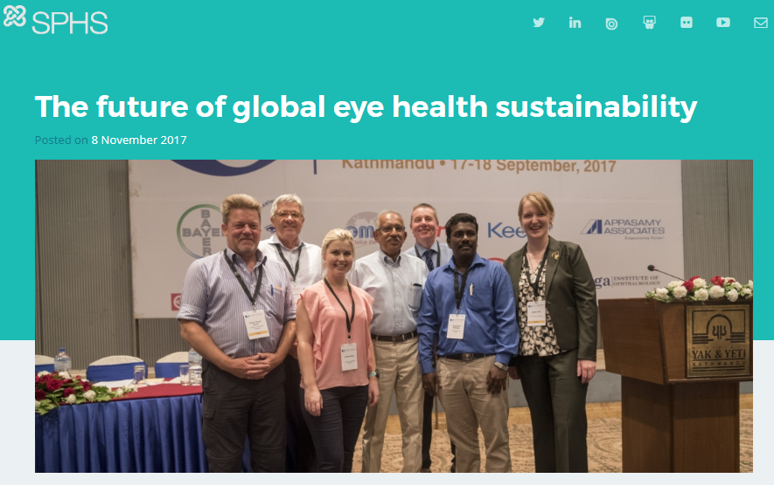
EXAMPLES IN ACTION The Fred Hollows Foundation
Transformative cross-sector collaboration
IAPB Environmental Working Group https://savinglivesustainably.org/news/kK777K.html
https://www.opic.gov/press-releases/2017/cameroon-cataract-development-impact-loan-offers-innovative-approach-prevent-blindness

Slide 13
52 countries involved in developing ISO 20400:2017 – you have local expertise available
65% world population
85% world GDP
73% world CO2 emissions
Notes:
So how do you or you procurement teams navigate the imperatives of transparency and sustainable choices? The sustainable procurement ISO community covers many.
Country Representation: Argentina (IRAM), Brazil (ABNT), Chile (INN), Colombia (ICONTEC), Costa Rica (INTECO), Mexico (DGN), Australia (SA), Barbados (BNSI), Canada (SCC), United States (ANSI), China (SAC), India (BIS), Japan (JISC), Singapore (SPRING SG), Côte d'Ivoire (CODINORM), Egypt (EOS), Nigeria (SON), Rwanda (RSB), Israel (SII), Saudi Arabia (SASO), Austria (ASI), Belgium (NBN), Croatia (HZN), Denmark (DS), France (AFNOR), Ireland (NSAI), Italy (UNI), Netherlands (NEN), Norway (SN), Portugal (IPQ), Serbia (ISS), Sweden (SIS), Switzerland (SNV), Ukraine (DSTU), United Kingdom (BSI)
Observing: Armenia (SARM ), Congo (OCC ), Czech Republic (UNMZ ), Finland (SFS), Gabon (ANTT), Germany (DIN ), Hong Kong (ITCHKSAR), Iraq (COSQC), Korea, Republic of (KATS ), Lithuania (LST ), Poland (PKN), Spain (AENOR ), Thailand (TISI)

Slide 14
Liaisons with international organisations and ISO standards
International organisations
Liaison committees from ISO / PC277
ISO/TC 207 Environmental Management
ISO/PC 278 Anti-bribery Management System
ISO/TC 262 Risk Management
Notes:
You could reach out to any of these inter-governmental agencies who have endorsed or were involved in the development of Sustainable Procurement ISO 20400
European Commission, International Air Transport Association, International Federation of Purchasing and Supply Management , Independent International Organisation for Certification, International Trade Union Confederation, Organisation for Economic Co-operation and Development, United Nations Human Rights Council, Sustainable Purchasing Leadership Council, United Nations Global Compact, United Nations Environment Programme, United Nations Office for Project Services, various International Organization for Standardization groups

Slide 15
WE WORK BETTER TOGETHER
Notes:
Or the current global initiatives that are focused on improving the sustainability outcomes of our the Healthcare sector:
Healthcare Without Harm working with the United Nations Informal Interagency Task Team on Sustainable Procurement in the Health Sector (SPHS)/Saving Lives Sustainably project.
The www.iso20400.org not-for-profit site to contact the global community of Sustainable Procurement ISO experts
And under the umbrella of the International Agency for the Prevention of Blindness: the Environmental Working Group

Slide 16
Tanya Harris
tharris@hollows.org
Notes:
And last but not least of course – The Fred Hollows Foundation

