Slide 1
Environmental Sustainability
&
Aravind Eye Care System
Dr. R.D.Ravindran
Aravind Eye Hospital
Madurai, India

Slide 2
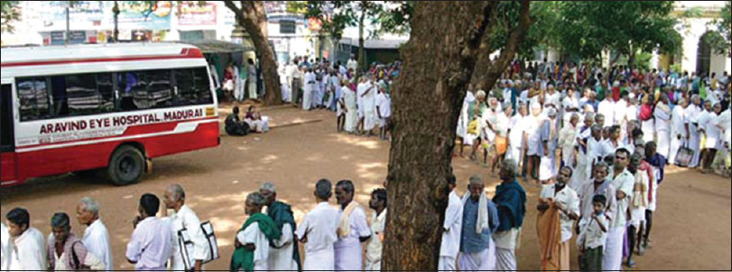
Need for Eye Care
Ophthalmology is one of the high volume outpatient specialties with many repeat patient visits for chronic diseases.
Has a high surgical throughput
Cataract surgery is the commonest elective procedure with a high disposable supplies & materials component

Slide 3
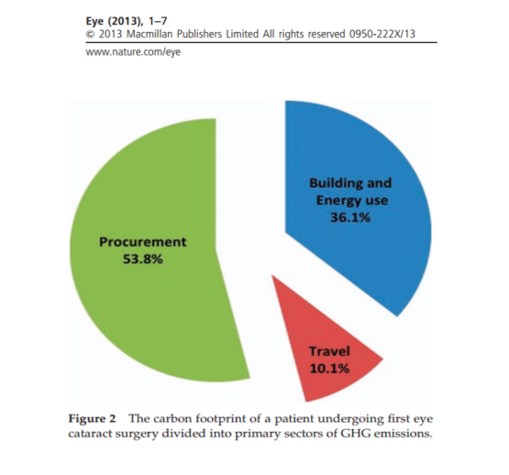
The Carbon Footprint of Cataract Surgery in UK
A single phacoemulsification emits 180kg CO2-equivalents
This is the equivalent of driving a car 500km
Over 50% of these GHG emissions originates in procurement of supplies.
Supplies are largely single-use disposables.
Morris, D. S., T. Wright, J. E. A. Somner and A. Connor (2013). The carbon footprint of cataract surgery. Eye(27): 495-501.

Slide 4
Global Cataract Surgical Volume
Around 26 million surgeries performed in 2017.
Procedure volume is growing at a compounded rate of 3.1 percent per year, driven by demographic changes and increased access to health care
2/3rd by Phacoemulsification procedure

Slide 5




Hospital Process
Access to
Care
Follow up
Diagnose & Advice
Treatment
Transport of staff, visitors, patients & suppliers
Procurement of goods & services
Energy use
Generation of waste

Slide 6
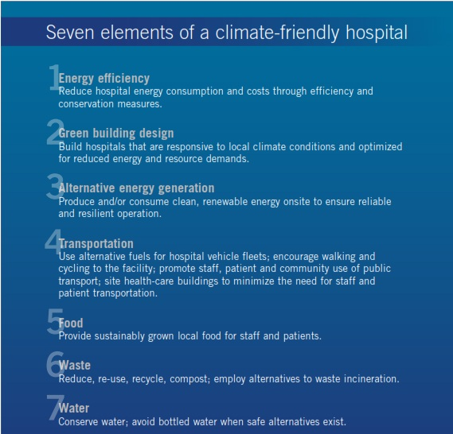

WHO Guidelines for
Climate Friendly Hospital
Energy Efficiency through operational efficiency & Conservation Measures

Slide 7
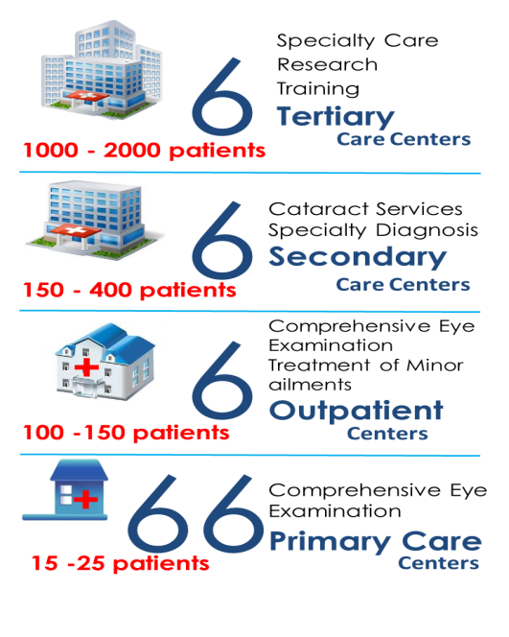
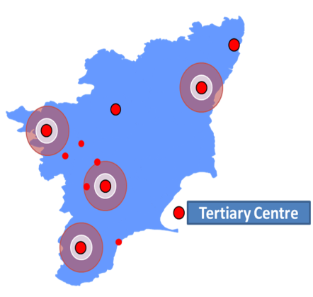

Aravind Eye Hospitals – South India
Serves a population of 80 Million

Slide 8
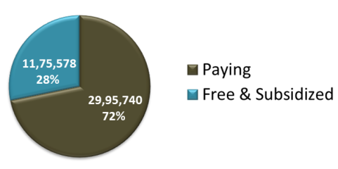
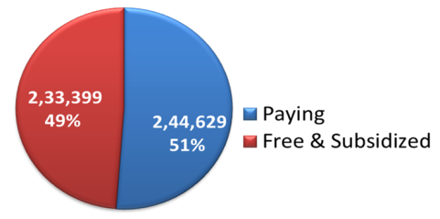
Aravind in 2017-18
4.17 Million
Outpatients examined
478,028
Surgeries and other procedures
Surgeries 50% for free/steeply subsidized

Slide 9
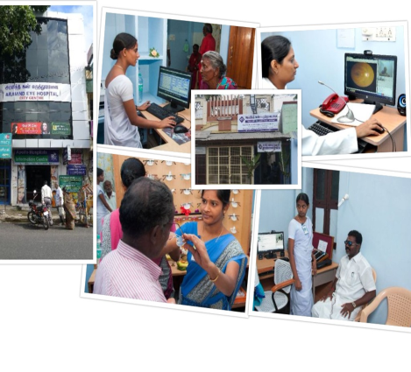
Access to Care in Hospitals
Non Appointment System
Pay & Free services
7 AM – 6 PM

Slide 10
Access to Care through Outreach
Hub and Spoke Model
  VC & CC
  Minimising visits to hospital
Outreach Camps
  Transport Patients alone
Staff Accommodation Within
Hospital Campus

Slide 11
Patient Flow – Work Process
Registration
Escorting
AutoRef
Refraction
IOP
BP
Prelim
Final
Escorting
15
interactions
One person – One task
Effective equipment utilization
Pharmacy
Opticals
Counselling

Slide 12
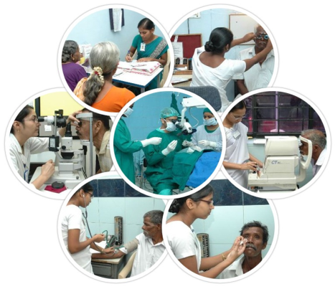
Diagnosis & Advice
Standard operating procedures
System design allows all investigation to be done on the same day
Specialty opinion completed -same day
No waiting period for cataract surgery

Slide 13
Treatment
Completing care cycle in a day / same visit
85% to 90% Spectacle delivered on same day
Patients adviced for surgey admitted on the same day

Slide 14
Surgical Treatment
OR = large carbon footprint
Cataract surgery= High Volume
Cataract surgery= large carbon footprint
High energy consumption
Capital equipment's and surgical instruments
High consumables
Complex waste generated
Water usage- RO, Sterilization
Sustainable Development Unit. Carbon Footprint update for NHS in England 2012 National Health Services (NHS), 2013.
Thiel CL, Eckelman M, Guido R, et al. Environmental Impacts of Surgical Procedures: Life Cycle Assessment of Hysterectomy in the United States. Environmental Science & Technology

Slide 15
Workflow Optimizing Resources
Productivity & Efficiency
Scenario | A | B
Surgeon | 1 | 1
Tables | 1 | 2
Scrub nurse | 1 | 2
Instrument sets | 1 | 6
Surgeries/hour | 1 | 6 - 8
Notes:
An example of optimizing use of scarce resources

Slide 16
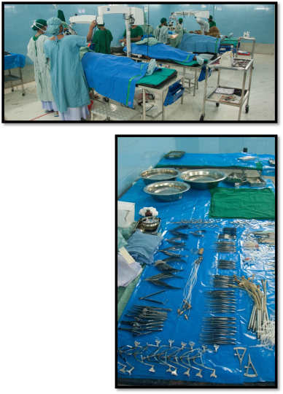
Surgical Protocol @ Aravind
Sharing of supplies
Minimise use of single use instruments
Reuse of single use instruments with strict sterilization protocols
Supply chain management
Waste segregation
Reduce-Recycle- Reuse

Slide 17
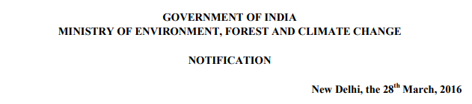
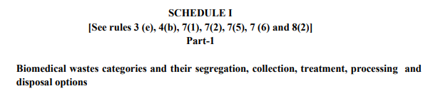
OR Materials Flow & Waste Disposal
Surgery dress & gowns
Surgical gloves
Trays & pans
Cotton swabs, gauze
Syringes IV
Sharps, Needles & blades
Surgical Instruments
Plastic drapes, Packing materials,
Medicine & Consumables containers
Disposed after 8-10 cases
Rub with antiseptic
End of the Session
End of the Session
8-10 Sets
Disposed
Disposed
Disposed
Linen
Flash Autoclave
Disposed
Disposed
End of day
CSSD
BMW
BMW
BMW
CSSD
CSSD
BMW Puncture proof Container
Recycle/ Resale
Recycle/ Resale

Slide 18
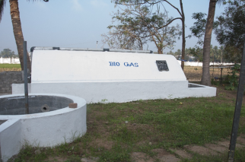
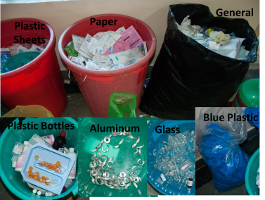
Patient Load & Waste Generation
Mar to May 18
Total OP visits | 1,10,787
Procedures | 22,863
Waste Category | Disposal Type | Mar-18 | Apr-18 | May-18
Biomedical waste- Red | Outsourced Incineration & Landfill | 380 | 420 | 480
Biomedical waste-Yellow |  | 310 | 355 | 420
Resalable waste
Paper waste | Sale to Scrap vendor | 1187 | 653 | 1644
Polythene waste |  | 89 | 108 | 89
Plastic Container |  | 63 | 109 | 78
Big bottle- Glass |  | 800 | 225 | 255
Small bottle- Glass |  | 90 | 138 | 97
Lens cover |  | 24 | 20 | 18
Plastic paper |  | 97 | 97 | 124
Card board |  | 622 | 581 | 540
Food waste | To pig farm and Biogas | 92 | 79 | 92
Waste Includes both Outpatient and Inpatient from Mar to May

Slide 19
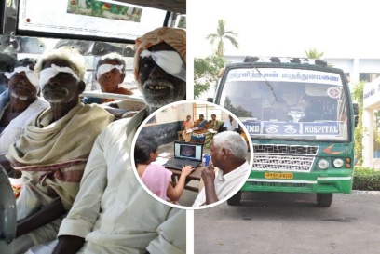
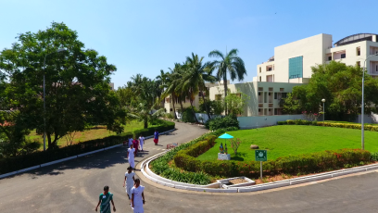
Transport
Reducing patients visits
Providing bus to outreach camps to shift patients
Encouraging patients for follow-up in satellite centers
90% of staff live within the campus an walk to work

Slide 20
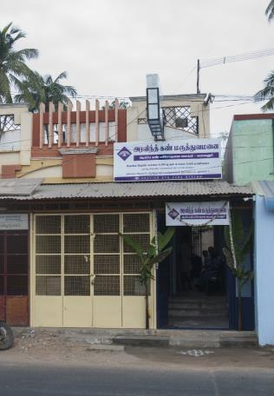
Patients from Satellite Centers
Promoting daycare surgery
  Reduce hospital resources
  Reduce food waste & other general waste
Post Op and follow-up care at vision centers
  Reduce patient travel
  Increase patient footfalls

Slide 21
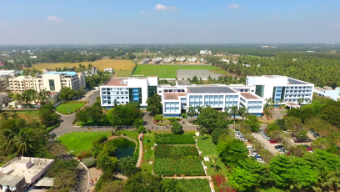
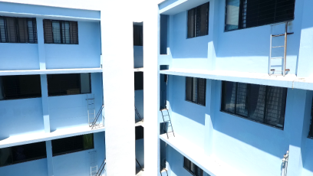
Green Building
Natural ventilation
Natural Light
Garden & Vegetation
Foot path

Slide 22
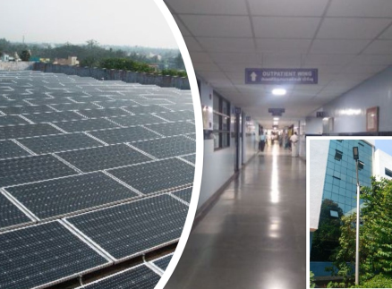
Energy efficiency
Air-conditioning only at Key areas
Conventional lights converted to LED
Effective utilization of equipment's
Staff and Patients awareness
Effective Instrument and electricity maintenance
Installation off clean energy
Solar generation 2,09,530 unit/Year
Financial Savings 11,00,00 /Year
CO2 reduction 2,00,000 kg/year

Slide 23
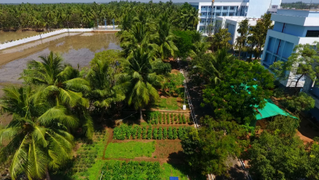
Food
  Reducing food wastage from Cafeteria
    Restricted menu .
    Full meal to Mini meal
Creating awareness to staff and patients
  Display waste of previous day

Slide 24
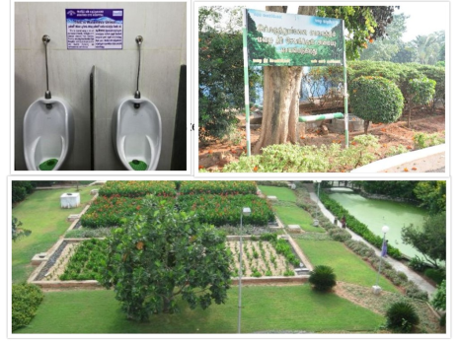
Water
Waste water treatment plant
  Decentralized waster water plant treats over 90% of water used
  Used of gardens
Rain water Harvesting
Reducing water consumption
  Reduced water flow in tap

Slide 25
Taking this forward
    To take this initiative to our other facilities and with our partnership organizations
    Will Make hospital’s operations more environmentally friendly
    These efforts would benefit the facility by reducing cost

Slide 26
Leadership
High level commitment
Raising staff awareness and Staff engagement
Identifying and implementing opportunities
Taking the message forward

Slide 27
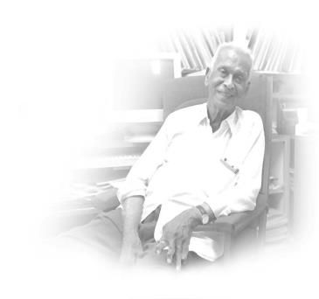
Thank you
“Intelligence & capabilities are not enough.
There must be the joy of doing something beautiful..”
            Dr.G.Venkatasamy
            Founder - Aravind eye care system

