Slide 1
Future proofing occupational therapy in mental health through sustainable commissioning
COT Annual Conference 30/06/2016
Daniel Maughan (Associate Registrar in Sustainability, RCPsych)
Ben Whittaker (Occupational Therapy Programme Lead, CSH)

Slide 2
What are the factors that affect the ability of mental health services to be sustained?

Slide 3
What is sustainable development?
Development that meets the needs of the present without compromising the ability of future generations to meet their own needs
(WCED 1987)
Social
Sustainable development
Environmental
Economic

Slide 4
outcomes
costs
value =
economic
social
environmental
Notes:
Slide from: Mortimer (2013).

Slide 6
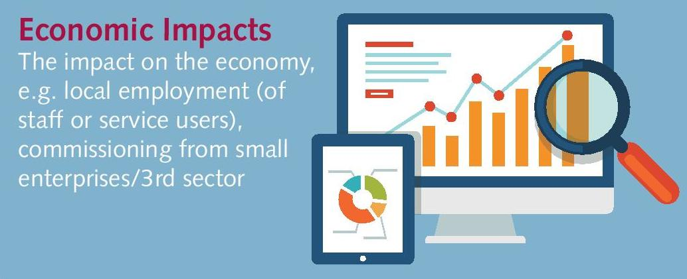
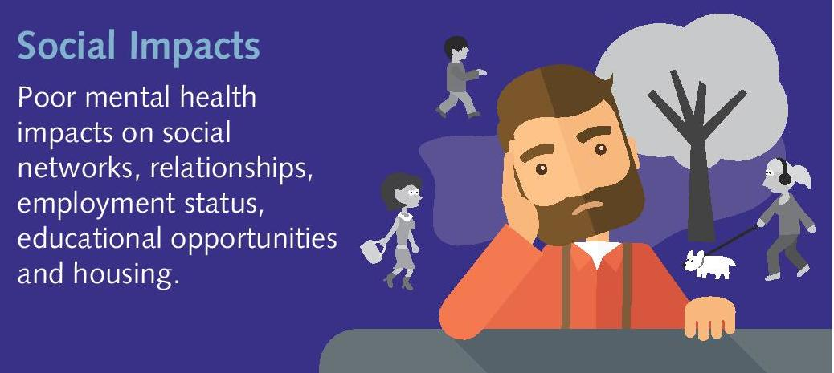

Slide 7
Total health expenditures as percentage of GDP

Slide 8
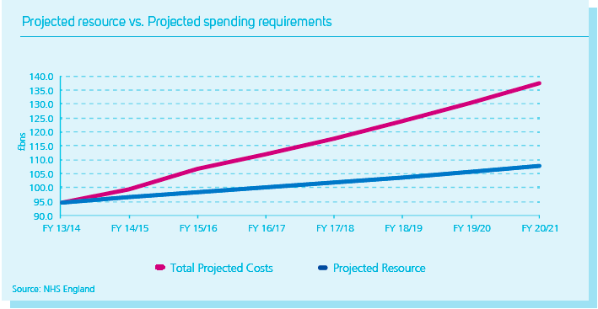

Slide 10
“…every year climate change leaves over 300,000 people dead, 325 million people seriously affected, and economic losses of US$125 billion. Four billion people are vulnerable, and 500 million people are at extreme risk.” (GHF 2009, p1)

Slide 11
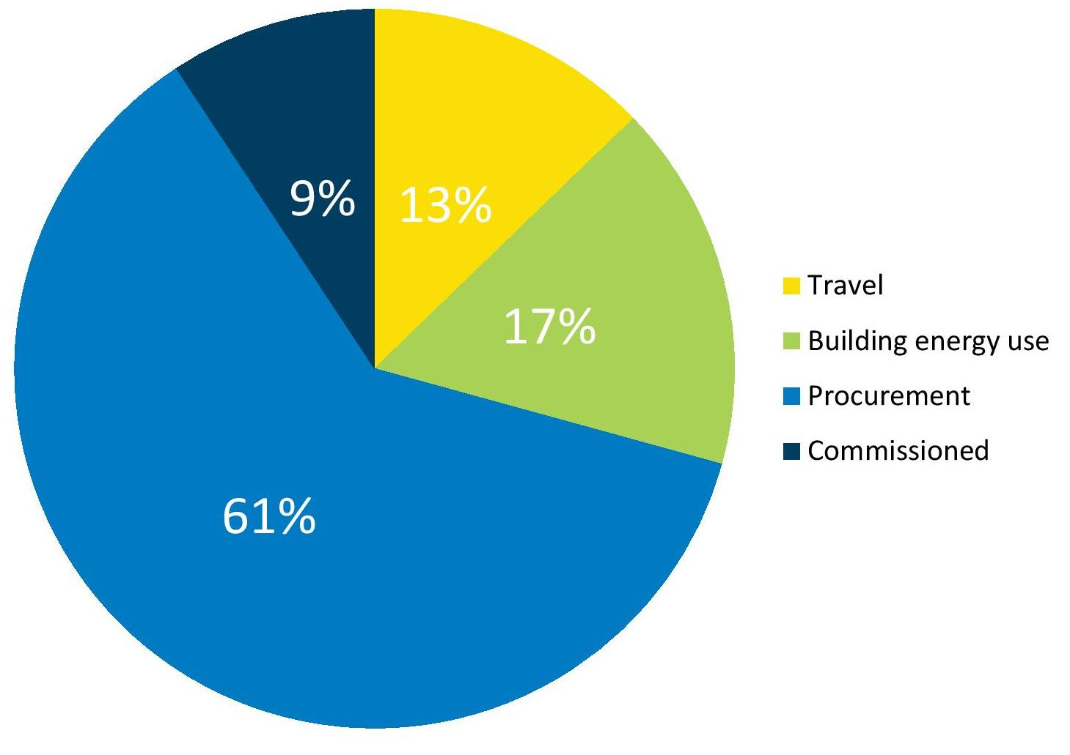
Nhs CARBON FOOTPRINT 2012

Slide 13
Social Sustainability
Defn: Restoring the social capital that is lost through mental illness
Social capital: housing, employment; educational opportunities, community connectedness
OT approach enables social capital to be restored
OT outcome measures can audit social sustainability of services

Slide 14
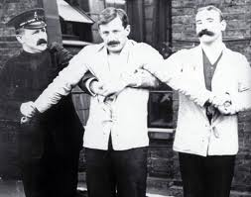
?

Slide 15
INDIVIDUAL
ILLNESS
INTERVENTION
COMMUNITY
HEALTH
RESILIENCE
Sustainable health care system
Over-burdened health care system
Chronically unwell patients
Healthy
community

Slide 16
principles of sustainable practice
Secondary drivers
Reduce carbon without reducing health
Reduce activity
Prevention
Self care
Reduce carbon intensity
Low carbon alternatives
Lean pathways
Sustainable estates
Primary driver
Outcome needed
Sustainable clinical practice
Primary driver
Infrastructure & process
CENTRE for
SUSTAINABLE
HEALTHCARE
Mortimer-F. The Sustainable Physician
Clinical Medicine 2010, Vol 10, No 2: 110–11

Slide 17
What mental health services have you worked in that weren’t sustainable?
Why weren’t they sustainable?

Slide 18
A FOCUS ON VALUE

Slide 19
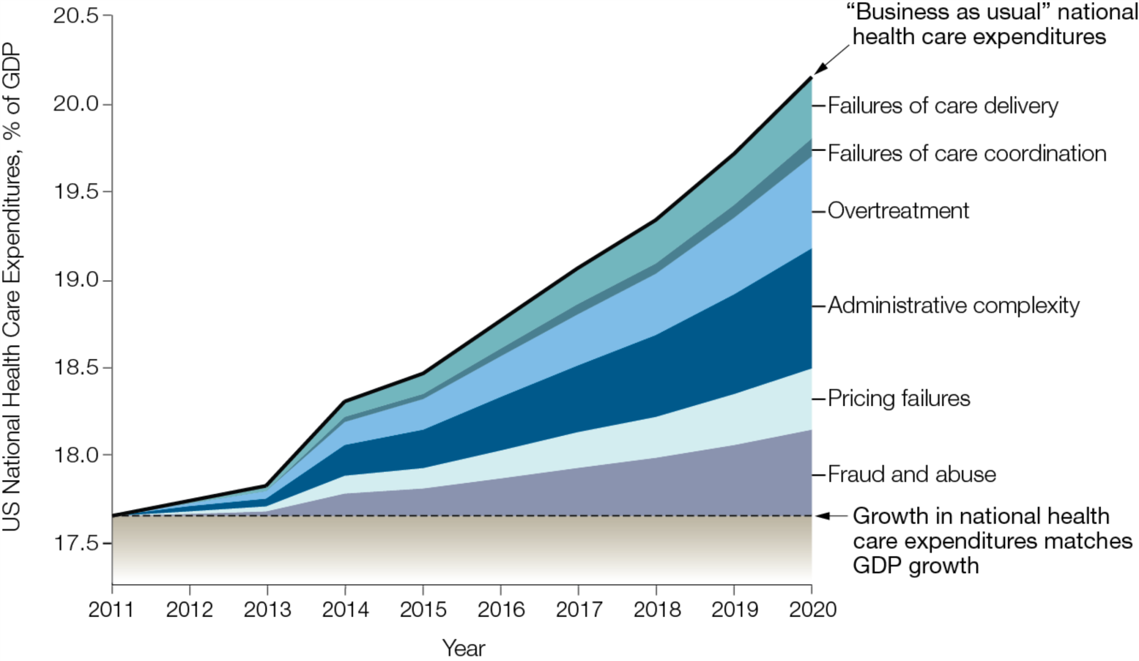
Berwick D. JAMA. 2012.

Slide 20
Overtreatment
When:
treatment brings no benefit to the service user
there is a lack of evidence
the harms outweigh the benefits
a treatment is excessive in complexity, duration or cost

Slide 21
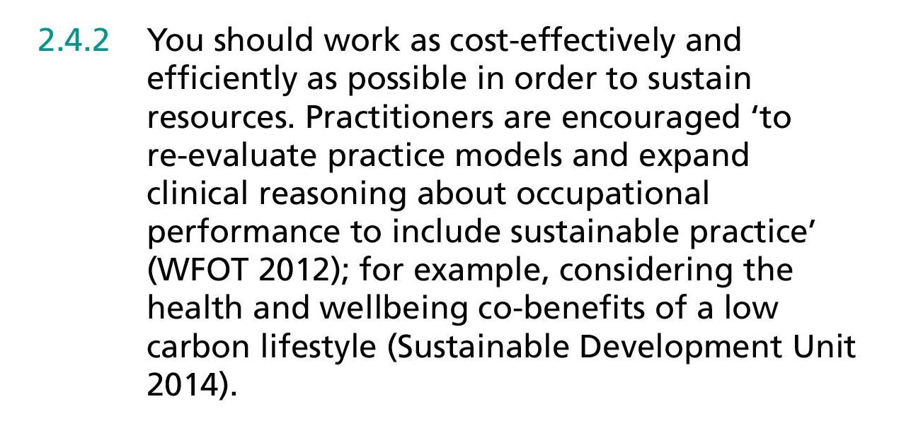
COT CODE OF ETHICS AND PROFESSIONAL CONDUCT

Slide 22
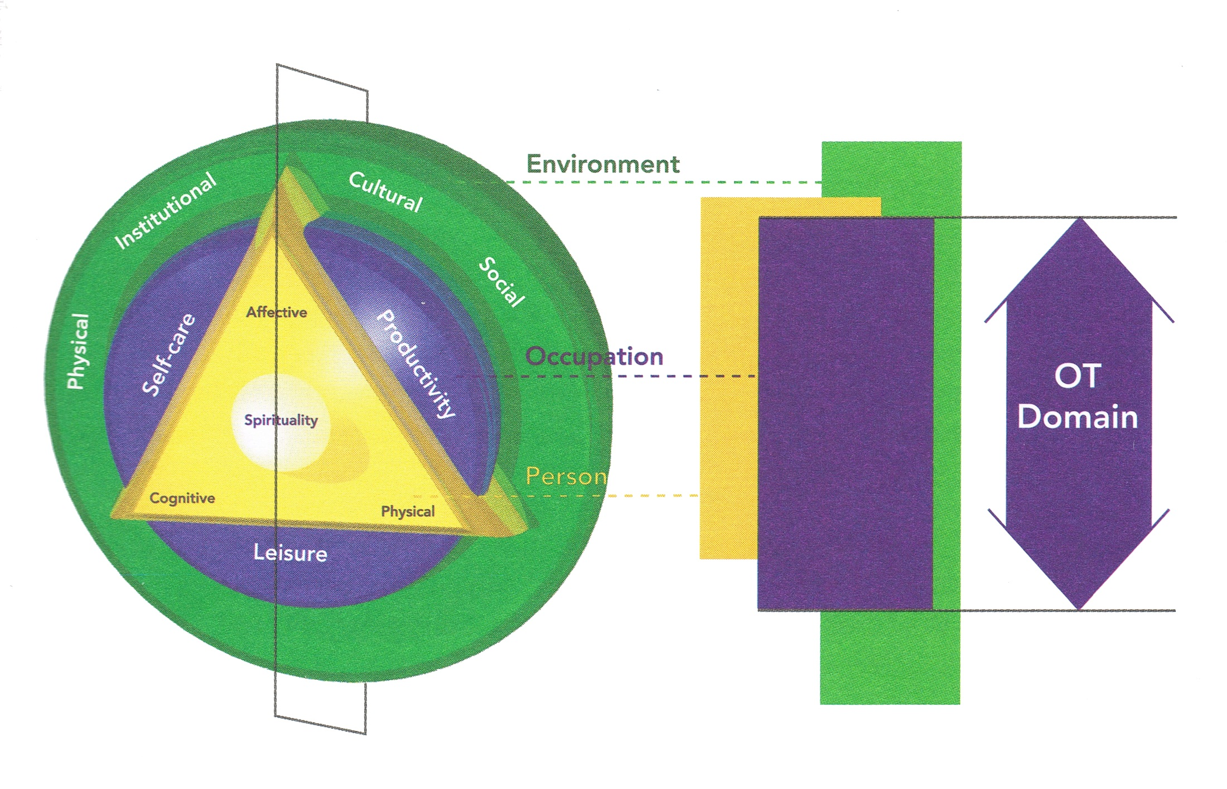
Canadian Model of Occupational Performance and Engagement (CMOP-E) (Polatajko, Townsend & Craik, 2007)

Slide 23
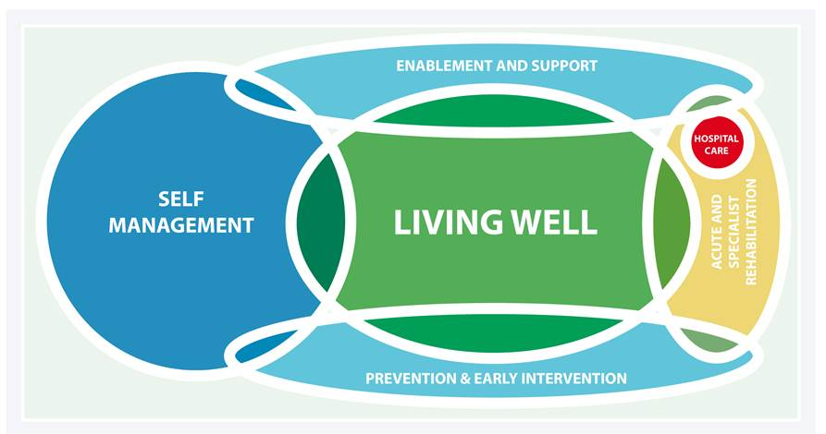
Care model for a healthy life
(Sustainable Development Unit 2014)

Slide 24
What would a sustainable mental health service look like?

Slide 25
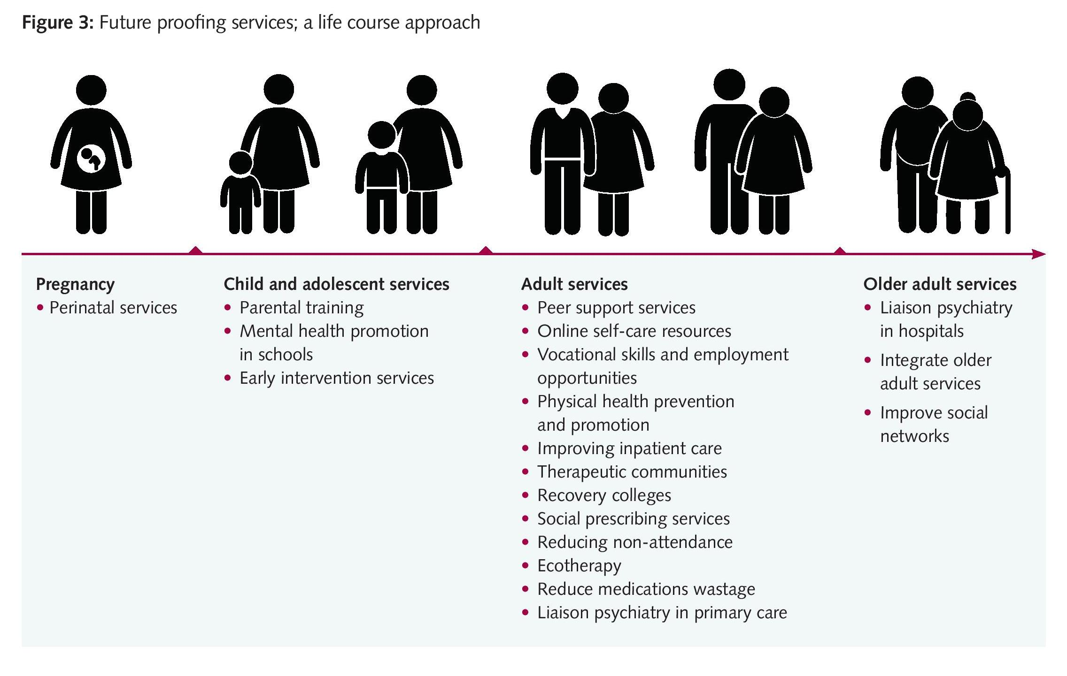

Slide 26
What is one change you’d make for your service to be more sustainable?
Make a pitch to commissioners

Slide 27
A sustainability lens
Sustainability is a new lens to ‘future proof mental health services’

Slide 28
Health of population
Health costs
Sustainable
health care
=
Economic
Environmental
Social

Slide 29
Sustainable approaches
OT approach
Embed sustainable health care principles
Work with third sector/primary health/community structures
Wise stewardship of resources across the triple bottom line

Slide 30
Thank you
“The future depends on what you do today.”
― Mahatma Gandhi

