Slide 1

Green Impact in dental practices
Kim Croasdale
Sustainability Project Officer, Sustainability Department, National Union of Students

Slide 2
Why NUS?
NUS is a confederation of 600 students’ unions, operating as a fully democratic organisation
We’re led by a team of elected student officers and our policies are voted in by students
80% of students want their institution to do more on sustainability
60% of students want to learn more about it
70% of students are concerned about the effects of climate change
Notes:
DON’T SPEND TOO MUCH TIME ON THIS

Slide 3
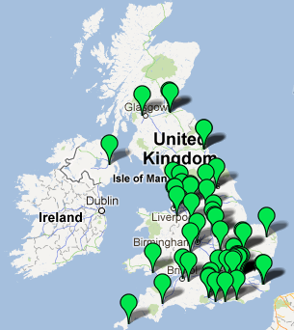
The national stats
Last year:
72 off-campus organisations
62 universities and colleges
114 students’ unions
Over 55,000 actions completed
Over 1,000 students trained
Notes:
This is a standardised outline: feel free to change the timings and details to suit your training, adding a institution specific photo too if you fancy ☺
Talk them through this briefly.

Slide 4
What is Green Impact?
A sustainability accreditation scheme
Giving people simple, straightforward actions to make themselves and their workplace more sustainable and environmentally-friendly
Rewarding people for their efforts and hard work
Notes:
Go through cycle briefly
Workbook
Forming teams
Completing actions
Audits
Rewards
M&E

Slide 5
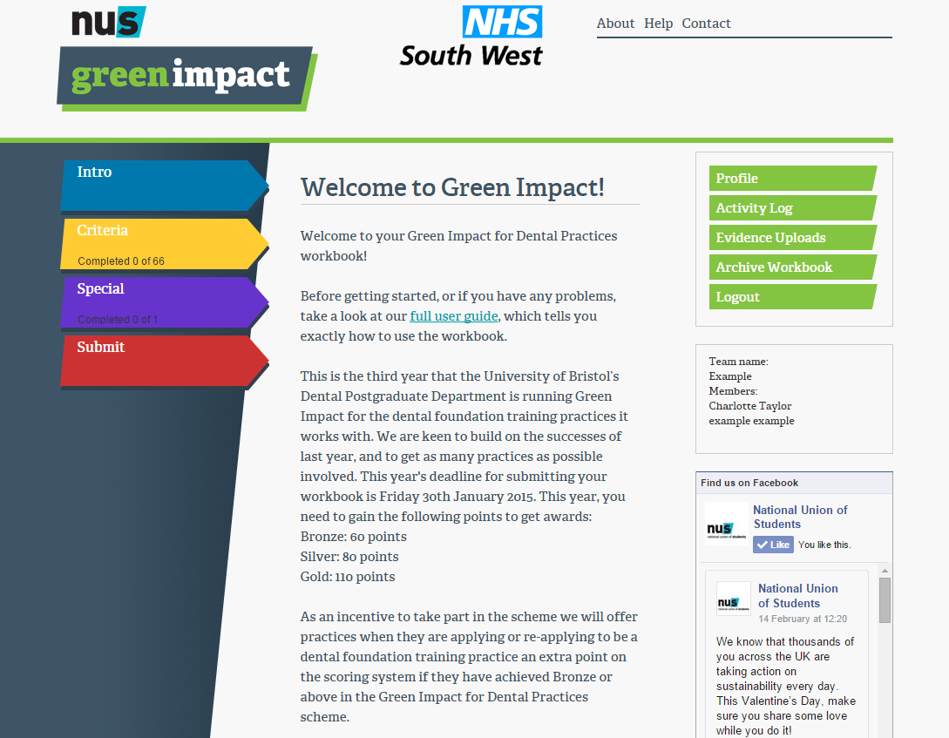
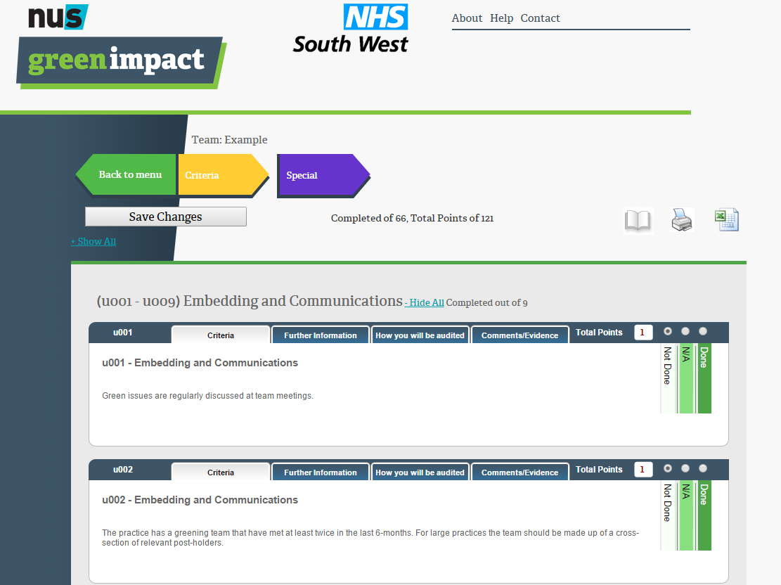
The workbook

Slide 6
Why dental practices?
Grew out of the University of Bristol programme
Similar challenges to offices
  As well as carbon-intensive procedures
Advice and ideas about what can be done

Slide 7
The kinds of things we ask
Simple actions:
  “All printer/toner cartridges are recycled by the practice.”
More complex actions:
  “Within the last 6 months, the practice has carried out a basic walk-around to identify areas that are being heated unnecessarily and taken action to save energy as required.”
Encouraging health and teamwork:
  “Practice staff are encouraged to bring and share healthy food, AND at least twice a year, the team have a 'bring and share' healthy lunch.”
Strategic actions:
  “The practice has a corporate social responsibility policy and/or strategy. ”
Dentistry-specific actions:
  “The practice has a policy to implement the Minamata Convention on the phase-down of amalgam and relevant staff have been trained on this.”

Slide 8
How were these decided?
Initial audits of a small sample of practices
Discussions with the Postgraduate Dental Unit
Dental consultant advising
Policies, health and safety
Continually monitoring and evaluating
Notes:
Audits highlighted good practice that could be shared and things that we could help to improve
Health and safety has an interesting effect – some see them as easy wins useful for checking up, others see them as a waste of time because they’re already done for other reasons
M&E happens every year, we are making the workbook more and more specific to dentistry and are also currently considering having different workbooks for practices of different sizes

Slide 9
How do people respond?
“It helps us save money and it’s good for business as well.”
“We found that we were doing lots anyway, and it points us in the right direction for other things…It’s a tough industry to be green in!”
“This year we concentrated on the charity aspect. Everyone finds it interesting and likes to improve personally.”
“We’ve introduced travel mugs for our staff so their tea doesn’t get cold and we don’t boil the kettle as much – it actually also means they don’t get stuff dropping in their drinks!”

Slide 10
Our achievements
Over 40 practices involved
2013/14:
  483 staff directly involved in the scheme
  2055 actions completed (836 as a result of the scheme)
  Saved up to an estimated 52 tonnes CO2 and over £8,000 from staff and patients switching off lights*
*Estimations made using The Carbon Trust’s Empower Carbon Calculator
Notes:
Our analysis has to be based on actions rather than carbon figures because we have no robust tool to interrogate the data
We use the Carbon Trust’s Empower Carbon Calculator, which is based on offices and actions such as switching off lights and computers, depending on members of staff engaged. Would be really great to have a tool we could use that could give a more accurate reflection of what practices could be saving.
Tried to use energy bills from certain surgeries but proves difficult to get hold of the data!

Slide 11
Thank you!
Kim Croasdale, Sustainability Project Officer
Kim.Croasdale@nus.org.uk
07584 630392

