Slide 1
Environmental Sustainability for Ophthalmology
Dept. of Population Health Dept. of Ophthalmology
Cassandra L Thiel, PhD
19 June, 2018
WOC – Masterclass in Environmental Sustainability
Author has no financial disclosures or conflicts of interest related to this topic. Images are not meant to support or criticize any particular company, product, or health system.

Slide 2
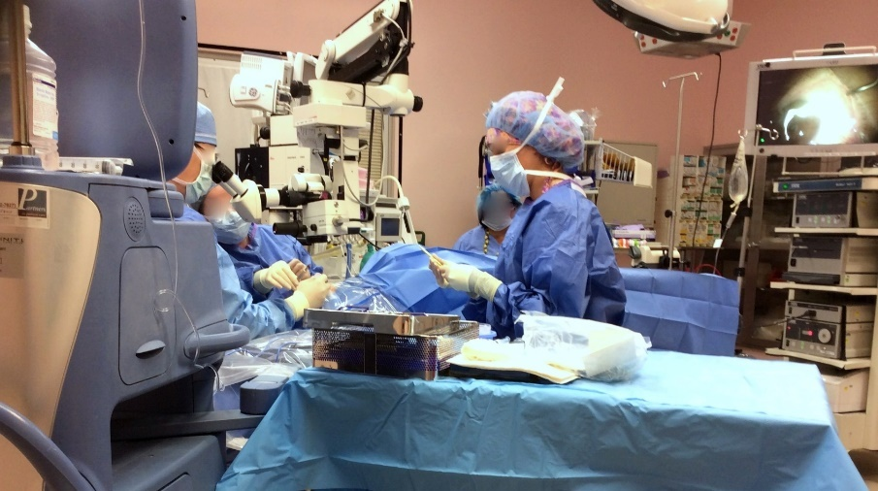
“Tackling climate change could be the greatest global health opportunity of the 21st century.”
Healthcare creates
10% of US’s GHGs
5% of UK’s GHGs
7% of Australia’s GHGs
“If the US health care sector were itself a country, it would rank 13th in the world for GHG emissions, ahead of the entire U.K.”
Eckelman, M. J. and J. Sherman (2016). "Environmental Impacts of the U.S. Health Care System and Effects on Public Health." PLoS ONE 11(6): e0157014.
Sustainable Development Unit. (2016). Carbon Footprint update for NHS in England 2015. Retrieved from http://www.sduhealth.org.uk/documents/publications/2016/Carbon_Footprint_summary_NHS_update_2015_final_v2.pdf
Malik, A., Lenzen, M., McAlister, S., & McGain, F. (2018). The carbon footprint of Australian health care. The Lancet Planetary Health, 2(1), e27-e35. doi:https://doi.org/10.1016/S2542-5196(17)30180-8
Watts N, Adger WN, Agnolucci P, et al. Health and climate change: policy responses to protect public health. Lancet 2015; published online June 23. http://dx.doi.org/10.1016/S0140-6736(15)60854-62.
Costello A, Abbas M, Allen A, et al. Managing the health effects of climate change: Lancet and University College London Institute for Global Health Commission. Lancet 2009; 373: 1693–733.

Slide 3
The Carbon Footprint of Cataract Surgery (in the UK)
Morris, D. S., T. Wright, J. E. A. Somner and A. Connor (2013). "The carbon footprint of cataract surgery." Eye(27): 495-501.
A single phacoemulsification emits about 180kg CO2-equivalents (this is about one week of “living” for the average Brit).
Over 50% of these GHG emissions originates in procurement of supplies.
Supplies are largely single-use disposables.
How can we improve sustainability in eye care and eye health?
Venkatesh, R., S. W. van Landingham, A. M. Khodifad, A. Haripriya, C. L. Thiel, P. Ramulu and A. L. Robin (2016). "Carbon footprint and cost–effectiveness of cataract surgery." Current Opinion in Ophthalmology 27(1): 82-88.

Slide 4
Setting Priorities

Slide 5
Where to focus your green energies?
Clinical
Non-Clinical
Notes:
Clinical areas typically represent the largest use of resources, largest waste generation, and largest spending = largest opportunity. BUT typically have more regulations, policies, liabilities, and risks.
Non-clinical areas are easier to get started on, but may have lower yields. HOWEVER, you can generate MORE interest in projects here.

Slide 6
Where to focus your green energies?
Facility & Utilities
Process & Supplies (Operations)
Notes:
Clinical areas typically represent the largest use of resources, largest waste generation, and largest spending = largest opportunity. BUT typically have more regulations, policies, liabilities, and risks.
Non-clinical areas are easier to get started on, but may have lower yields. HOWEVER, you can generate MORE interest in projects here.

Slide 7
Top-Down or Bottom-Up?
Sphere of Influence
Organizational Size & Structure
Outside
Organization
Division
Unit/Office
Office Group
Image: https://www.youtube.com/watch?v=FpQEwbAV3Qw

Slide 8
Gathering Ideas

Slide 9
From the Literature

Slide 10
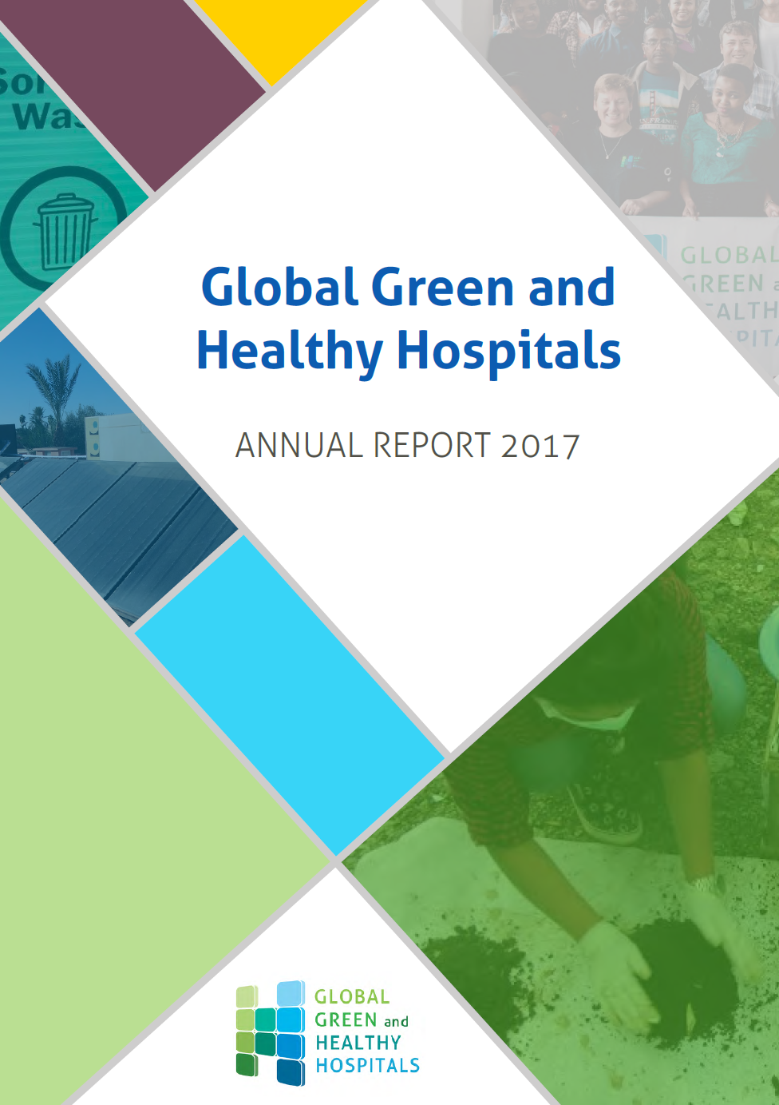
Lots of literature

Slide 11
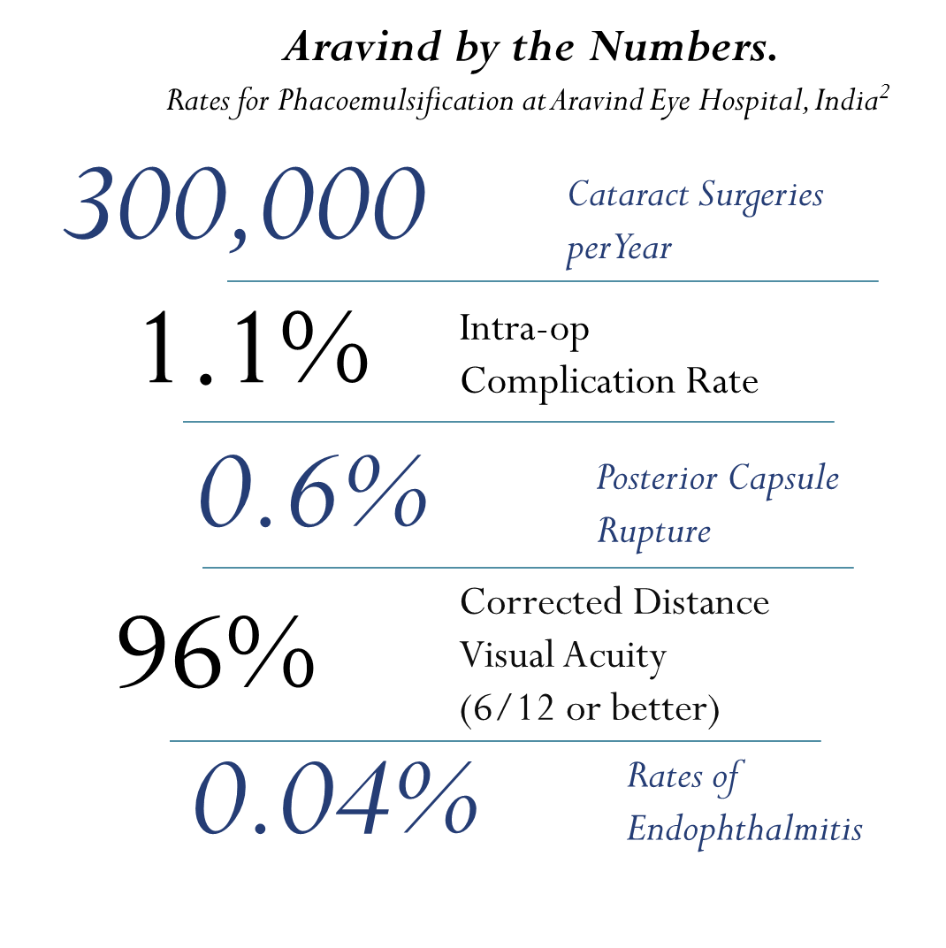
A Note about Aravind Eye Care System, the Special Case in this Study Rangan VK, Thulasiraj RD. Making Sight Affordable (Innovations Case Narrative: The Aravind Eye Care System). Innovations: Technology, Governance, Globalization 2007;2(4):35-49. Rangan VK. The Aravind eye hospital, Madurai, India: in service for sight: Harvard Business School, 1993. Haripriya A, Chang DF, Reena M, Shekhar M. Complication rates of phacoemulsification and manual small-incision cataract surgery at Aravind Eye Hospital. J Cataract Refract Surg 2012;38(8):1360-9. TED talk: https://www.ted.com/talks/thulasiraj_ravilla_how_low_cost_eye_care_can_be_world_class

Slide 12
Waste Generation in the OR
1 Cataract Removal, Phaco (USA)
93 Cataract Removals, Phacos (Aravind, India)
Awarded “best paper” at American Academy of Ophthalmology’s (AAO) Annual Meeting. Chicago, IL. 2016

Slide 13
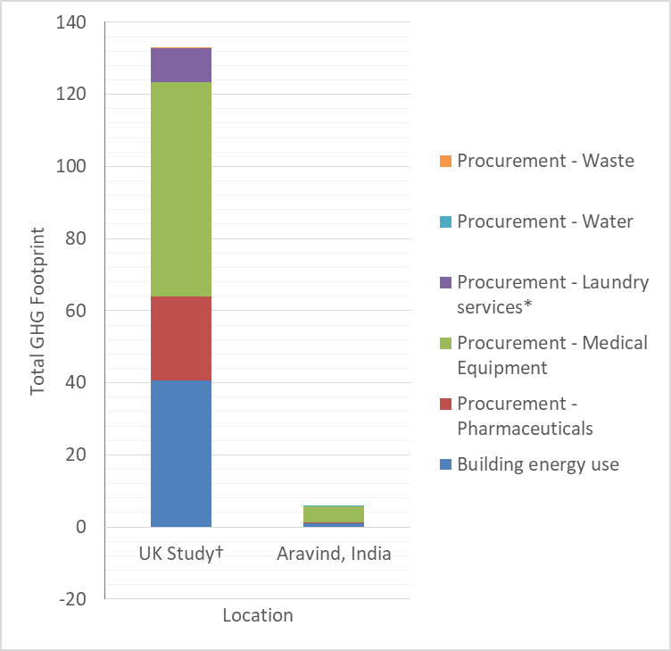
Carbon Footprint of Average Single Phacoemulsification at Aravind and the UK
Published in: Thiel, C., et. al (2017). Cataract surgery and environmental sustainability: Waste and lifecycle assessment of phacoemulsification at a private healthcare facility. Journal of Cataract & Refractive Surgery, 43(11), 1391-1398. doi: https://doi.org/10.1016/j.jcrs.2017.08.017
500km (UK)
†Modified to match system boundaries, from Morris, D. S., T. Wright, J. E. A. Somner and A. Connor (2013). "The carbon footprint of cataract surgery." Eye(27): 495-501.
25 km (Aravind)

Slide 14
From your Colleagues and Peers

Slide 15
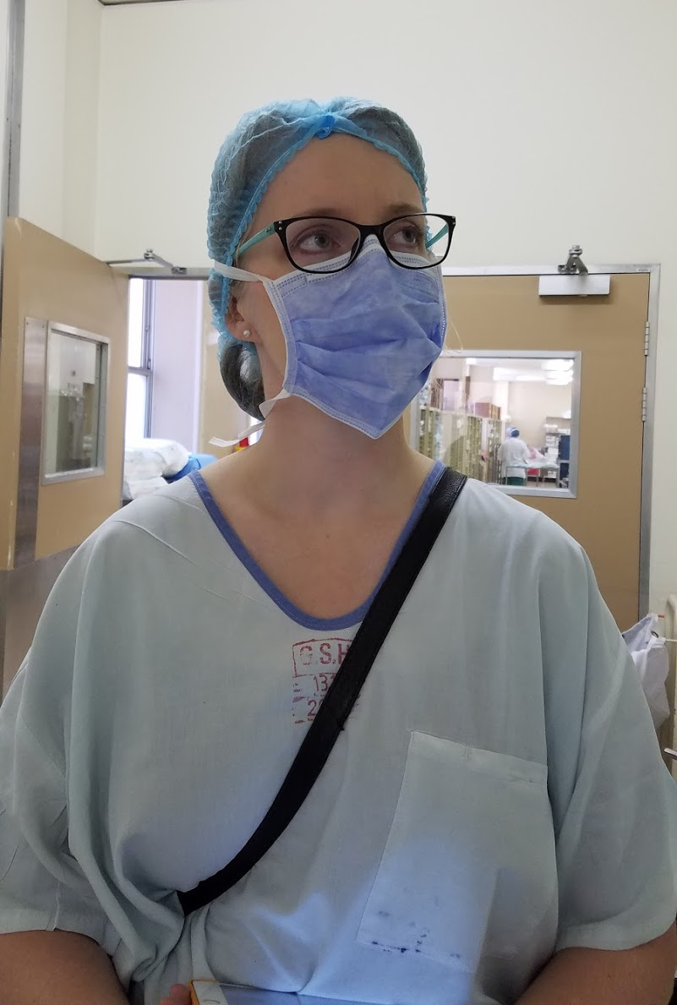
The Importance of the Interdisciplinary
Infection Control
Regulatory Compliance
Clinicians
Pharmacy
Supply Chain
Waste Management
Building Services
…

Slide 16
Changing for the better

Slide 17
In the operating room (theatre).

Slide 18
(Energize.) Observe. Measure. Record. Repeat.

Slide 19
Observing Surgical Prep (USA)
Weighing Drug Waste

Slide 20
Find Your Barriers & the Scope of Your Problem
Root Cause Analysis
Why?
Why?
Why?
Why?
Why?

Slide 21
Calculate the TOTAL Cost
From ISO 20400: Sustainable Procurement Guidance

Slide 22
Rethink Your Process
With the Information You Collected

Slide 23
A Note about Aravind Eye Care System, the Special Case in this Study Rangan VK, Thulasiraj RD. Making Sight Affordable (Innovations Case Narrative: The Aravind Eye Care System). Innovations: Technology, Governance, Globalization 2007;2(4):35-49. Rangan VK. The Aravind eye hospital, Madurai, India: in service for sight: Harvard Business School, 1993. Haripriya A, Chang DF, Reena M, Shekhar M. Complication rates of phacoemulsification and manual small-incision cataract surgery at Aravind Eye Hospital. J Cataract Refract Surg 2012;38(8):1360-9. TED talk: https://www.ted.com/talks/thulasiraj_ravilla_how_low_cost_eye_care_can_be_world_class
Task shifting
Side-by-side surgeries
Hub-and-spoke systems
Reusable or recyclable materials
Immediate use, same day sterilization
…

Slide 24
Simultaneous Bi-Lateral Surgery?

Slide 25
Reduce, Reuse, Recycle
What you use to provide excellent care.
(In That Order)

Slide 26
Energy Use Image: https://gundersenenvision.wordpress.com/2015/03/12/envision-can-help-with-building-design/

Slide 27
Waste Generation in the OR
1 Cataract Removal, Phaco (USA)
93 Cataract Removals, Phacos (Aravind, India)
Awarded “best paper” at American Academy of Ophthalmology’s (AAO) Annual Meeting. Chicago, IL. 2016

Slide 28
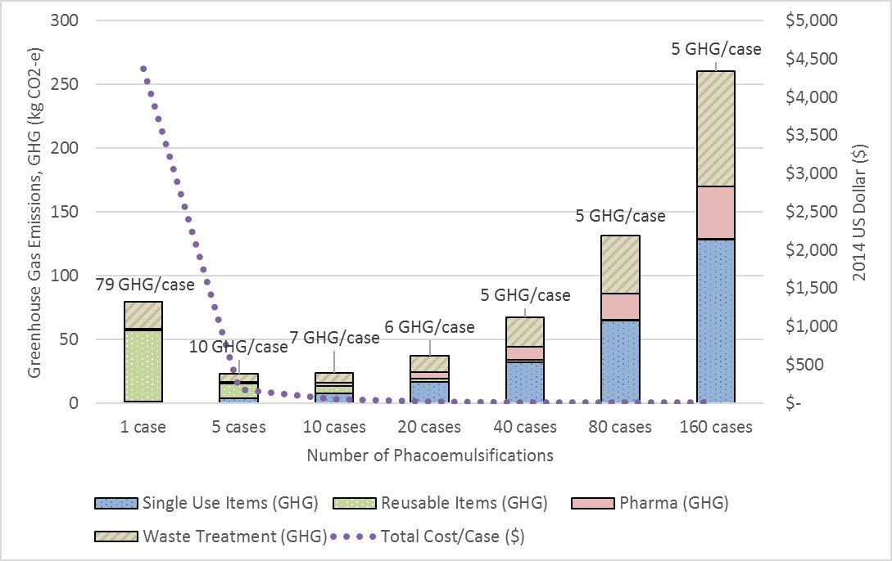
(Safely) Reusing Surgical Supplies Reduces Cost and Carbon Footprint per Case
Published in: Thiel, C., et. al (2017). Cataract surgery and environmental sustainability: Waste and lifecycle assessment of phacoemulsification at a private healthcare facility. Journal of Cataract & Refractive Surgery, 43(11), 1391-1398. doi: https://doi.org/10.1016/j.jcrs.2017.08.017

Slide 29
Greenhouse Gas emissions from Laparoscopic Hysterectomy Thiel, C. L., Woods, N. C., & Bilec, M. M. (2018). Strategies to Reduce Greenhouse Gas Emissions from Laparoscopic Surgery. American Journal of Public Health, 108(S2), S158-S164. doi: 10.2105/ajph.2018.304397
Reduce
Reuse
Recycle

Slide 30
Your Turn

Slide 31
Write down:
Your name
Your role in your medical facility
Your sphere of influence (roughly)
In your day-to-day job, what do you think is particularly wasteful? What could be better? (Make a list!)
Outside
Organization
Division
Unit/Office
Office Group
5 MINUTES

Slide 32
Focus: Pick one of those issues
Who needs to be involved to design an effective solution? Ex: infection control, supply chain/procurement, waste management, building services/housekeeping, nursing, leadership, trainees, patients, etc.
How will you know if you’re making a difference (which data will you need to measure?) Ex: cost, outcomes, patient satisfaction, waste generation, kilowatt hours of electricity, liters of cleaning solution, etc.
What steps will you take when you leave here to get this started?
5 MINUTES

Slide 33
Trade with your neighbor
Answer the 5 Why’s
Who else might need to be involved to tackle this project?
Is there anything you might have to be watchful for? (ex: laws or regulations, safety issues, politics?)
Is this an issue unique to this facility, or something that could be done anywhere?
8 MINUTES

Slide 34
Find Your Support Group

Slide 35
Online forums by specialty: http://networks.sustainablehealthcare.org.uk
Royal College Sustainability Work Group
International Organization with GGHH forum and Annual CleanMed Conference
IAPB Environmental Sustainability Work Group

Slide 36
Other Ophthalmology Sustainability Events and Groups
ICO’s World Ophthalmology Congress (WOC) in Barcelona, Spain, 16-19 June
Posters on cataract pharmaceutical waste and the Eyefficiency surgery audit tool
International Agency for Prevention of Blindness (IAPB)
Newly formed Sustainability Working Group
Their 2020 General Assembly in Auckland New Zealand will have a “Sustainability” theme
Aravind Eye Hospital in Pondicherry hosting a summit on “Eye Care Delivery and Environmental Impact – Creating Environmentally Sustainable Eye Care Delivery”
21 & 22 September, 2018

Slide 37
Economy
Equity / Quality
Environment
Sustainability “Triple Bottom Line”
Addressing human industrial systems and consumption so that we meet our needs without compromising future generations’ ability to meet their needs.
☺
Sustainability

Slide 38
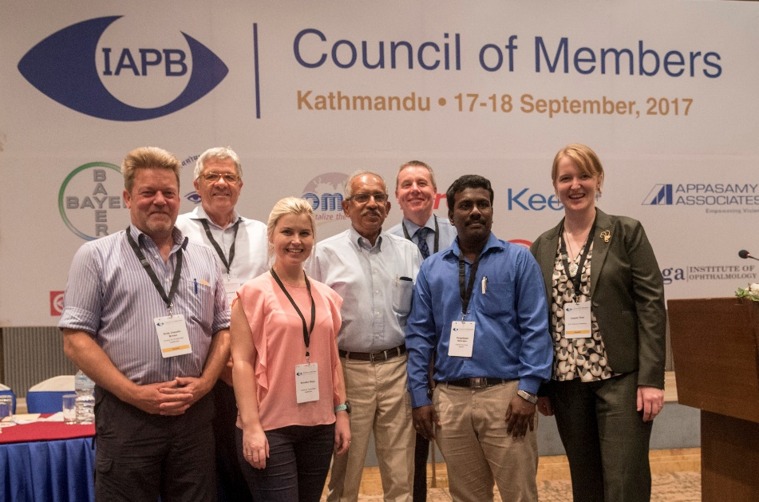
Thank You Team!
Contact Info: Cassandra.Thiel@nyumc.org
Twitter: @CassandraLThiel Instagram: Clinically_Sustainable
Collaborators:
Dr. Joel Schuman, NYU
Dr. Jonathan Kahn, NYU
Dr. Paresh Shah, NYU
Ms. Diana Hong, NYU
Ms. Rachel Stancliffe
Ms. Inge Steinbach
Dr. Jorge Vendries
Dr. Andy Cassels-Brown
Dr. Dan Morris
Dr. Peter Thomas
Dr. John Somner
Dr. John Buchan
Dr. Colin Cook
Dr. Annalien Stein
Mr. Thulasiraj Ravilla
Mr. R. Vengadesan
Dr. R. Venkatesh
Students & Residents:
Mr. David Kleyn
Ms. Jenna Tauber
Dr. Ijeoma Chinwuba
Dr. Michael Rothschild
Ms. Chhavi Gupta
Funding & Support:
The National Science Foundation
International Agency for the Prevention of Blindness, Seeing Is Believing Pilot Grant through Standard Charter Bank
Centre for Sustainable Healthcare
Coalition for Sustainable Healthcare & Environmental Resources Management
US-India Exchange Foundation (Fulbright Commission)

