Slide 1
Global quality in occupational therapy design, service and evaluation:
World Federation of Occupational Therapists
Quality Evaluation Strategy Tool
Camilla Cox
Occupational Therapist
July 2022
Notes:
Thank you for joining me today from your respective locations, as I present The Global Quality in Occupational Therapy Design, Service and Evaluation.
I would like to thank the OT show for continuing to offer this sharing and learning opportunity despite the circumstances
I am Camilla Cox and occupational therapist who has practiced mental health occupational therapy here in the UK and Trinidad and Tobago, specifically Tobago.
During my time in the Caribbean I was fortunate to be the Caribbean delegate to the WFOT and from this point became engaged with their work.
On return to the UK in 2012 I became the council member for international affairs and UK WFOT delegate at the Royal College of Occupational Therapists 4 year term of office.
It is an honour to be able to present the work of the expert working group who have developed QUEST over the past 8 years.
I would like to give special thanks to Dr. Claudia von Zweck who has led us through this work and Sandra Bressler who was the Practice Development lead for the WFOT during the development of QUEST
1 minute

Slide 2
World Federation of Occupational Therapists (WFOT)
Notes:
Firstly I would like to take you whistle stop tour of the WFOT, for some of you this will be very familiar and for others this might be new information.

Slide 3
WFOT is the global voice for occupational therapy and sets the standard for its practice

Slide 4
Why do we exist?
As a worldwide body we represent the occupational therapy profession in its role of improving world health and wellbeing

Slide 5
What do we do and how do we do it?
We are a global network of national occupational therapy associations, representing 550,000 occupational therapists.
We set the standard for occupational therapy practice internationally and promote excellence through research and education.
We raise awareness for the profession and provide a platform to celebrate and exchange the diversity of our members.
We facilitate the profession to enable engaged, meaningful lives, for everyone by encouraging occupational therapy excellence.

Slide 6
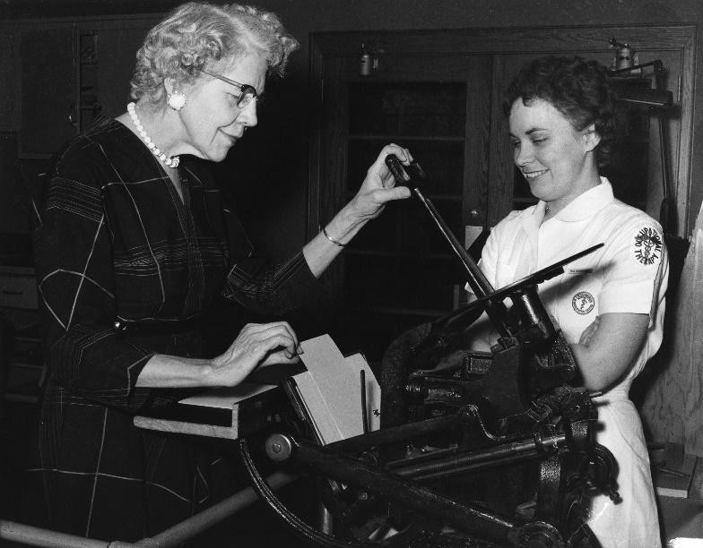
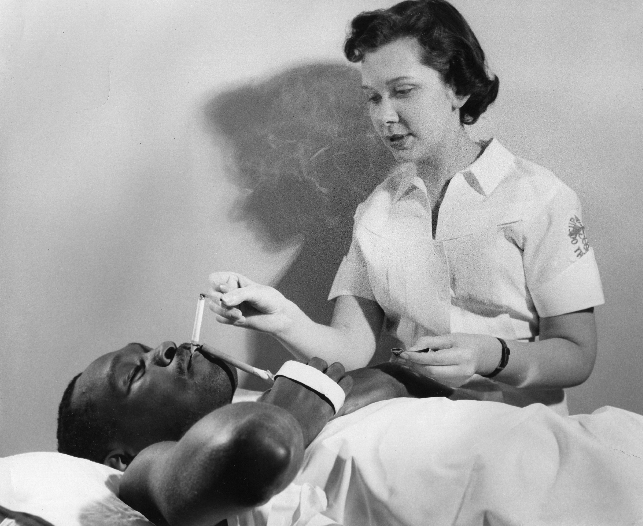
2020
1952
Iran
Indonesia
Ireland
Israel
Italy
Japan
Jordan
Kenya
Republic of Korea
Kosovo
Latvia
Lithuania
Malawi
Malaysia
Madagascar
Malta
Mauritius
Mexico
Morocco
Netherlands
New Zealand
Norway
Pakistan
Palestine
Australia
Canada
Denmark
India
Israel
New Zealand
Sweden
United Kingdom
South Africa
United States of America
Argentina
Australia
Austria
Bangladesh
Belgium
Brazil
Bulgaria
Canada
Chile
China
Colombia
Cyprus
Czech Republic
Estonia
Denmark
Finland
France
Georgia
Germany
Ghana
Greece
Haiti
Hong Kong
Iceland
India
Philippines
Portugal
Romania
Russia
Rwanda
Saudi Arabia
Singapore
Slovenia
South Africa
Spain
Sri Lanka
Sweden
Switzerland
Taiwan
Tanzania
Thailand
Trinidad & Tobago
Turkey
Uganda
United Kingdom
United States of America
Venezuela
Zambia
Zimbabwe
Armenia
Bahamas
Croatia
Dominican Republic
Faroe Islands
Bermuda
Guyana
Costa Rica
Jamaica
Kazakhstan
Macau
Namibia
Nigeria
Republic de Panama
Peru
Seychelles
Tunisia
Ukraine
Luxembourg
Poland
Lebanon
ACOT
APOTRG
COTEC
CLATO
OTARG
Kuwait
AOTRG
73 Full Members
Approved constitution + Education Programme
21 Associate Members
Approved constitution
7 Regional Groups
Arab, Caribbean, Asia-Pacific, Europe, Latin America, Africa, Kuwait
Notes:
For us in the UK, RCOT is a member of COTEC – the Council of Occupational Therapy for European Countries
The UK was one of the founding countries of the WFOT in 1952
Full Member Organisations = National Occupational Therapy Associations who have a constitution that meets the membership requirements of the WFOT in addition to having one or more WFOT Approved Education Programmes. Each Full Member has full voting rights.
Associate Membership = National Occupational Therapy Associations who have a constitution that meets the membership requirements of the WFOT but no WFOT Approved Education Programmes. Associate Members have no voting rights.
Regional Groups = International OT Groups/Councils. No voting rights.
Arabic Occupational Therapists Regional Group (AOTRG) - Since 2012
Association of Caribbean Occupational Therapists (ACOT) - Since 1994
Asia Pacific Occupational Therapists Regional Group (APOTRG) - Since 2006
Council of Occupational Therapists for the European Countries (COTEC) - Since 1994
Confederacion Latino Americana De Terapeutas Ocupacionales (CLATO) - Since 2002
Occupational Therapy Africa Regional Group (OTARG) - Since 2004
Kuwait Group - Since 2003

Slide 7
Programme areas
Education
we are enabling excellence in occupational therapy and promoting its global growth and development
Practice Development
we are fostering a global quality of practice that is relevant and sensitive to context and culture
Leadership & Advocacy
we are finding and supporting the voices in occupational therapy to enhance our role in world health and wellbeing
Research
we are discovering new ways for occupational therapy to evolve through broad and deep collaboration across the profession
Notes:
QUEST that I will be presenting comes under practice development

Slide 8
We represent the profession at a global level by influencing and collaborating with international stakeholders

Slide 9
Examples of who we collaborate with:
Collaborations
World Federation of Occupational Therapists | www.wfot.org |

Slide 10
580,000
900
63,000
100,000
Practicing occupational therapists worldwide
Approved Education Programmes worldwide that meet the WFOT Minimum Standards for Education
Practicing occupational therapy assistants worldwide
Occupational therapy students studying in WFOT approved programmes
Therapists
Education
Assistants
Students
Notes:
The Human Resource Project 2020 – available free on the WFOT website gives global demographics of the occupational therapy profession – such as training programmes, and the numbers of those that are WFOT approved.
To be an individual member of the WFOT at approx £20 per year you can do so through the RCOT – there are member benefits, such as access to all resources on website and discounts on books and being part of the advancement of the profession globally. The vast majority of the work of the WFOT is done by volunteers such as myself, there is approx 80 live projects being run by volunteers such as the one I am about to present.

Slide 11
Quality Improvement: Some UK examples
Service Innovation
Occupational therapists provide life-changing support to people of all ages at different stages of their life.
Notes:
Quality Improvement is increasingly becoming part of every day language, for all of us I imagine. Some of you may have been led or been involved in Qi within your practice areas.
Being able to demonstrate the value of Occupational Therapy interventions with quantifiable data is paramount to stop the profession from being marginalised, and being able to show this through how we set and meet quality standards is one way of demonstrating the value of OT –
The Royal College of Occupational Therapy has focused on this in its Improving Lives, Saving Money campaign that gives a plethora of case studies of how OTs meeting quality standards, improving services and are able to demonstrate finances involved (most often when there is cost savings there is carbon saving) – It has allowed those approaches that have been of benefit to the client and demonstrated cost savings to be replicated. Such as having OTs within university support services – evidence shows this has allowed student who may otherwise have had more difficulties or in the worst case scenario not been able to continue studying – and complete courses, it may also prevent the need for the student to have to access other primary and secondary services.
The Green Ward or Teams Competition facilitated by the Centre for Sustainable Healthcare takes the data a step further looking at financial implications, clinical improvements, social and environmental benefits and carbon reduction – often when there are benefits in the former two there is a reduction in the later – in such current climates where we can design services that provide for the needs of today without compromising those needed for the future we must – the process for the green wards competitions is one that uses QI teaching staff about sustainability principles and how to calculate carbon use alongside clinical, social and financial components of the quality improvement. One example is University Hospital Southhampton who pioneered Early Mobilisation on Cardiac Intensive Care Unit – reducing need for ventilation by 4 days and need for intensive cardiac stay by 6 days. This and lots more examples are available on the Centre For Sustainable Health Care Website and OT is one of practice groups, and includes a large networks of OT’s engaged in improving the sustainability components of practice.
Within the service where I work, QI is being rolled out with an expectation that we are doing QI projects as part of practice, training is becoming increasingly readily available to all staff, partnership with QI expert organisations. The QI department works with teams to hear them, to hear where the issues and solutions are, there are often really good solutions within teams working in the services and those QI projects that have been most successful are those that have ha the full investment of the team because they have been born within the team, rather than those that feel imposed. For example reducing self harm or violent incidents by understanding when these sorts of incidents are most likely to occur, thinking about what the factors are that might be causing more distress at this time and adapting the social or therapeutic environment at these time.

Slide 12
QUEST Project Timelines and Activities
Sites:
South Africa
United Kingdom
Argentina
Israel
Online
Objective:
To define a global set of indicators that describe quality occupational therapy in an interdisciplinary practice context
Resources:
Online Course
Guide
Five instructional videos
Worksheets
Glossary
Handout
Poster
Slide Presentations
Case Studies
Phase 1 Report
First Draft
Report Publication
Project
Start
Phase 3 Dissemination
2014
2015
2016
2018
2019
2019
2020
Objectives:
To understand how quality indicators are being used in health care
To understand how occupational therapists are using quality indicators
To define ‘quality indicators’
To develop a set of quality indicators that can be used by occupational therapists globally
Objectives:
To understand the meaning of ‘quality indicators’
To understand how quality indicators are being used in health care globally
To understand the current evidence base and research gaps in occupational therapy
To form recommendations to inform further work in this area within the WFOT
Components:
Conceptual model
Core indicators
SMART criteria
Implementation process
WFOT Bulletin
‘Development of a Quality Indicator Framework for
occupational therapy’
Pilot Testing Complete
Phase 2 Start
Launch
World Federation of Occupational Therapists | www.wfot.org |
Notes:
An occupational therapy Quality Indicator (QI) Framework was developed as an initiative of the World Federation of Occupational Therapists (WFOT), with a purpose of providing a guide for occupational therapists practicing in countries around the world to select a coherent, relevant and balanced set of quality indicators to monitor and improve the quality of services they provide
Started at the 2014 WFOT council meeting and congress, we were a group of OT’s from several countries,
It was recognised back then that Quality Improvement as an approach to service transformation was growing in popularity and that Occupational therapists to reduce the risk of being marganalised needed to have set of quality standards of their own by which to design and measure services.
QI I have to admit was new to me at that time but it caught my attention and I saw the value in us having a tool such as QUEST
Having worked in a setting where there was little and in some areas no OT you can also feel quite lost about to set up a quality OT service, for example I was asked to be part of introducing OT to a new peadiatric clinic that opened not long after I arrived in Tobago, and later occupational therapy clinic to a new outpatient mental health service, and having a tool such as QUEST as a way of designing the services would have been of huge benefit.
Also in the UK increasingly we are working in unknown territory – so useful to have a framework to develop the service around and evaluate effectiveness – however it Is a tool designed for across the spectrum of occupational therapy work settings and service cycle.
Phase 2 11 members from around the world
First Draft – 56 Quality Indicators under the seven Quality Indicator Domains – which we described as a basket of indicators, later refined as will be demonstrated later

Slide 13
Seven core quality indicators
Measures used to monitor, evaluate and improve quality
Data provides evidence and accountability for occupational therapy
Measure quality across services, regardless of location, setting, populations
Notes:
Quality indicators are measures that are used to monitor, evaluate and improve occupational therapy services
Data from indicators provide evidence and accountability of how occupational therapy advances health outcomes, enhances satisfaction and optimises use of limited resources.
Seven core indicators are identified by QUEST that measure quality in services provided by all occupational therapists, regardless of geographic location, practice settings and populations served - from an rural clinic in Bangladesh to a hospital service in St Lucia, to a peadiatric practice in Buenos Aires, to a nursing home in the Sheffield. Appreciating that each will have different factors to consider and will want to tailor and further develop the indicators to be relevant to their setting.

Slide 14
QUEST
quality
dimensions
Appropriateness
Right services, person,
place, time
Sustainability
Access to resources without jeopardising future
Accessibility
Ease in obtaining services
Efficiency
Optimal use of resources
Effectiveness
Evidence-informed
services
Person-centredness
Experiences with service
Safety
Incidents resulting in harm
World Federation of Occupational Therapists | www.wfot.org |
Notes:
The core indicators evaluate the value of occupational therapy in relation to seven quality dimensions, including appropriateness, sustainability, accessibility, efficiency, effectiveness, person-centredness, and safety.
Appropriateness – those from WFOT approved education programmes – that meet minimum practice standards, do they have access to the training needed a particular interventions delivered, is it the right time to be doing an assessment or intervention with an individual according to their clinical presentation, is it the work for an OT or another profession
Sustainability – what resources are needed, what is the supply chain for resources thinking about locally sourced, or thinking about a piece of equipments carbon footprint, easy of maintaining, considering more sustainable delivery of services such as moving to online or a blended approach, and types of intervention that are low impact on the environment and have positive social impact – we get a natural pat on the back as OT’s in this regard.
Accessibility – what might be the barriers to accessing the service – I was asked to increase accessibility of a day Programme where treatment was offered for a small cohort, full time over a number of months, by introducing a shorter Programme option and a part time option – increased the accessibility of the service – increased over all numbers who could attend at one time and treatment options which were more viable and effective for some service users
Efficiency – what are the resources needed, are they being used efficiently, what process could improve the efficiency – duration of treatment, length of session, type of intervention
Effectiveness – what is the evidence for the intervention, could a different intervention be more effective, what are the service user goals - you will see that they are all interrelated – to be effective we need to ensure the right person is delivering the right intervention or assessment at the optimal time
Person- centredness – we will all be very familiar with using outcomes and patient feedback – do we always glean this for OT specific services, how do we collate and then share this information
Safety – as we change services to improve accessibility or efficiency do we inadvertently increase risk, how do then adjust services to reduce risk and harm, we must consider the safest option for a service user at a given time – OT in looking at safe discharge and independence in the home are experts at assisting persons to be safe throughout the interventions delivered.

Slide 15
Environmental
factors and resources
QUEST
quality
perspectives
STRUCTURE
Changes resulting
from service
How service is
delivered
OUTCOME
PROCESS
Notes:
The tool then with these Seven domains has named them as a either a Structural, Process or Outcome Indicator
Structural – Physical or Social factors and Resources
Process – How is the service delivered – what do we actually do
Outcome – those changes that occur because of the service received

Slide 16
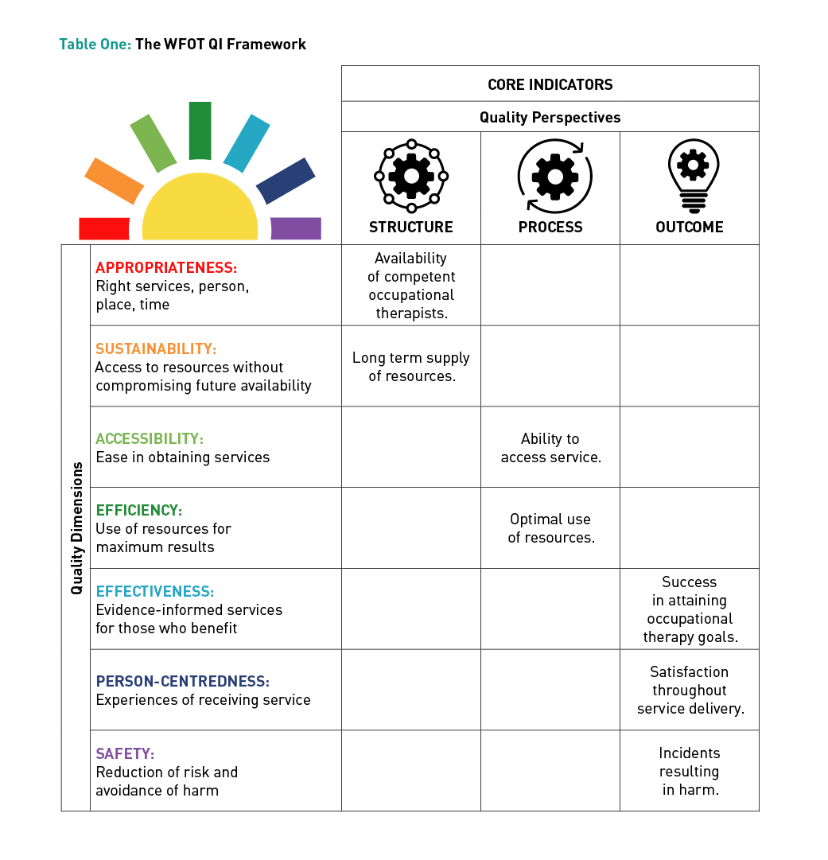
Framework
Design
Quality
perspectives
Quality dimensions
Core indicators
Notes:
The core indicators therefore provide a comprehensive evaluation of occupational therapy that considers many quality dimensions from different perspectives.
Here you see it in the chart form and we start to build a picture of how you might frame your service into this format

Slide 17
S
PECIFIC
Quality Evaluation Process
Defines core indicator specifications to be SMART
M
EASUREABLE
A
SMART
GREED UPON
R
ELEVANT
T
IMELY
Notes:
So once you reach the Quality Evaluation Process one stage of the process is to define core indicator specifications
Something we are very familiar with doing with our clients
Making the specifications to be SMART
Specific
Measurable
Agreed Upon
Relevant
Timely

Slide 18
Quality Evaluation Process
Notes:
Using the quality evaluation process, the method of calculating the indicator result is identified. Terms used in the indicator are defined and sources for obtaining the required data are specified.

Slide 19
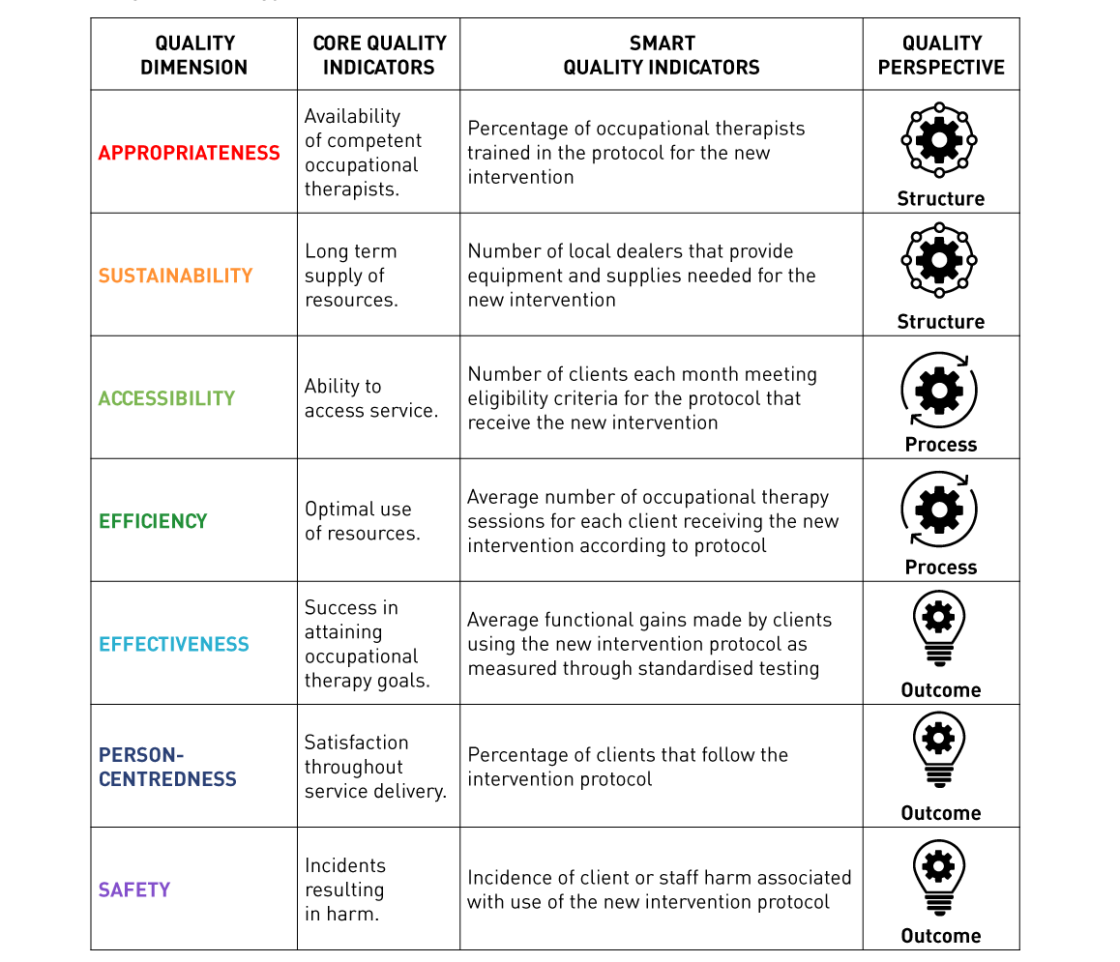
Sample SMART Structure Indicators
Notes:
As an example, these SMART indicators were developed to measure the impact of introducing a new intervention in an occupational therapy practice. In this example, the structure indicators measure the availability of staff trained to use the intervention, as well availability of local suppliers to provide equipment required for the occupational therapy intervention
Local supply of materials are likely to have a lower carbon foot print, and hopefully can be locally maintained.

Slide 20
Sample SMART Process Indicators
Notes:
Under process perspectives
SMART process indicators evaluate the number of clients each month meeting eligibility criteria that actually receive the occupational therapy intervention – accessibility of service, as well as the average number of sessions required per client to deliver the intervention according to the treatment protocol – the efficiency of the service.

Slide 21
Sample SMART Outcome Indicators
Notes:
And then finally looking at the outcome perspectives
SMART outcome indicators evaluate the average functional gains made by clients - effectiveness, the number of clients that are satisfied to follow the protocol – person centredness and the incidence of harm to clients or staff associated with use of the intervention – safety

Slide 22
SUSTAINABLE CLINICAL PRACTICE
Secondary drivers
Reduce carbon without reducing health
Reduce activity
Prevention
Self care
Reduce carbon intensity
Low carbon alternatives
Lean pathways
Sustainable estates
Primary driver
Outcome needed
Sustainable clinical practice
Primary driver
CENTRE for
SUSTAINABLE
HEALTHCARE
Infrastructure & process
Mortimer-F. The Sustainable Physician
Clinical Medicine 2010, Vol 10, No 2: 110–11
Notes:
SusQI – taken from the Centre for Sustainable Healthcare

Slide 23
Notes:
Started January 2021 – May 2021 – used QUEST framework with the team to design and implement the Programme
Closed May 2021 as funding source was time limited – winter funds
Re-Opened November 2021 with funding from CCG for an initial 18 months with a view to continuation funding if successful in meeting its principle aims

Slide 24
Project Aims
The programme will work collaboratively with local organisations and experts by experience to deliver an accessible and effective programme, supporting a diverse population and in-particular, Black and Minority Ethnic (BAME) men in the borough. The programme will offer alternatives to NHS mental health service, supporting people to achieve their personal goals, manage their wellbeing and helping them with the motivation for change rather than simply a mental health diagnosis, in particular, long term goals around employment, meaningful occupation and enhancing community connection and belonging, fundamental to improved mental health and wellbeing.
Notes:
Concern in the borough about significant inequalities and barriers to accessing healthcare, healthcare is often inaccessible and often does not meet the needs of members of our community, diversifying, working in formal partnership with VCS which is more trusted among certain groups or individuals in the community. We know that young black men are more likely than other ethnic groups to be sectioned and require potentially traumatic admission to the ward, rather than access GP or other primary or secondary care. This type of services is designed to be an alternative to traditional clinical service as we know them at this time.

Slide 25
Secondary Drivers
Prevention
Self Referral
Discharge Pathway – In Reach To Ward
Empowering through engagement in meaningful activity, belonging with team
Referred due to interest not diagnosis, age, borough location
Partnership with Twinings Employment support, Volunteering Programme
Peer Led Service
EBE collaborating with team to deliver projects, workshops – ‘US’ Film, Singing Workshops
Self Care
Learning and Growing in Groups with individual support as needed
Activity based groups – movement for the soul, connect with nature, baking, creative writing
Increased motivation to attend due to group cohesion and meaningful activity
Principles of empowerment
Team check-in daily
Reflective Practice
Open and honest conversations between peers
Support needs respected

Slide 26
Secondary Drivers, cont.
Lean Services
Low resource activity
Reduce, Reuse, Recycle
Capacity for 120 10 paid staff – Partnerships to extend service offer ie connected communities broadwater farm
Trainee/Students
Volunteer Programme
Community Collaboration
Low Carbon Alternatives
Reduce need for hospital admission, accessing urgent care services
self referral, may avoid: crisis, further deterioration and secondary implications of mental health distress
Partnerships with local projects/organsiations with sustainable principles – Edible London, StAGS, Connected Communities, Recovery College
Sustainable Estates
Community centre – multiuse building
Online

Slide 27
“Had a very stressful week. So stressful that I was not going to attend the group today. I felt so rushed and stressed. I am glad that I did attend. It has given me time out. It feels like coming into another world, which has calmed me and made me feel constructive by concentrating on my artwork which I really enjoy.”
“This group has had a tremendous impact on my wellbeing and creativity. I find that I am able to let loose and develop my creative spirit without judgement or worrying”

Slide 28
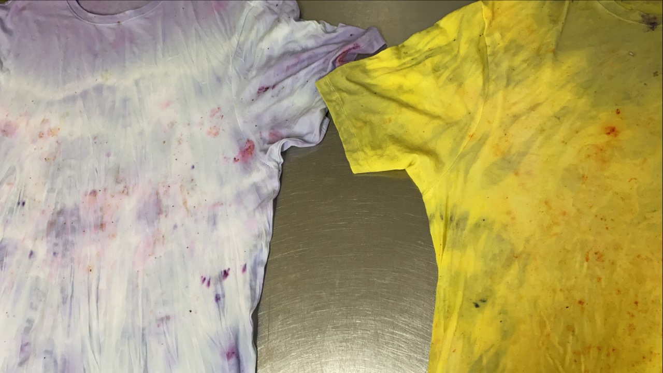
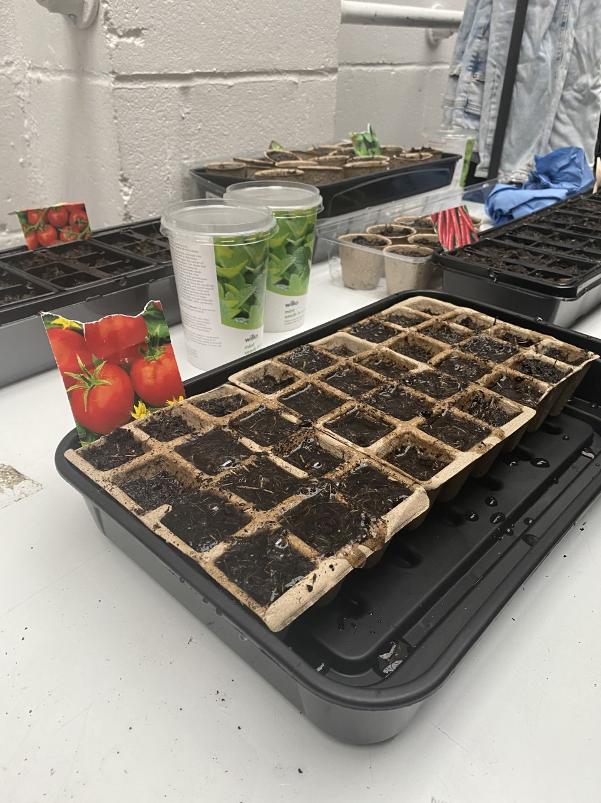

Slide 29
Sustainable value in healthcare:
Informed by patient values
outcomes
(goods – harms)
value =
environmental + social + financial costs
(the “triple bottom line”)
Academy of Medical Royal Colleges, 2016 (with CSH)

Slide 30
Resources free at https://wfot.org/quest
Case Studies
WFOT Bulletin Article
Slide Presentations
Poster
Handout
Online Course
Guide*
Instructional videos
Worksheets
Glossary
*Available in English, French, German and Spanish
Notes:
The working group has developed numerous resources available free on the WFOT website which have also been translated into French, German and Spanish.

Slide 32
QUEST
case
studies
Occupational therapy education programme
Stroke services
Fall prevention programme
Mental health clinic
Memory services
Notes:
Several Case Studies have been developed based on actual services and programmes around the world – we are looking to develop more of these from around the world – so if you go away and use this tool, find it useful then it would be great if you could share it with us and add to the growing body of evidence and resources.

Slide 33
Learn about quality and measurement
Use as a research framework
Examples of Use
Evaluate quality of service
Develop standards for practice

Slide 34
University of Capetown Occupational Therapy Programme
Final year students each completed QUEST online course
Students then worked together to complete a QUEST case study
Case study posted on WFOT website
Notes:
SA Education – students were invited to complete the online QUEST Programme, then complete a case study using the worksheets and materials together with their peers and set quality standards for the case example,
.
And these have been posted on website
University of Cardiff is including this in their Programme
It is recognised that it is neccessary now for students to have a good understanding of Qaulity Indicators and the Quality Improvement process as part of their education, so that they are adoping this approach from the outset in the workplace

Slide 35
Argentina Evaluated effectiveness of telehealth during COVID-19 pandemic
Notes:
In Argnetina a group of practitioners have been using the QUEST to evaluate the effectiveness of telehealth that has recently been rolled out due to the COVID pandemic – something I am sure many of us can relate to!
I am sure many of you are very familiar with having had to move services to telehealth – and now we are looking at a new normal of using onine, increase use of apps and digital technology, it will be important to evaluate this against quality indicators, for which clients is it appropriate, for which is it safe, for which is it increasingly accessibility, reduction in travel might have enviromental and social benefits – and for us to undersand what are the limits and health and wellbeing implications of moving to an online service – we are now talking blended or hybrid services and this means we are needing to understand the benefits and negative implications.

Slide 36
United Kingdom
Set quality standards for a mental health clinic
Notes:
Within the UK we are used to working with lots of quality standards, targets for quality assurance and there is several practice standards and recommendations for particular settings developed by the RCOT – the standards are likely to fall within the seven domains of the QUEST Quality Indicators.
It was useful to apply the QUEST to a setting in which I worked and used QUEST to set quality standards specific for the occupational therapy service that align with Quality Inpatient Eating Disorder Srandards – some specifically linked to the role of OT and how they meet the stadards others involved other members of the MDT.

Slide 37
WFOT
Surveyed occupational therapists regarding the impact of Covid-19 for the quality and delivery of occupational therapy
QUEST served as a research framework to analyse and group collected data
Results published in upcoming in WFOT Bulletin
Notes:
WFOT bulletin
Global survey that WFOT 2750 OT’s and Students responded from 100 countries – questions leading to the Quality Dimensions – looking at the pandemic has impacted on rehabilitation practice
QUEST helped as a framework to help organise the findings
WHO was looking for material to demonstrate the impact of COVID19 on rehabilitation and are keen to use the research findings for the WHO Rehab 2030 initiative – they are concerned of impact re covid19 on rehabilitation services and keen to understand – the capacity for rehabilitation to continue and how this might be facilitated

Slide 38
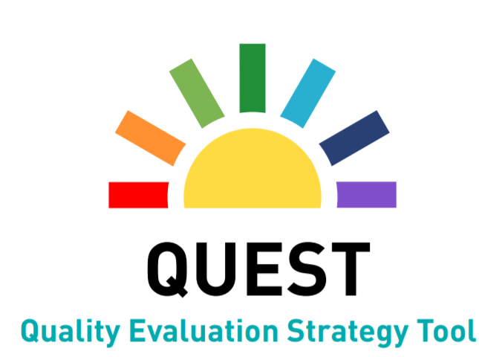
Summary
Provides a comprehensive strategy to use data to demonstrate the value of occupational therapy.
Describes a set of seven occupational therapy quality indicators applicable to all practice settings.
Provides evidence and accountability of how occupational therapy advances health outcomes, enhances satisfaction and optimises use of limited resources.

Slide 39
CONTACT INFORMATION
wfot.org
otion.wfot.org
facebook.com/thewfot
@thewfot
youtube.com/thewfot
admin@wfot.org
World Federation of Occupational Therapists | www.wfot.org |
Notes:
Thank you very much for taking the time to join me today and listen to this presentation.
If you would like to be in contact then please do let us know – we would like to support person to be using this in practice and share their examples so we can build the knowledge and evidence in using QUEST and how this is of benefit to the clients we serve.
We now have about 10 minutes for some questions

