Slide 1
How-to guide launch
Reusable sterile and isolation gowns
Nicole Fletcher, Sustainable Procurement Lead
16.04.2024

Slide 2
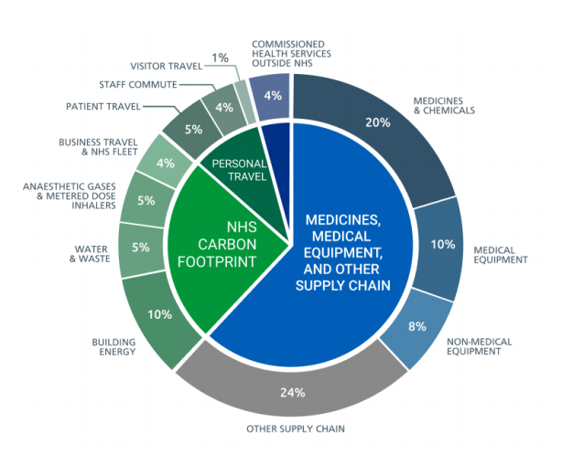
NHS Net Zero Targets
The 'Delivering a Net Zero NHS' report outlined that 66% of the NHS Carbon footprint plus sits within supply chain - equivalent to emissions from powering 15 million UK homes with electricity.
The NHS Carbon Footprint Plus
Reaching net zero carbon
by 2040 for the emissions we control directly (the NHS Carbon Footprint)
  with an ambition to reach an 80% reduction, compared with a 1990 baseline, by 2028 to 2032.
by 2045 for all emissions, including those embedded in the supply chain (the NHS Carbon Footprint Plus)
  with an ambition for an 80% reduction, compared with a 1990 baseline, by 2036 to 2039.

Slide 3
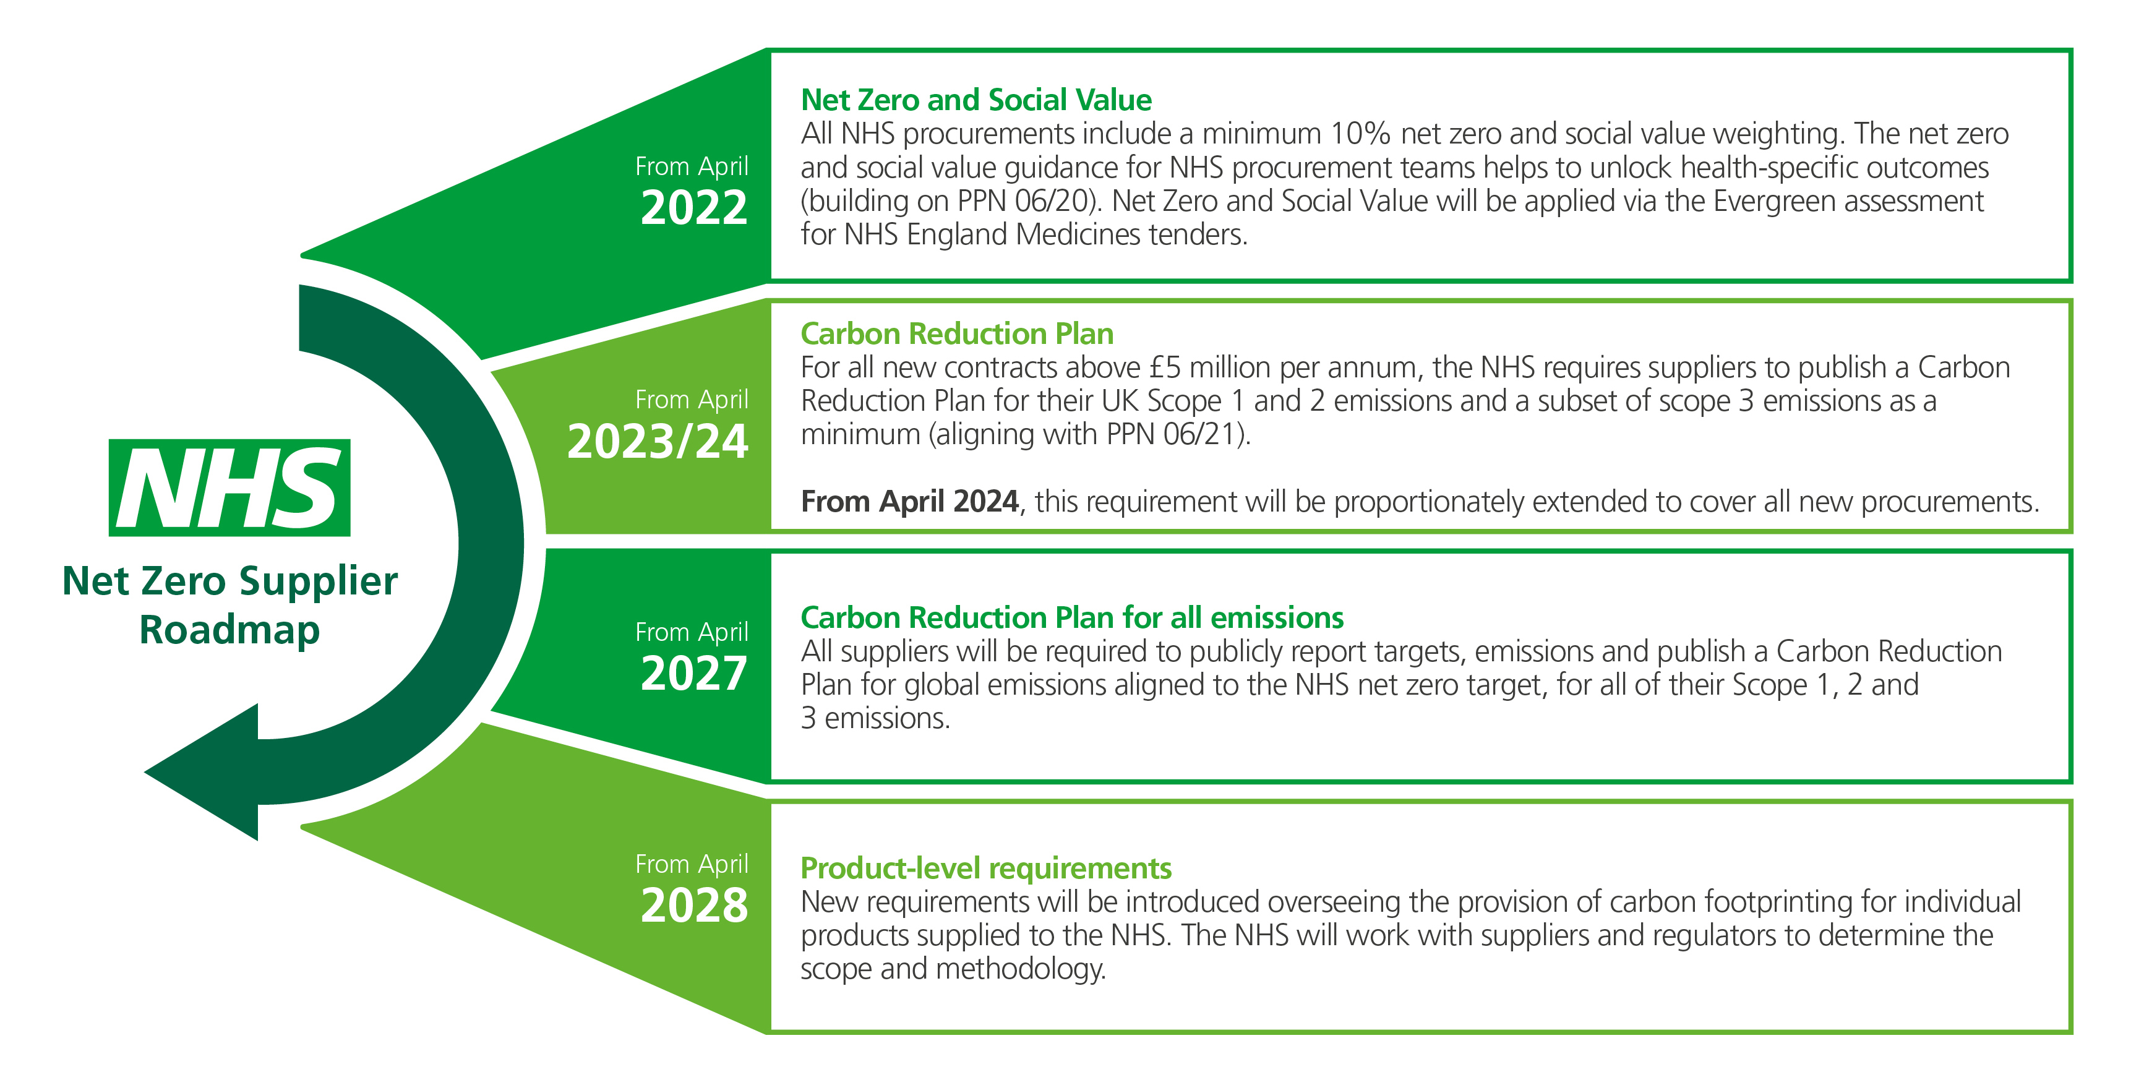
The Net Zero Supplier Roadmap

Slide 4


The Business Case
Sterile surgical gowns provide essential barrier protection between patients and staff during invasive procedures. Reusable surgical gowns have been shown to be superior for safety with no increased risk of infection, they can be laundered for reuse some 75 times or more and save around 45%* on cost and 69% on carbon compared to single use gowns
Why Reuse
Reusable gowns currently make up around 30% of the surgical gowns and 8% of the isolation gowns used by the NHS each year*, indicating significant scope to switch to reusable to save money and carbon.
Reusable gowns have the potential to save the NHS 5.2 kilo Tonnes CO2e**, 1.1 kilotonnes of waste**, 31m litres of water, and £9.4m* in costs across both surgical and isolation gowns.
Reuse Roadmap
Revenue and savings
On average reusable surgical gowns are 45%* cheaper, with VAT reclaimable on reusable products (NHS service code).
Liability and risk
Surgical gowns are medical devices that must meet BS EN 13795. Studies indicate reusable gowns outperform single use on key safety measures of protection, durability, fluid resistance and strength AJIC, with no measurable increased risk of infection IC&HE.
Case study example
Royal Derby Hospital moved to reusable sterile gowns reducing the number of single use gowns purchased annually from 100K to some 3k reusable gowns servicing the same 100k use requirements, delivering £91k financial savings, 19 Tonnes CO2e and storage efficiencies.
Reuse Portfolio
Case Studies
Greener NHS ambition
Life Cycle Assessments (Blazewski & Rothman; Vozzola et al) report carbon reductions of 69% by switching, which also supports NHS aims to reduce single-use clinical plastics by 10%.
Additional Guidance
Ease of implementation
Laundered gowns are frequently replenished, requiring less storage space than single use gowns that are stored in greater volumes to ensure resilience for stock availability.
*NHSE calculations based on NHS and supplier data
** NHSE calculations based on Rizan et al. Life Cycle Assessment

Slide 5
Protection from reusable gowns
Reusable gowns meet the same Standards & Guidance for protection as single use, with additional standards for sterile services*. Evidence shows they outperform in key test areas and combined with Awareness raising at trust level can support clinical confidence in their use.
Why Reuse
Standards & Guidance
BS EN 13795 *Surgical clothing and drapes – Requirements and test methods – for manufacturers, processors and products, test methods, performance requirements and performance levels
HTM 01-01 *Decontamination of medical devices - explains the management of decontamination and the various ways to sterilize reusable medical devices used in acute care
HTM-01-04 **Decontamination of linen for health and social care – provides guidance for those who process linen such as laundries, launderette operators and linen processors (Guidance for implementing BS EN 14065)
ISO 13485 *Medical Devices – Quality Management System covering the product lifecycle from design, manufacture to installation and services.
Reuse Roadmap
Reuse Portfolio
Evidence
Reusable gowns out-performed disposable gowns in all tests at all wash levels for ability to provide adequate protection across their expected service lifespan
Level I, II, and III gowns were tested for water resistance, hydrostatic pressure, and durability (breaking, tear, and seam strength, pilling resistance, dimensional stability, and air permeability)
Data was collected for new disposable gowns and after 1, 25, 50, and 75 washes for reusable gowns.
McQuery et al, Performance Comparison.
Case Studies
Awareness
Address common misconceptions and improve awareness, through actions such as:
staff gown trials
show and tell days
mock fluid repellence tests using water
Post trial survey results
94% of staff found reusable gowns clinically acceptable, and 96% stated that they provided excellent or satisfactory protection levels.
Stockport NHS Foundation trust
Additional Guidance
*Applies to sterile surgical gowns only **Applies to both non-sterile and sterile gowns

Slide 6
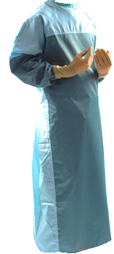
How to set up a reusable gown scheme
Reusable gowns deliver benefits for sterile surgical gowns (used in surgical theatres or other invasive procedures that use some aseptic techniques) and isolation gowns (used to provide non-sterile barrier protection to staff or patients on isolation wards³ or where extensive splashing of fluid is anticipated⁴). The savings potential can be maximised by referring to the National Infection and Prevention Control Manual (IPC) and applying the key principle of avoiding overuse or inappropriate use.
Why Reuse
Additional Guidance ​
​
Case Studies, a basic SOP for circularity, and protection standards are provided in the Additional Guidance section to assist implementation. ​
​
If you need more support, please contact the NHSE Net Zero and Sustainable Procurement team england.ccf-sustainability@nhs.net
​
Reuse Roadmap
Consult and investigate
Develop procedures and training
Communicate to end users
Introduce and Manage laundry service
Source gowns and laundry service
Sterile Surgical Gowns
Non-Sterile Isolation Gowns
Reuse Portfolio
Case Studies
Consult key stakeholders and identify end user concerns. Identify single use gown numbers and frequencies of use across different sites. Calculate carbon and financial benefits of switching. | Laundry frameworks include lots to procure reusable surgical gown services (LPP Linen & Laundry DPS, NoECPC 0572) and isolation gown services (NoECPC 0572). Include clinical leads in evaluation of gowns. | Develop a Standard Operating Procedure (SOP) specific to each gown type (surgical or isolation) covering gown donning and doffing, bagging and used gown collection. | Provide simple and clear messaging to end users addressing key concerns on protection levels and comfort; benefits of switching; and bagging processes. Train housekeeping/ cleaners on collection of used gowns. | Agree delivery frequency and monitor performance. Track and manage loss reduction through RFID asset tagging of gowns, site audits or improving user awareness through local campaigns.
Additional Guidance

Slide 7
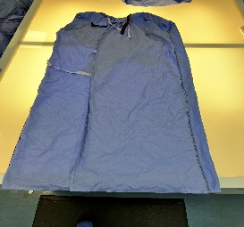


Basic Standard Operating Procedure (SOP) for circularity
A SOP covering the transfer of gowns from use to collection for laundering can reduce gown damage and loss, significantly improving the financial and carbon benefits. Research identifies gowns only need to be reused 4-12 times to be better than single use for most impacts reviewed under a Life Cycle Analysis⁴. Refer to IPC guidance^{5, 6} to support SOP development.
Used gowns sent for laundry.
Infectious gowns double bagged in dissolvable bag inside impermeable bag and placed in collection bins (HTM:01-04)
Gowns returned to NHS
Laundry sent for cleaning and repairs
Gowns provided in storerooms and robing rooms
Gowns donned and used by clinical staff
Why Reuse
Gowns washed,
repaired,
sterilised and
inspected
Managing bagging errors
Work with suppliers to manage returns of incorrectly bagged items where laundry services are split across different suppliers.
Reuse Roadmap
Reuse Portfolio
Minimising stock losses
Educate end users on the importance of following bagging procedure to reduce gown losses e.g. incorrectly placed in linen laundry or clinical waste.
RFID asset tagging of gowns can help identify problem areas to address.
Case Studies
Minimising damage
Clear procedures, training and awareness to avoid damage:
No personalising or altering
Correct donning and doffing
Additional Guidance

Slide 8







Case studies
Many NHS trusts have undertaken pilots and established permanent schemes to increase the number of reusable drapes and gowns.

Slide 9
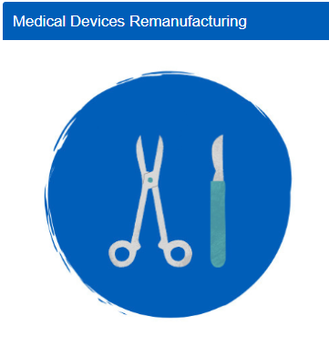
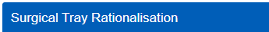



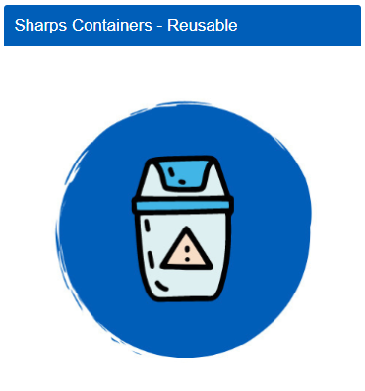
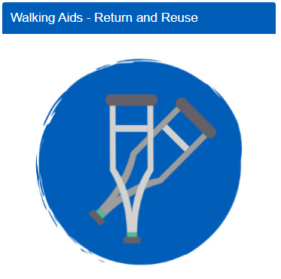
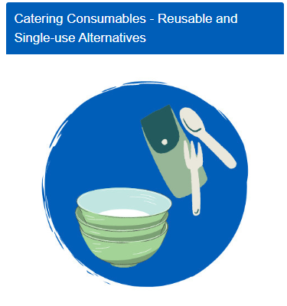
Product How to Guides
Reusable PPE Gowns
Access Product How to Guides
Business case
Step-by-step implementation guidance
Case studies & lessons learned
Links to supporting evidence

Slide 10

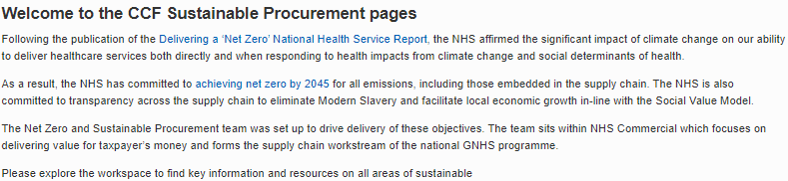
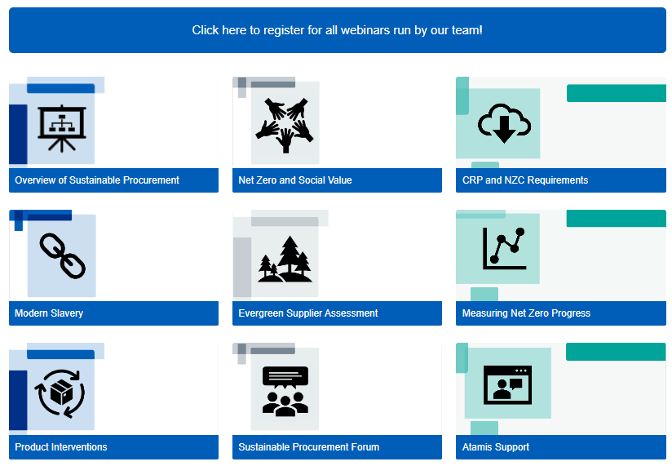
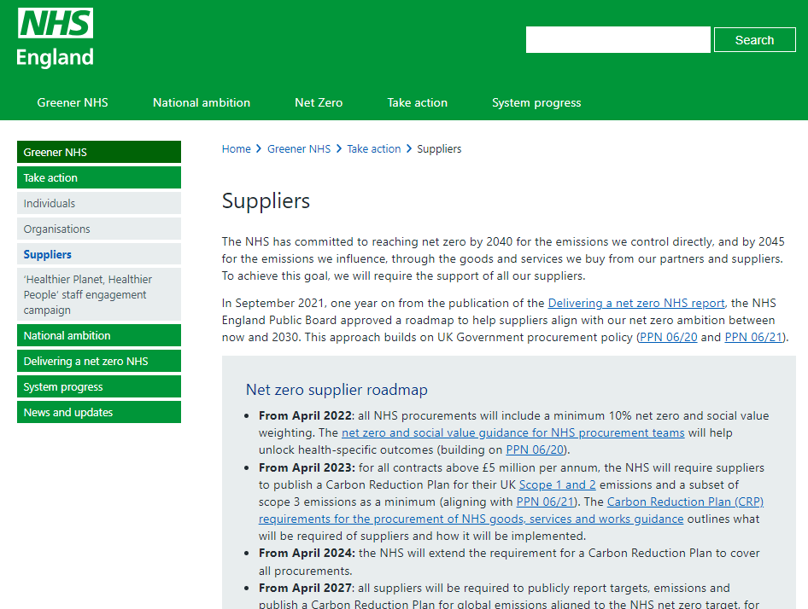
Key resources & Future NHS
Our Future NHS page
Product How to Guides
Tacking action and measuring progress
Net Zero Supplier Roadmap
Evergreen Sustainable Supplier Assessment

Slide 11
End slide

