Slide 1




CSH Facilitator Training
With Phil Walsh
Structure
and Purpose
Finding the right structure to fit the purpose and how to communicate them
Inge
Una
Neil
Sara
Rachel S.
sustainablehealthcare.org.uk @sushealthcare

Slide 2
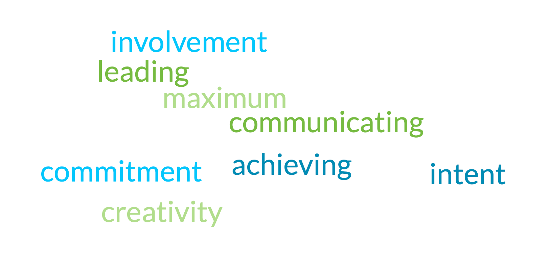
“Facilitation is about process, movement and destination”
Dale Hunter, “The Art of Facilitation”
sustainablehealthcare.org.uk @sushealthcare
Notes:
"it is a form of leading and communicating with the intent of achieving maximum creativity, involvement, and commitment to the task at hand.”

Slide 3
Overview of today’s
Facilitator Training Workshop
1
Structure and Purpose
Finding the right structure to fit the purpose and how to communicate them
2
Engagement and Fun:
Making sure the participants are fully engaged and where possible enjoying the session
3
tools and Techniques:
How to make your session, engaging, dymaique, and interactive
4
Conflict and Challenge :
How to handle conflict and challenging participants
sustainablehealthcare.org.uk @sushealthcare

Slide 4
1
Structure and Purpose:
Finding the right structure to fit the purpose and
how to communicate them
01
Delivering the Introduction
02
Establishing Connection
03
Establishing the Purpose
04
Establishing the Structure
05
Delivering the Conclusion
sustainablehealthcare.org.uk @sushealthcare

Slide 5


01
Delivering
the Introduction
– ‘what is the subject?’
WHAT –
Introduction – what is the content of our session?
A concise opening summary of the subject matter to affirm participants’ expectations
It is important to makes things easy by providing your group with the right environment and clear information from the start.
Advice 1: Clearly announce the name of your session.
Advice 2: Introduce yourself and let your co-facilitators do the same.
Advice 3: Give a brief overview of the subjects you’ll cover and the structure of the session.
sustainablehealthcare.org.uk @sushealthcare

Slide 6
02
Establishing
Connection
or ‘breaking the ice’.
WHO –
Establish a connection – who are our co-participants?
Understanding the group, establishing familiarity and the
context for participation
Why is it important to establish connections and break the ice?
Help everyone to feel comfortable and assure workshop is a safe space.
Give participants an opportunity to learn something about each other.
Increase participation in the workshop.
sustainablehealthcare.org.uk @sushealthcare

Slide 7
03
Establishing
the Purpose
and the contract.
WHY –
Shared purpose and objectives – why are we all here?
Defining a collective purpose and specific goals for the session
It’s important to establish the purpose of the session you are running and to create a ‘contract’ with your participants.
Ask your participants what they want to get out of the session.
You can do this verbally or use written options like post its or the chat function.
sustainablehealthcare.org.uk @sushealthcare

Slide 8
03
Establishing
the purpose
and the contract.
WHY –
Shared purpose and objectives – why are we all here?
Defining a collective purpose and specific goals for the session
What do you hope to get out of today?
Use the chat to share your answer
sustainablehealthcare.org.uk @sushealthcare

Slide 9
03
Establishing
the purpose
and the contract.
WHY –
Shared purpose and objectives – why are we all here?
Defining a collective purpose and specific goals for the session
Creating a ‘contract’ with your participants will help to set the tone.
Ask your participants how the group as a whole can make sure the session is successful.
sustainablehealthcare.org.uk @sushealthcare

Slide 10
03
Establishing
the purpose
and the contract.
WHY –
Shared purpose and objectives – why are we all here?
Defining a collective purpose and specific goals for the session
What values should we, as a group, bring to this session?
Use the chat to share your answer
sustainablehealthcare.org.uk @sushealthcare

Slide 11
04
Establishing
the Structure
or how to deliver your session
HOW & WHEN –
Structure – how and when will the session be delivered?
The main steps, topics and timings that will underpin the facilitation work
Defined by purpose and resources /materials (incl audience, time, money)
Directive or open
Tips from experience
(e.g. avoid circle of death, engage regularly)
sustainablehealthcare.org.uk @sushealthcare

Slide 12
05
Delivering
the Conclusion
WHAT –
Introduction – what is the content of our session?
A concise opening summary of the subject matter to affirm participants’ expectations
WHO –
Establish a connection – who are our co-participants?
Understanding the group, establishing familiarity and the
context for participation
WHY –
Shared purpose and objectives – why are we all here?
Defining a collective purpose and specific goals for the session
The aim is to ensure active participation, with clear and mutually agreed objectives and intent; a structured programme, but shaped by the participants with active engagement every 5 – 7 minutes.
HOW & WHEN –
Structure – how and when will the session be delivered?
The main steps, topics and timings that will underpin the facilitation work
Conclusion – a succinct summary of these foundational elements
Weaving these themes together to establish the learning framework for the session
sustainablehealthcare.org.uk @sushealthcare

Slide 13
Thank you!
sustainablehealthcare.org.uk @sushealthcare

