Slide 1
Tray Rationalisation
Thursday 12th October 12:00-13:00

Slide 2
Agenda
Timings | Agenda Item | Speaker
12:00-12:05 | Welcome | Nicole Fletcher Sustainable Procurement Lead
12:05-12:15 | NHS Overview & How To Guide | Agnes Henson, Net Zero & Sustainable Procurement Senior Analyst
12:15-12:20 | Methodology Evaluation – Health Innovation North-West Coast (AHSN) | Laura Boland, Head of Innovation Pipeline, Evaluation & Insights
12:20-12:30 | Trust Case Study- Leeds Teaching Hospitals NHS Trust | Adam Peckham-Cooper Consultant Emergency General Surgeon
12:30-12:35 | Findings Evaluation – Health Innovation North-West Coast | Laura Boland, Head of Innovation Pipeline, Evaluation & Insights
12:35-12:55 | Q&A | Nicole Fletcher
12:55-13:00 | Wrap up & Surgical Care Co-Leads | Nicole Fletcher

Slide 3
NHS Overview & How To Guide
Agnes Henson

Slide 4
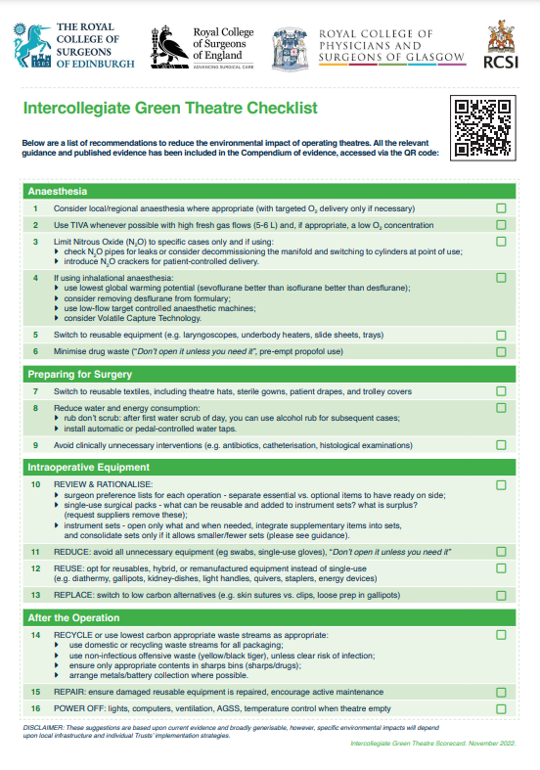
The challenge & the opportunity
Switching from single-use surgical items to reusables reflects a huge reduction in the carbon emissions associated with the production of items the healthcare system buys
However, in shifting to reusables the ‘carbon hotspot’ of surgical instruments moves to the decontamination cycle - ~85% of emissions (Rizan, Lilywhite, Reed & Bhutta, 2022)
Surgical trays are often added to over time without due reflection>75% of instruments in open trays of surgical sets remain unused resulting in regular unnecessary sterilisation (Stockert & Langerman, 2014). This provides additional opportunities to make substantial carbon reductions in the operating room
The Intercollegiate Green Theatre Checklist recognises the significant carbon impacts of surgery and recommends collective actions, including a review and rationalisation of instrument sets.

Slide 5
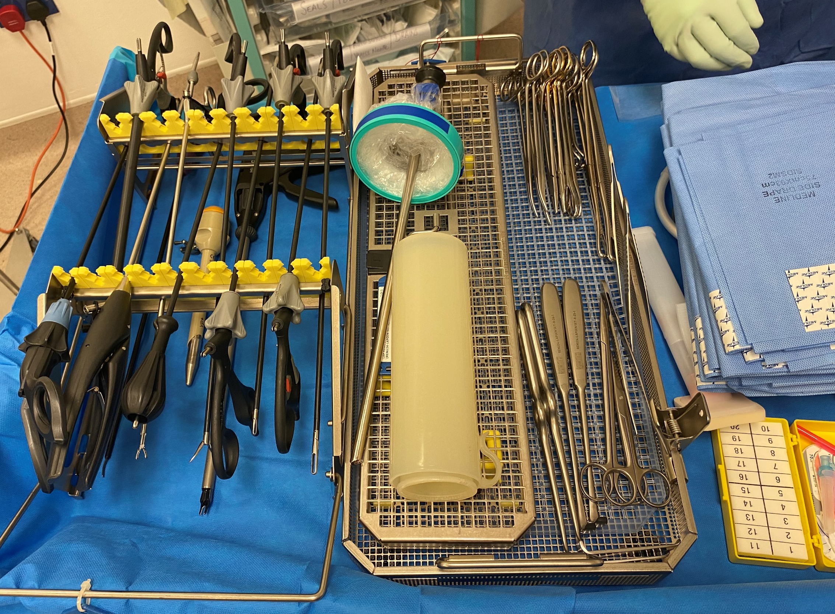
HOW-TO GUIDE SURGICAL INSTRUMENT SET RATIONALISATION

Slide 6
The business case
Revenue and savings
Removing rarely used instruments from sets to consolidate to fewer trays and optimising grouping can significantly reduce sterilisation costs with third party providers, saving one trust around £20k p.a.
Risk and liability
Infrequently used items removed from consolidated sets can remain to-hand as individually wrapped items or on a contingency tray, without impacting patient care or procedure time.
Greener NHS ambition
Rationalising surgical instrument sets can save unnecessary sterilisation and reduce carbon, supporting the NHS target of a net zero carbon footprint plus by 2045.
Ease of implementation
By following a few simple steps, usage audits can support internal stakeholders to undertake clinically informed, data-driven decision-making to rationalise surgical sets.

Slide 7
Decontamination life cycle - saving opportunities
By rationalising and consolidating instrument sets, operational, cost and carbon savings can be made across instrument use and decontamination cycles.
Step 3
Used trays delivered to in-house / offsite sterilisation unit
Fewer or smaller trays per procedure saves trolley space, increasing capacity for other reusable instruments
Step 2
Used instruments placed back in tray and moved to transport trolley for sterilisation
Reduce transport emission carbon intensity per procedure
Consolidating instrument sets reduces sterilisation costs per procedure
Fewer trays reduces central repository / theatre storage per procedure set
Step 4
Fewer trays and instruments means less preparation time, counting instruments before a procedure*
Used instrument trays undergo decontamination and sterilisation process
Step 1
Reduce carbon emissions through reduced wash and sterilisation demand per decontamination cycle
Opening tray and preparing instruments to be used during surgery
Step 5
Sterilised trays are stored in a central repository until recall or transported immediately back to theatre storage
*96% respondents in this case study agreed

Slide 8
Saving carbon in decontamination
CO₂e emissions occur at the level of washer and autoclave cycles
PROCEDURE 1
Reduces items across same 3 trays, no carbon savings at the procedure level
PROCEDURE 2
Reduces items and consolidates trays, halves carbon impact at the procedure level
Pre-Rationalised
9-Slot Washer
Post-Rationalised
PROCEDURE 3
Reduces tray size with small reduction in items, reduces carbon impact by ~20% at the procedure level
SPACE FREED FOR 4TH PROCEDURE
Instruments should be reduced with the view of optimising procedures per cycle

Slide 9
Laura Boland. Head of Programmes, Health Innovation North West Coast SURGICAL INSTRUMENT SET RATIONALISATION: UNDERSTANDING THE BENEFITS AND REPLICATING THE PROCESS A HEALTH INNOVATION NWC (formally the INNOVATION AGENCY) REPORT FOR THE NHSE SUSTAINABLE PROCUREMENT TEAM

Slide 10
Health Innovation North West Coast (formally the Innovation Agency)
Health Innovation Network work to improve health and to generate economic growth.
We collaborated on this project to capture both the sustainability benefits and the potential cost savings, and to evaluate if the process was acceptable to clinicians and replicable in other trusts.

Slide 11
The Methodology
The pilot sites agreed a target surgical procedure of gallbladder removal (laparoscopic cholecystectomy).
A prospective audit of instrument use was undertaken (Jan – Mar 2023) and included Acute surgeries, Emergency General Surgery (EGS), Day Case surgery, and Hepato-Pancreatico-Biliary surgeries (HPB).
The mandated surgical tray checklists were used to record the actual instruments used during the procedure and note the redundant and supplementary instruments.
A minimum sample size of 50 was recommended with the final numbers of 70 cases in Leeds and 60 in Mid Yorkshire submitted for analysis. A utilisation rate was calculated against each instrument.
The data was presented to an advisory surgical group who were asked to agree the instruments for routine instrument use and propose instruments for removal deemed redundant or from the same functional or common group.

Slide 12
The Methodology
A “hack” was set up with all the key stakeholders from surgical and leadership teams to review the utilisation data. The threshold for routine inclusion in the final tray was agreed by the hack. Instruments with a zero utilisation were excluded if no objections raised.
A consensus by discussion was used to identify the remaining instruments to be routinely included or excluded or assigned a supplementary status if no consensus could be reached on their exclusion.
The hack proposals were reviewed by the local sterilisation service to determine the optimal DIN basket/tray configuration against their respective off-site or on-site sterilisation facilities.
A green pilot tray recommendation was produced for the surgical teams, and an approved surgical tray and supplementary list was entered into surgical practice for cholecystectomy surgeries. Feedback was collected from the pilot trays to determine if any further changes were required.

Slide 13
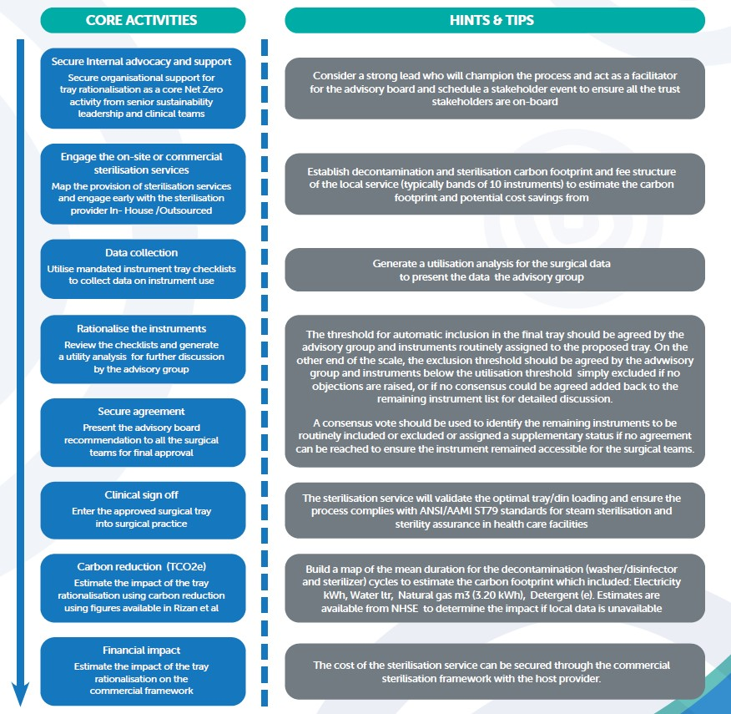

Slide 14
Trust Case Study - Leeds
Adam Peckham - Cooper

Slide 15
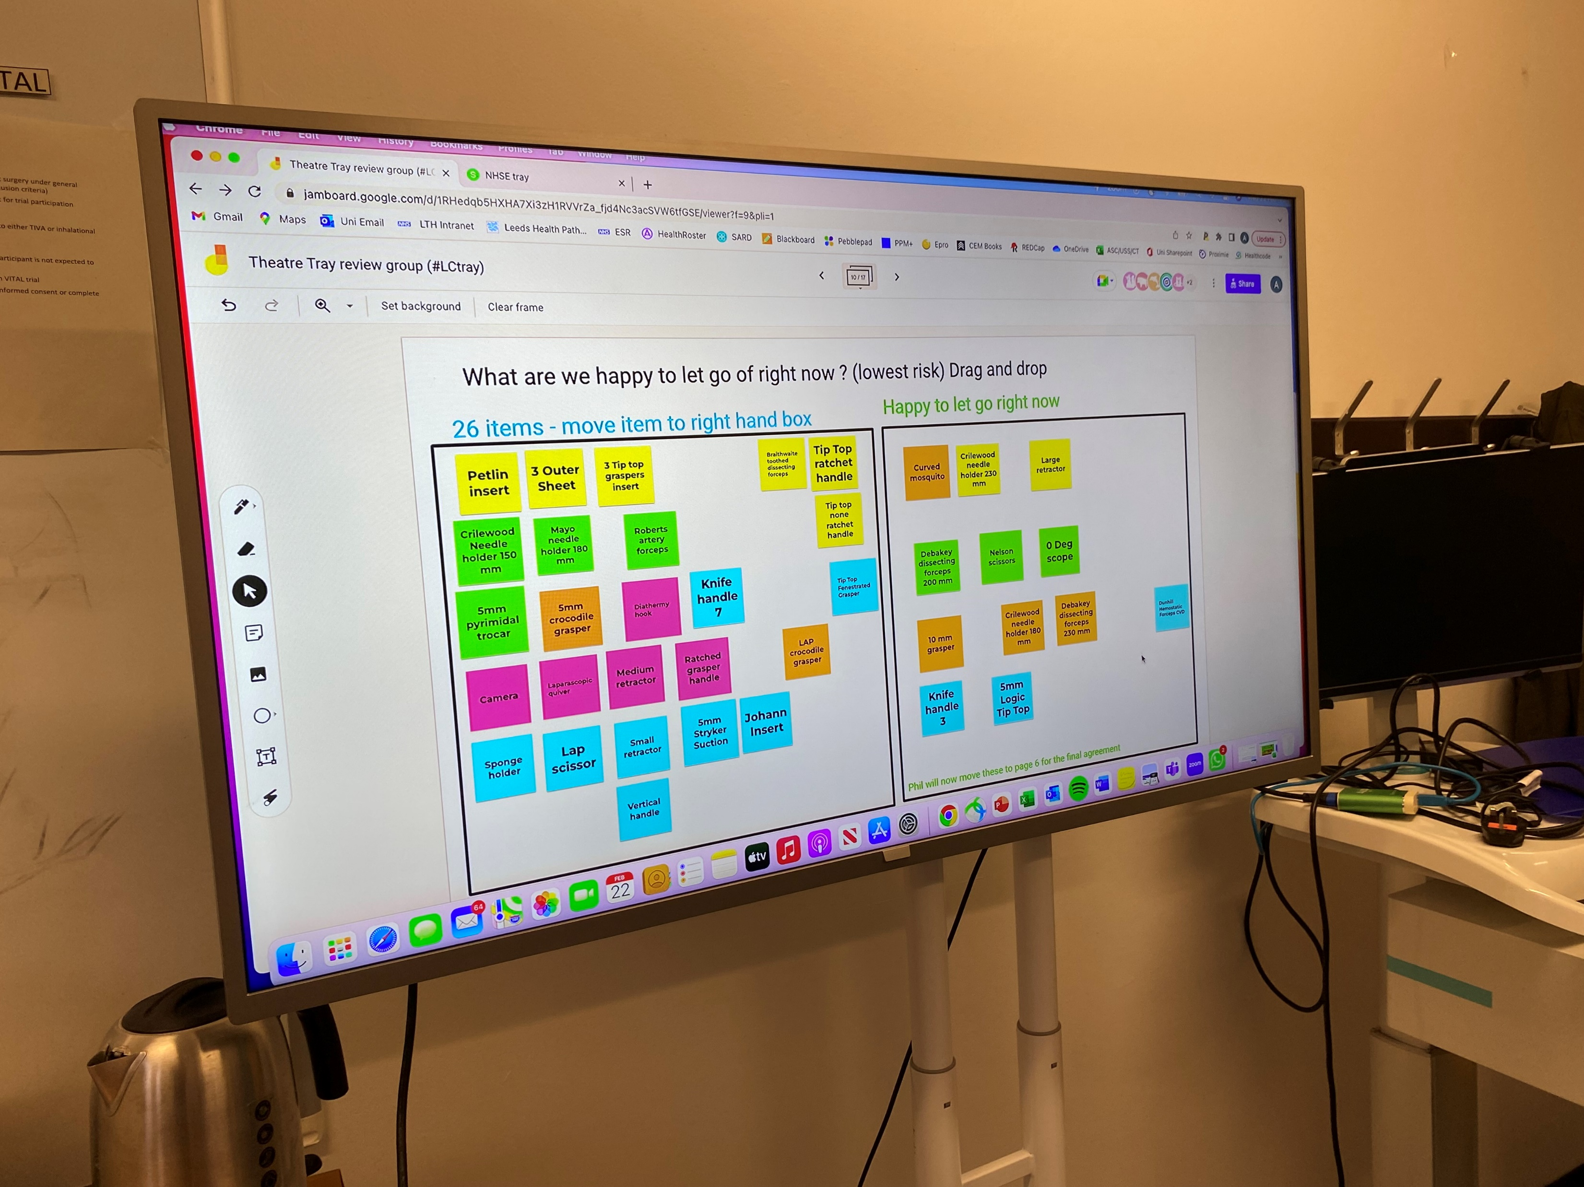
Trust case study: Leeds Teaching Hospitals (LTH)
‘We are routinely transporting and washing equipment that is never used’
Issue
LTH conduct ~800 laparoscopic cholecystectomies annually, across four specialty units, which had different surgical instrument setups, using over 100 instruments across multiple trays
Many instruments present in sets, went unused for the majority of procedures, undergoing unnecessary energy intensive sterilisation, adding to theatre set up times, and cost

Slide 16
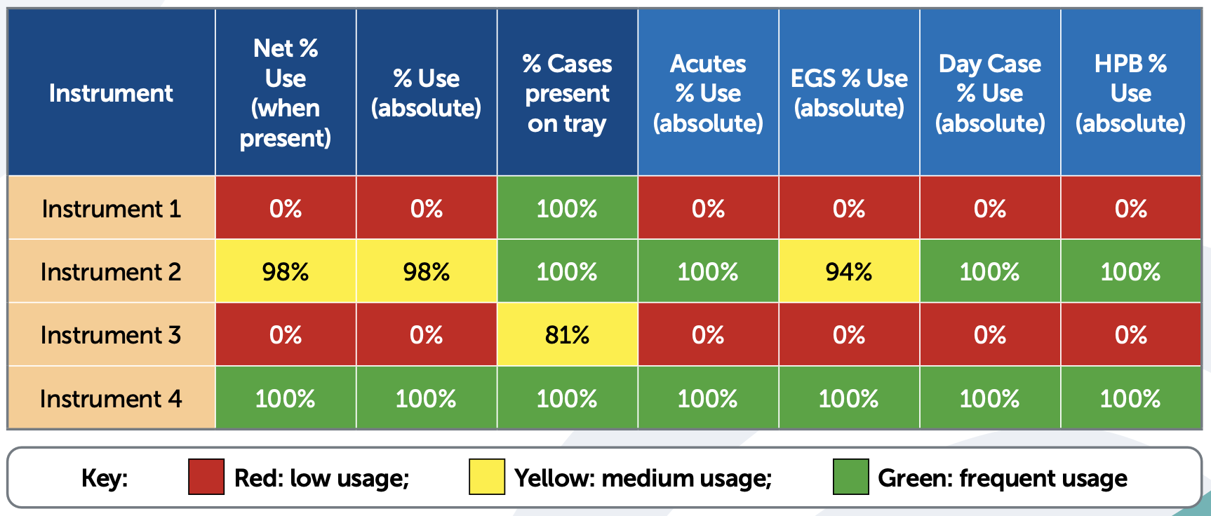
Trust case study: Leeds Teaching Hospitals (LTH)
Action
An instrument use-audit was conducted over 70 cases across four specialty units, with a usage heatmap produced to triage decision-making in a 'Hackathon' by surgical team representatives
Variation in instrument preference was accommodated where inclusion in the set did not materially affect the number or size of trays sent for decontamination

Slide 17
Trust case study: Leeds Teaching Hospitals (LTH)
Research assessing set utilisation across 4 surgical specialties found > 75% instruments remained unused per procedure
Impact
The carbon footprint of their laparoscopic cholecystectomy set sterilisation was reduced by 60%
The change is projected to save between 2-3 tCO2e annually and c. £20k in sterilisation costs
A survey of the teams agreed rationalisation would make surgical preparation easier and quicker (96% respondents agreed)
Rationalisation provided space on the tray to switch to more reusable items e.g. from single-use to reusable kidney dishes and galipots

Slide 18
Trust case study: Leeds Teaching Hospitals (LTH)
LOCATION | TRAY | NUMBER OF ITEMS
DAVID BEAVERS DAY UNIT | LAP RENU SET | 67
 | ELEMENTAL LAP CHOLE& HERNIA SET | 15
 | NEW DBDU FIBREOPTIC LIGHT CABLE | 1
 | PURPLE HEM-O-LOCK | 3
TOTAL | 4 TRAYS | 86
HPB | MR TOOGOODS LAPARASCOPIC INSTRUMENTS | 23
 | HPB MINOR TRAY | 47
 | HPB LAP CHOLE PORTS & SCISSOR HANDLE & CLIP | 13
 | STRYKER CAMERA HEAD & SCOPES | 4
 | PURPLE & GOLD HEM-O-LOCK | 6
TOTAL | 5 TRAYS | 93
ACUTES | ACUTES LAPARASCOPIC TRAY | 93
 | CAMERA HEAD TRAY | 1
 | SCOPES & LIGHT LEAD TRAY | 3
 | ELEMENTAL PORTS& CLIP | 13
TOTAL | 4 TRAYS | 97

Slide 19
Trust case study: Leeds Teaching Hospitals (LTH)
LOCATION | TRAY | NUMBER OF ITEMS
DAVID BEAVERS DAY UNIT | 4 TRAYS | 86
HPB | 5 TRAYS | 93
ACUTES | 4 TRAYS | 97
Rationalised to 67 Instruments across one double-layered container
Setup Type | Likely rationalised scenario (Cost reduction) | Integrate cameras/scopes (Cost reduction)
Acutes | 33% | 53%
Day | 39% | 39%
HPB | 30% | 42%
Average Cost | 34% | 46%

Slide 20
Trust case study: Leeds Teaching Hospitals (LTH)
Lessons learned
Audit data required the normalisation of instruments names across sets to ensure use-rates were truthfully reflected in outputs
The Hackathon benefitted from representatives from both surgical and theatre leads
Audit use-rate data provided confidence in an evidence-based approach, with the heatmap fast-tracking instrument inclusion/exclusion or identifying marginal cases for further discussion
Instrument usage can be categorised by function vs. surgeon preference to facilitate decision-making i.e., two frequently used items performing the same function could be reduced to one
Rationalisation benefits are gained by reducing the number or size of trays and not absolute number of instruments

Slide 21
Engagement Approach
Support clinical acceptance of surgical rationalisation through an evidence-based, multi-stage engagement approach with stakeholders as reviewed by the Innovation Agency (Academic Health Science Network for the North-West Coast).
.
Hold a key stakeholder kick-off meeting to agree the rationalisation aims and approach, identify potential benefits and how to measure them
Discuss proposed tray setup with sterile services providers to ensure optimum tray design for decontamination standards
5
2
3
4
1
Hold an instrument ‘Hackathon’, presenting evidence-based usage results to surgical and theatre leads to develop a proposed rationalised set
Present final proposed set to wider surgical and theatre stakeholder groups to gain sign off
Produce a heatmap from instrument use audits covering all settings for the target procedure

Slide 22
Example ‘Hackathon’ process flow
A ‘Hackathon’ brings together key representatives, to collectively discuss and agree a change (‘Hack’) through a group discussion.
Fast-track to inclusion
Do any instruments have unnecessary duplicate functions?
No
Include
Include
>70% use-rate
Yes
*
Function
Exclude †
Set triage thresholds based on % use rate from audit
10-70% use-rate
Deep-dive discussion
Are lower frequency items used in tandem?
No
Is frequency of use based on general surgical function or specific instrument preference?
Exclude minority use preferences †
Yes
Exclude, but consider curating a contingency tray
Preference
Include majority use preferences
<10% use-rate
*
Yes
Fast-track to exclusion
Does catering for low-frequency preference items
materially affect costs or reduction of number / size of trays?
No
Exclude †
Include all preferences
Conduct periodic tray reviews
* Conduct light-touch sense-check of triaged instruments, reintroducing excluded / included items that could benefit from further discussion based on clinical judgement
† Optionally make available as an individually wrapped supplementary item, where considered clinically important to be ‘on-hand’

Slide 23
Laura Boland. Head of Programmes, Health Innovation North West Coast SURGICAL INSTRUMENT SET RATIONALISATION: UNDERSTANDING THE BENEFITS AND REPLICATING THE PROCESS A HEALTH INNOVATION NWC (formally the INNOVATION AGENCY) REPORT FOR THE NHSE SUSTAINABLE PROCUREMENT TEAM

Slide 24
The Findings
The benefits of tray rationalisation are; cost savings, carbon reduction, time saved during preparing for surgery and the satisfaction of the clinical teams delivering a sustainable future.
The financial savings were calculated using local sterilisation procurement frameworks which provides a methodology to calculate the cost savings based on incremental cost increases per instrument band
“Rule of thumb 1: moving an instrument set down a tray banding by one yields approximately 15% reduction in costs and more optimally grouping instruments into fewer sets may yield even higher savings”
“Rule of thumb 2: reducing a surgical set by a standard sized tray yields approximately 1.5kg of CO2e per set decontamination”

Slide 25
Feedback
Everyone surveyed (26/26) agreed that “yes, tray rationalisation does make surgery
preparation easier”.
25/26 Agreed that “surgical tray preparation time was quicker with tray rationalisation”
Everyone surveyed agreed that “Tray rationalisation is beneficial”
The reasons given:
• “Fewer trays to open”
• “Improves efficiency”
• “Reduces waste”
• “Quicker to set-up”
• “Easier to count”
• “Greener”

Slide 26
Recommendations
The NHS England sustainable procurement team and Health Innovation NWC recommend these key activities:
1. Identify a routine target procedure.
2. Audit the instrument use per procedure to determine an overall utilisation rate.
3. Host a broad engagement event with all the stakeholders.
4. Facilitate a hack across the surgical teams to determine the optimal number of instruments.
5. Agree and implement the rationalised trays
Good Luck!

Slide 27
Q&A

Slide 28
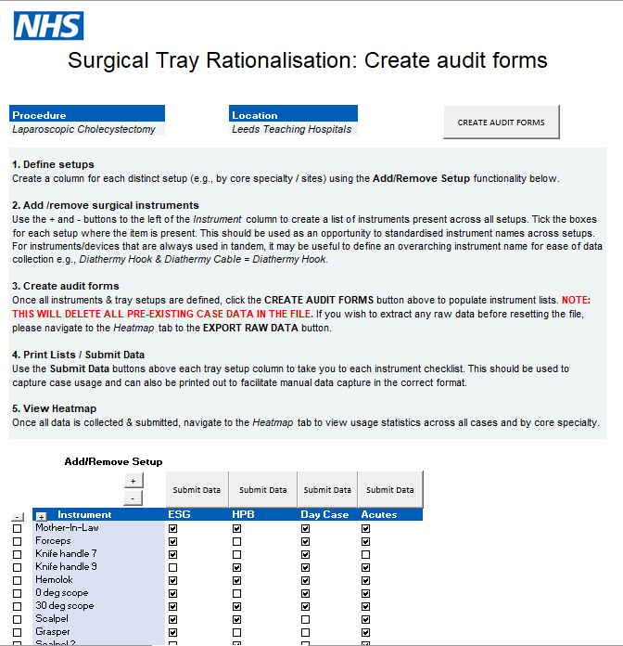
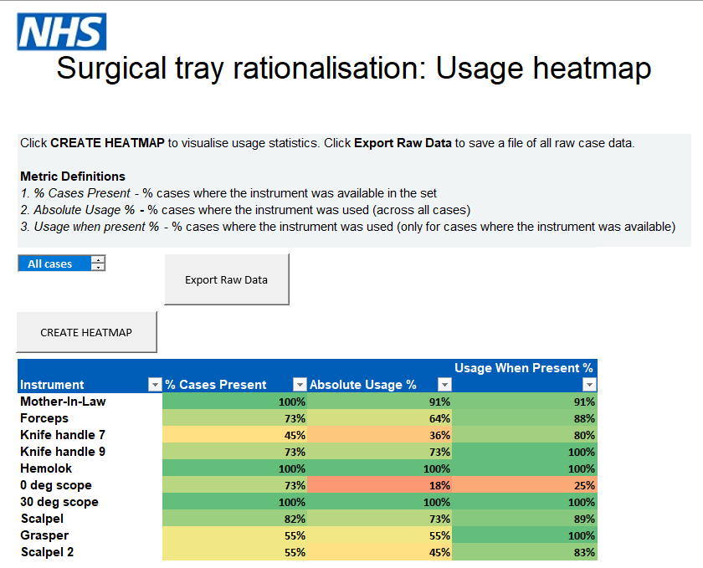
Supporting resource: Rationalisation audit tool (alpha)

Slide 29
Resources
NHSE support tools
Surgical instrument set rationalisation - How to Guide
Rationalisation Audit Tool (heatmap)
Downloadable by NHS staff from the Central Commercial Function CCF Hub (please contact england.ccf@nhs.net for access to Futures)
Health Innovation NWC report
SURGICAL INSTRUMENT SET RATIONALISATION: UNDERSTANDING THE BENEFITS AND REPLICATING THE PROCESS

Slide 32
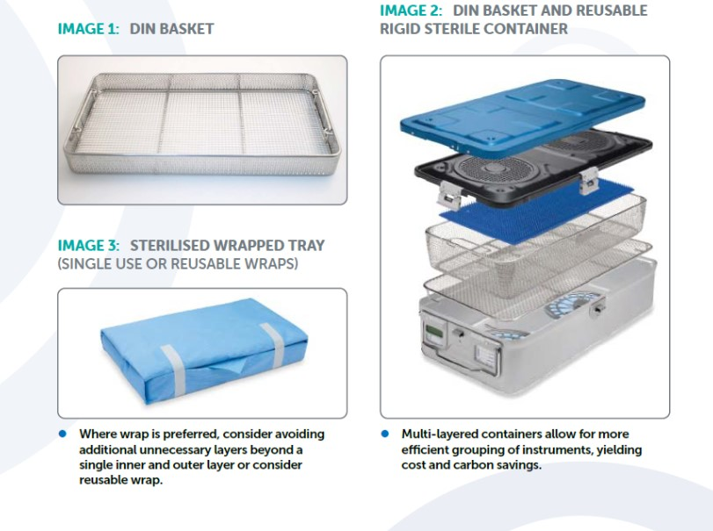
Container Considerations

