Slide 1


SusQI Academy Forum
13th July 2023

Slide 2

Introductions
Successes and Challenges
Established Beacon site criteria resource
SusQI Academy Network

Slide 3
Recent Challenges and Successes
Opportunity to share with the group and receive input and suggestions

Slide 4
Achieving Beacon site status
Teaching SusQI - Members
Password: Academy2022

Slide 5
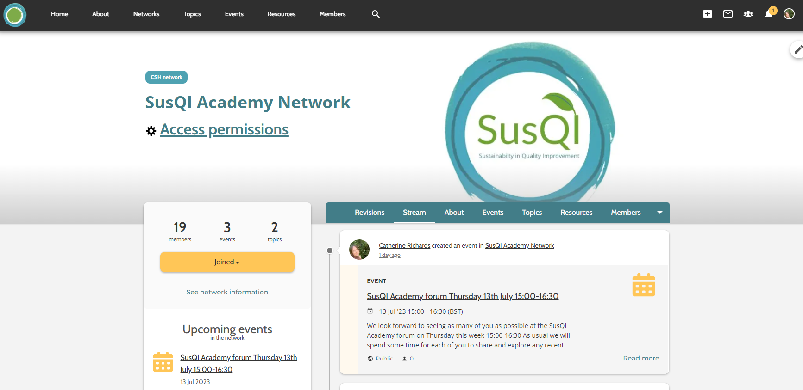

Slide 6
Purpose of the network
Support the growth of a community of best practice in embedding sustainability into QI
How we’ll achieve
CSH – share updated resources, case studies, events, engage in discussions
Academy Members - ask questions, share best practice, ideas, resources, share challenges, engage in discussions

