Slide 1
Speak to us about
Sustainable Kidney Care
and Climate Emergency at the
Tue 6th 13:15 – 14:15
@ UKKA stand, exhibition hall
Climate Clinic

Slide 2
We are members of the UKKA Sustainable Kidney Care Committee
Our three workstreams
For more
information go to https://ukkidney.org/sustainable-kidney-care-committee
or scan the QR code
Sustainable Kidney Care Committee | The UK Kidney Association
1. Action learning and education
‘12 Steps to Green a Kidney Unit’ guide to high impact sustainability actions
Named staff Sustainability Champions in 90% of units
2. Procurement, infrastructure and innovation
Joint statement of demand of industry for kidney products and services, covering sustainability, financial value, social value and resilience
Industry liaison group
3. Sustainable care pathways
RSTP toolkit sustainability package
Metrics for sustainability measures
Deliverables

Slide 3
How can we help you? Feel free to ask us about…
12 steps to green a kidney unit
Introducing you to like minded others in the CSH Kidney Care Sustainability Network
Helping get your unit signed up to having a named staff Sustainability Champion
Case studies of what has worked elsewhere
Things we can do as individuals

Slide 4
How you can help us!
Are you a member of staff?
Ask to be your unit’s named staff Sustainability Champion – sign up by clicking here https://rb.gy/atont or scan the QR code
Are you a patient?
Ask your Unit if you can be a Kidney Community Green Ambassador - click here to see an example of role description https://rb.gy/yxf0e or scan the QR code
All are welcome to sign up the free CSH Kidney Care Sustainability Network for access to the latest news, advice, case studies and to link with like minded others. We really want to hear about your ideas and case studies too! Click https://rb.gy/hknen or scan the QR code

Slide 5
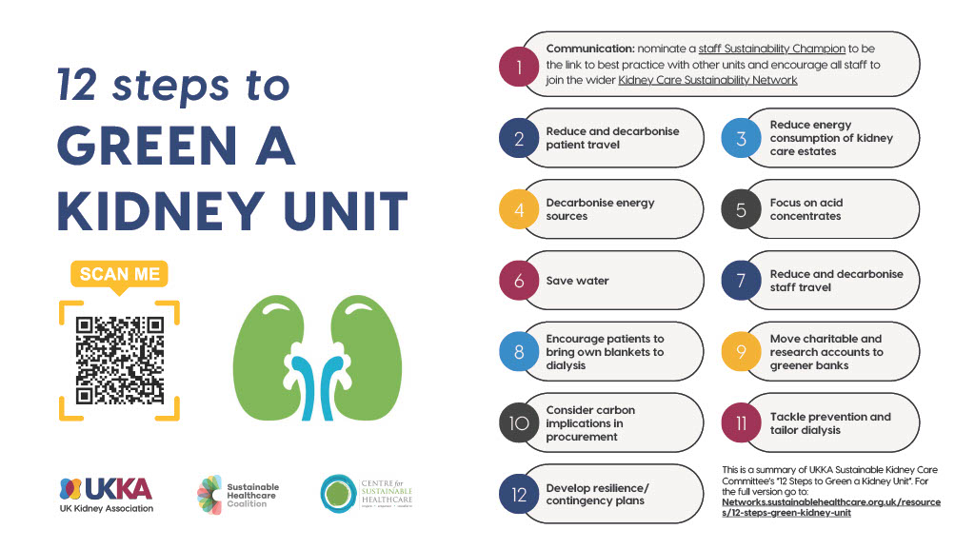

Slide 6
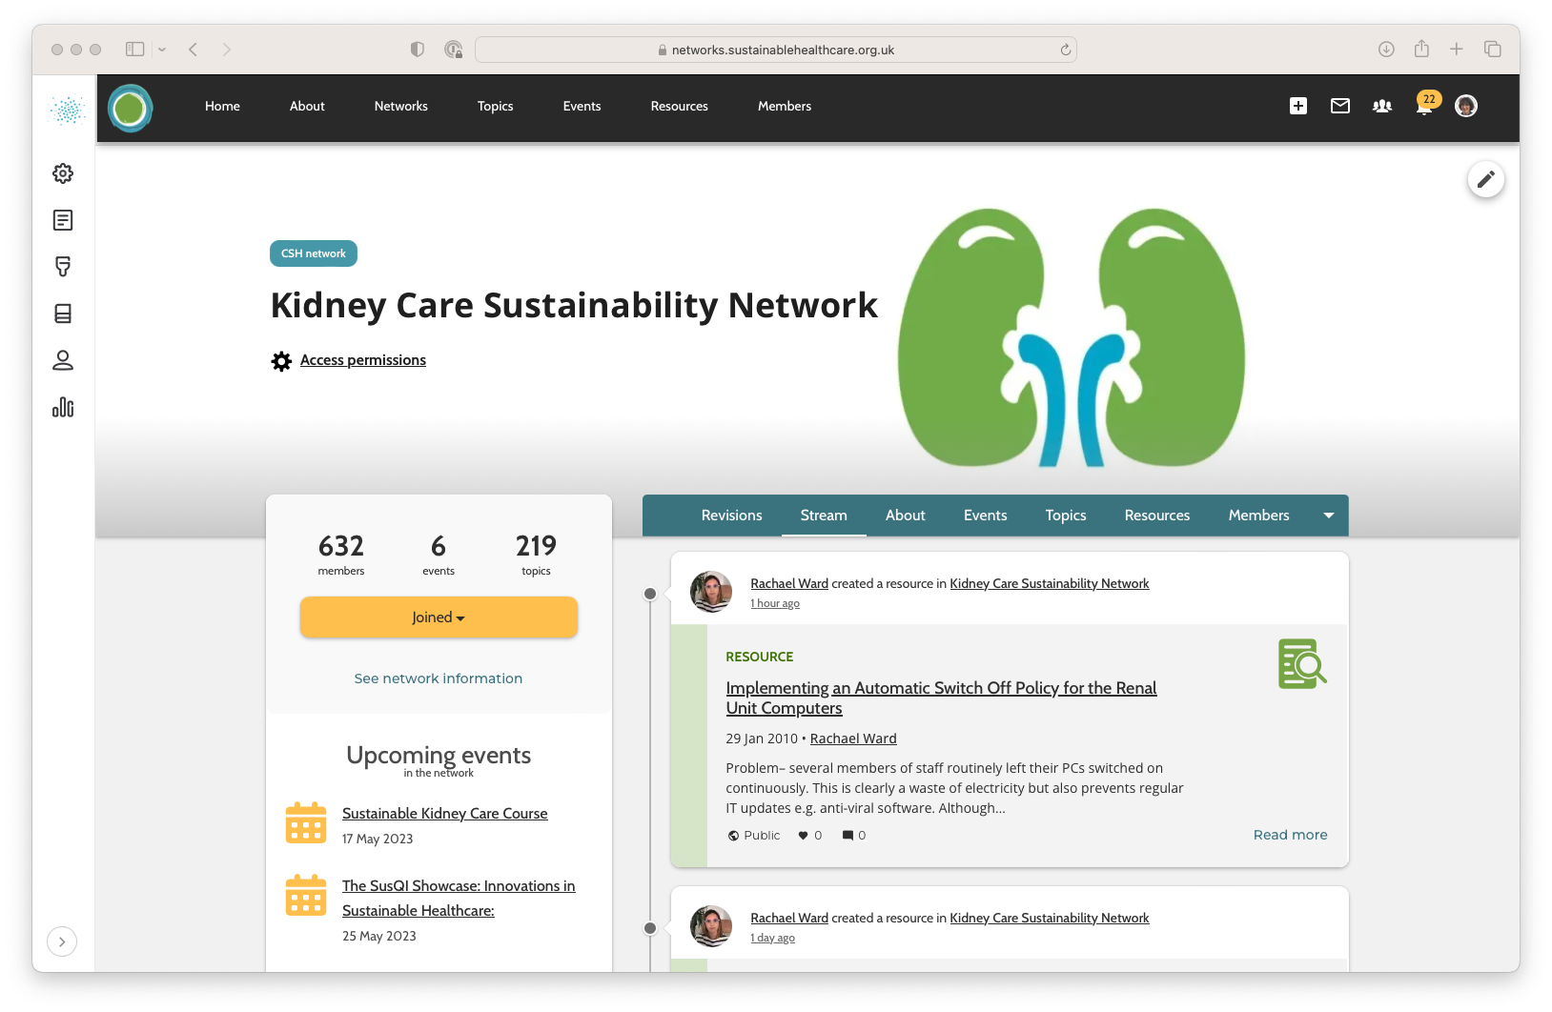
Kidney Care Sustainability Network & Case Library
Click https://rb.gy/hknen or scan the QR code

